Slide 1
It’s right that we repair… but is there a ‘Right to Repair’
Dr Poorna Mysoor
Fellow and Director of Studies in Law
Lucy Cavendish College
University of Cambridge
18 November 2021

Slide 2
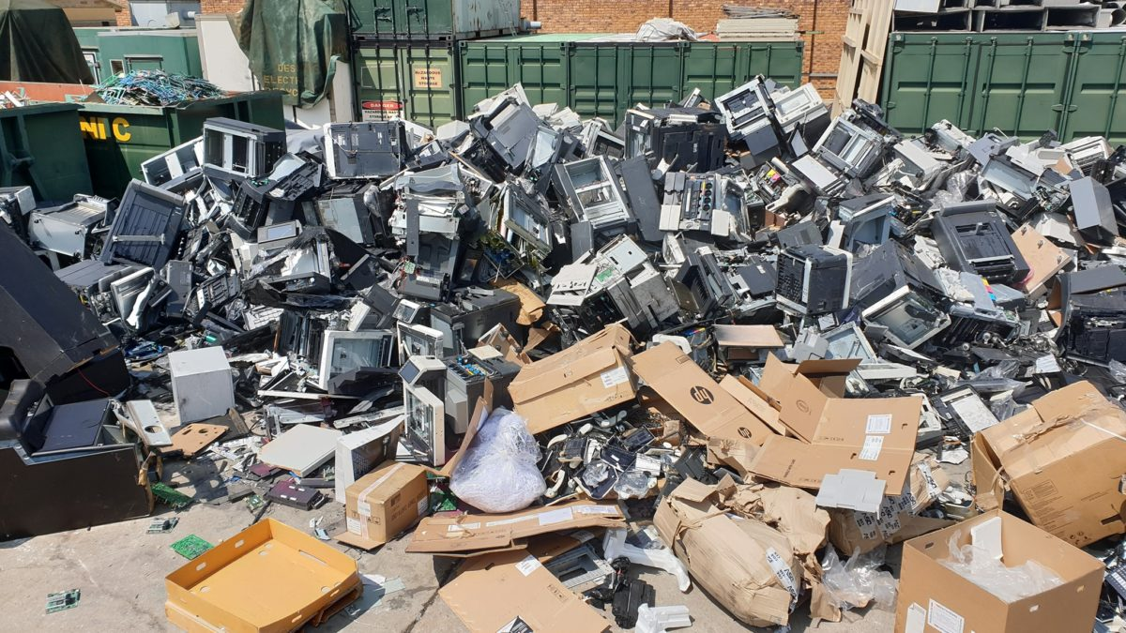
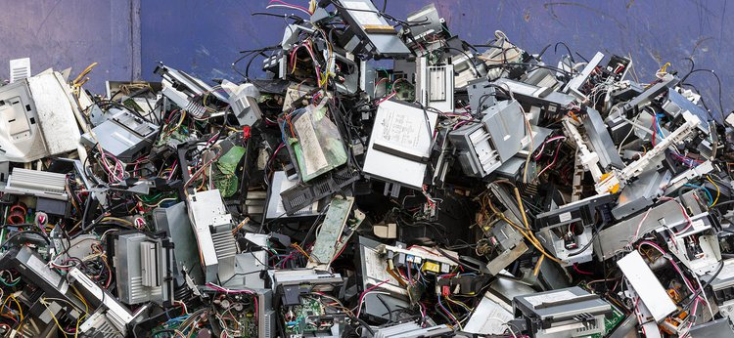
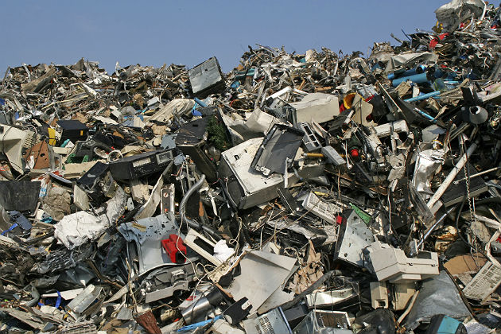
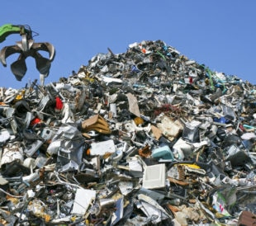
It’s the right thing to do to repair
Obvious benefit of saving consumers money
Huge benefit to the environment in reducing carbon footprint

Slide 3
Do we have a ‘right’ to repair in the UK?
A Right to repair that is enforceable
Places a corresponding obligation on the manufacturer to repair
The Ecodesign for Energy-Related Products
and Energy Information Regulations 2021
Ecodesign requiring energy efficiency
Resource efficiency requirements in Schedules 3, 6, 9, 13, and 19
Obligation on manufacturer to ensure availability of spare parts
Designed in such a way that common tools can be used to repair
Publish list of spare parts and repair instructions
Applies only to household dishwashers, washing machines, refrigerators and televisions
Does not apply to many other consumer goods like mobile phones, personal computers, motor vehicles
Contractual
Warranty
Repairing
Defective
Product
Supply of
Spare Parts and
Repair Information
Manufacturer’s
choice
General contract law
and Consumer
Rights Act, 2015
Manufacturer’s
liberty
Manufacturer’s
obligation

Slide 4
Does this go far enough?
Addresses built-in obsolescence to some degree
However, does not address supply or pricing of spare parts
Will manufacturers licence IP in spare parts to third parties to improve supply or pricing?
Contractual
Warranty
Repairing
Defective
Product
Supply of
Spare Parts and
Repair Information
License
Spare Part
Manufacturers
and Repair
Providers
Purchasers to be
able to freely access
Spare Parts and
Repair Services
Manufacturer’s
liberty
Manufacturer’s
obligation
Purchaser’s
liberty
Is opening up the market for spare parts and repair services a greener solution?
What does it mean for copyright, designs, and patents in spare parts?
Common law in the absence of statute

Slide 5
Implied Licence Route
Can a court imply a term into the contract of sale, a term to licence the relevant IP to enable repair?
IP Owner
Product
Purchaser
Product
Repairer
Contract of sale
Contract of repair
Implying a licence
enabling the exercise of relevant IP rights
for limited purpose of effecting repair
Sub-licence the
implied licence
What justifies a court implying an IP licence
if it does not give effect to
the unexpressed joint intention of the parties?

Slide 6
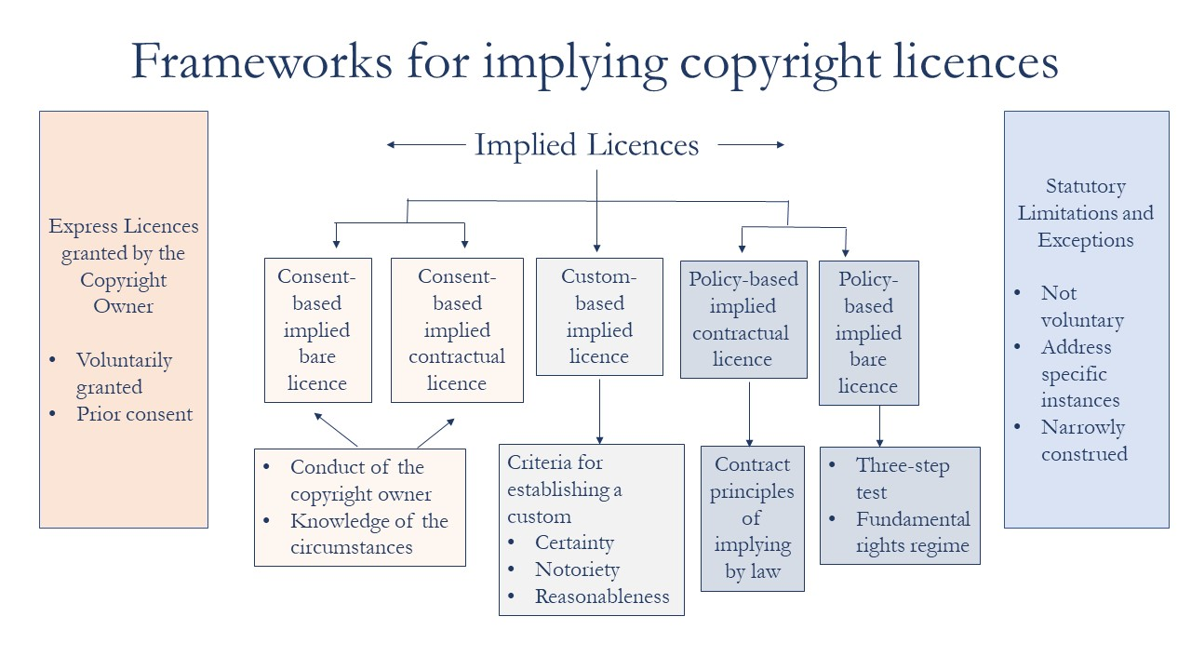
When can a court imply an IP licence?
Different bases for implying copyright licences

Slide 7
Implied Licence Route
Patent
Betts v Willmott (1871) LR 6 Ch App 239
Issue: resale infringes the patentee’s exclusive right to use
Held that implied into the contract of sale is a licence to use the patented product, and use includes resale
Sirdar Rubber v Wallington (1907) 24 RPC 539
Use includes repair because if one cannot repair, one cannot prolong the use of the product
United Wire v Screen Repair [2001] FSR 24
Repair lies at the boundary of making a patented product, but doesn’t impinge on it
If repair amounts to ‘making’ the patented product, then it infringes patentee’s exclusive right to make the product
No implied licence to repair the product that amounts to making the product
Effect: only minor repairs allowed
Schutz (UK) v Werit [2011] EWCA Civ 303
Refined when repair amounts to making
But a meaningful repair might mean that it impinges on ‘making’

Slide 8
Implied Licence Route
Copyright
Solar Thompson v Barton [1977] RPC 537
Copyright in design drawing of certain industrial machinery
Repair provider used these drawings to manufacture replacement parts
Buckley, LJ held:
If I am right in the view I have expressed about the existence here of an implied licence under the patent to repair pulleys by replacing worn rubber rings, it must, I think, follow that purchasers of Polyrim pulleys are also impliedly licensed to infringe the plaintiffs’ copyright in their drawings to the extent necessary to enable such repairs to be carried out. To hold otherwise would be to allow the copyright to stultify the implied licence under the patent. … [A]ny purchaser of a patented article might find himself deprived of his ostensible right to repair that article by the existence of a copyright of which he would probably be ignorant when he made the purchase.
Relied on in Gardner & Sons v Paul Sykes [1981] FSR 281 and Weir Pumps v CML Pumps [1984] FSR 33
Introduction of unregistered design regime under s 51, CDPA 1988
Must fit and must match exceptions under s 213(3)(b)(i) and (ii), CDPA 1988

Slide 9
Problems with Implied Licence
Use express terms to prevent courts implying terms
Product
Product
IP Owner
Purchaser
Repairer
Contract of sale
Contract of repair
Sub-licence the
implied licence
Imply a licence
enabling the exercise of one of the exclusive rights
for limited purpose of effecting repair
What if the repairer wants to maintain a stock of spare parts by manufacturing them before entering into a contract of repair
Timing issue
Repairer only gets a sub-licence of relevant IP
when purchaser enters into a repair contract

Slide 10
Does this go far enough?
Limited to made-to-order repairs
Repairer having to wait until repair order is placed
May be useful in high-end products
Instead of giving purchaser a liberty to repair, can we place a disability on manufacturer preventing them from challenging repairer’s IP use?
Contractual
Warranty
Repairing
Defective
Product
Supply of
Spare Parts and
Repair
Information
License
Spare Part
Manufacturers
and Repairs
Purchasers
to be able to
freely access
Spare Parts and
Repair Services
Manufacturers
restricted or
prevented
from challenging
IP use by repairers
Manufacturer’s
liberty
Manufacturer’s
obligation
Purchaser’s
liberty
Manufacturer’s
disability
What common law rules can help us place this disability on manufacturer?
Non-derogation from grant?
Public interest defence?

Slide 11
Non-derogation from Grant
British Leyland v Armstrong [1986] 1 All ER 850
Contract of sale which grants the consumer
property rights in the product
IP Owner
Purchaser
Having granted the property right the IP owner
cannot derogate from it by depriving the purchaser of
the substantial enjoyment of the product
Right to repair is inherent in the ownership of the product, which IP owner cannot take away
In Lord Templeman’s view this placed a disability on
IP owner from preventing repair providers using
their IP for repair purposes

Slide 12
Non-derogation from Grant
Subsequent decisions not convinced of Lord Templeman’s approach
Canon Kabushiki Kaisha v Green Cartridges [1997] AC 728
Case of printing cartridges being produced by non-licensees
Claimed that replacing print cartridges is repair since it prolongs use of printer
Held British Leyland does not apply
Lord Hoffmann wasn’t impressed with Lord Templeman
Not a case of genuine repair – replacing cartridges of a printer is not repair
Mars UK v Tecknowledge [1999] EWHC 226 (Pat)
Coin operated machines; reverse engineered software to accept newer coins
Held: list of exceptions exhaustive; no new exception for repair
But exhaustive list of exceptions no longer binds the UK post-Brexit
See also, Infosoc Directive, Article 5(3)(l) says repair exception possible
Not many cases have used British Leyland, although a HL authority

Slide 13
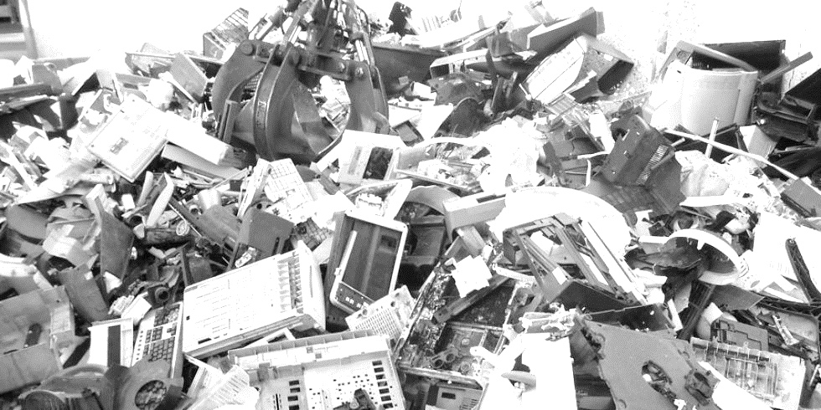
Public Interest – s 171(3), CDPA
Section 171(3), CDPA says:
Nothing in this Part affects any rule of law preventing or restricting the enforcement of copyright, on grounds of public interest or otherwise.
Limited application of this rule in case law
Compatible with International Treaties?
Limited successful use in case law
Denying remedy rather than denying the right
Isn’t managing climate change enough of a public interest?
Counter arguments of safety / security addressed by other areas of law?

Slide 14
Thank you!!

