Slide 1

Substantial Value as the Key to Functionality
Dr Ilanah Fhima
University College London, UK
Cambridge Seminar Series
29 October 2020

Slide 2
Overview
We should have a single functionality action based on substantial value
Substantial value reflects what it is that competitors need to compete
No other satisfactory scholarly explanation for the inclusion of the substantial value provision
We see this from the CJEU’s expansion of the definition of value in recent cases
It is also supported by the marketing and product design literature
Suggestions fo how can we adapt the way substantial value is interpreted to reflect these competitive interests

Slide 3
The functionality exclusion
Art.4(1)
The following shall not be registered or, if registered, shall be liable to be declared invalid:
(e) signs which consist exclusively of:
the shape, or another characteristic, which results from the nature of the goods themselves;
the shape, or another characteristic, of goods which is necessary to obtain a technical result;
the shape, or another characteristic, which gives substantial value to the goods.

Slide 4
Why a substantial value exclusion?

Slide 5
Cumulation?
Avoiding overlaps with patents stated rationale of technical functionality
BUT overlaps with copyright/designs and TMs inherent in the system
Less of a problem for copyright because of duration
Need to identify scope/validity for designs and copyright – Kur

Slide 6
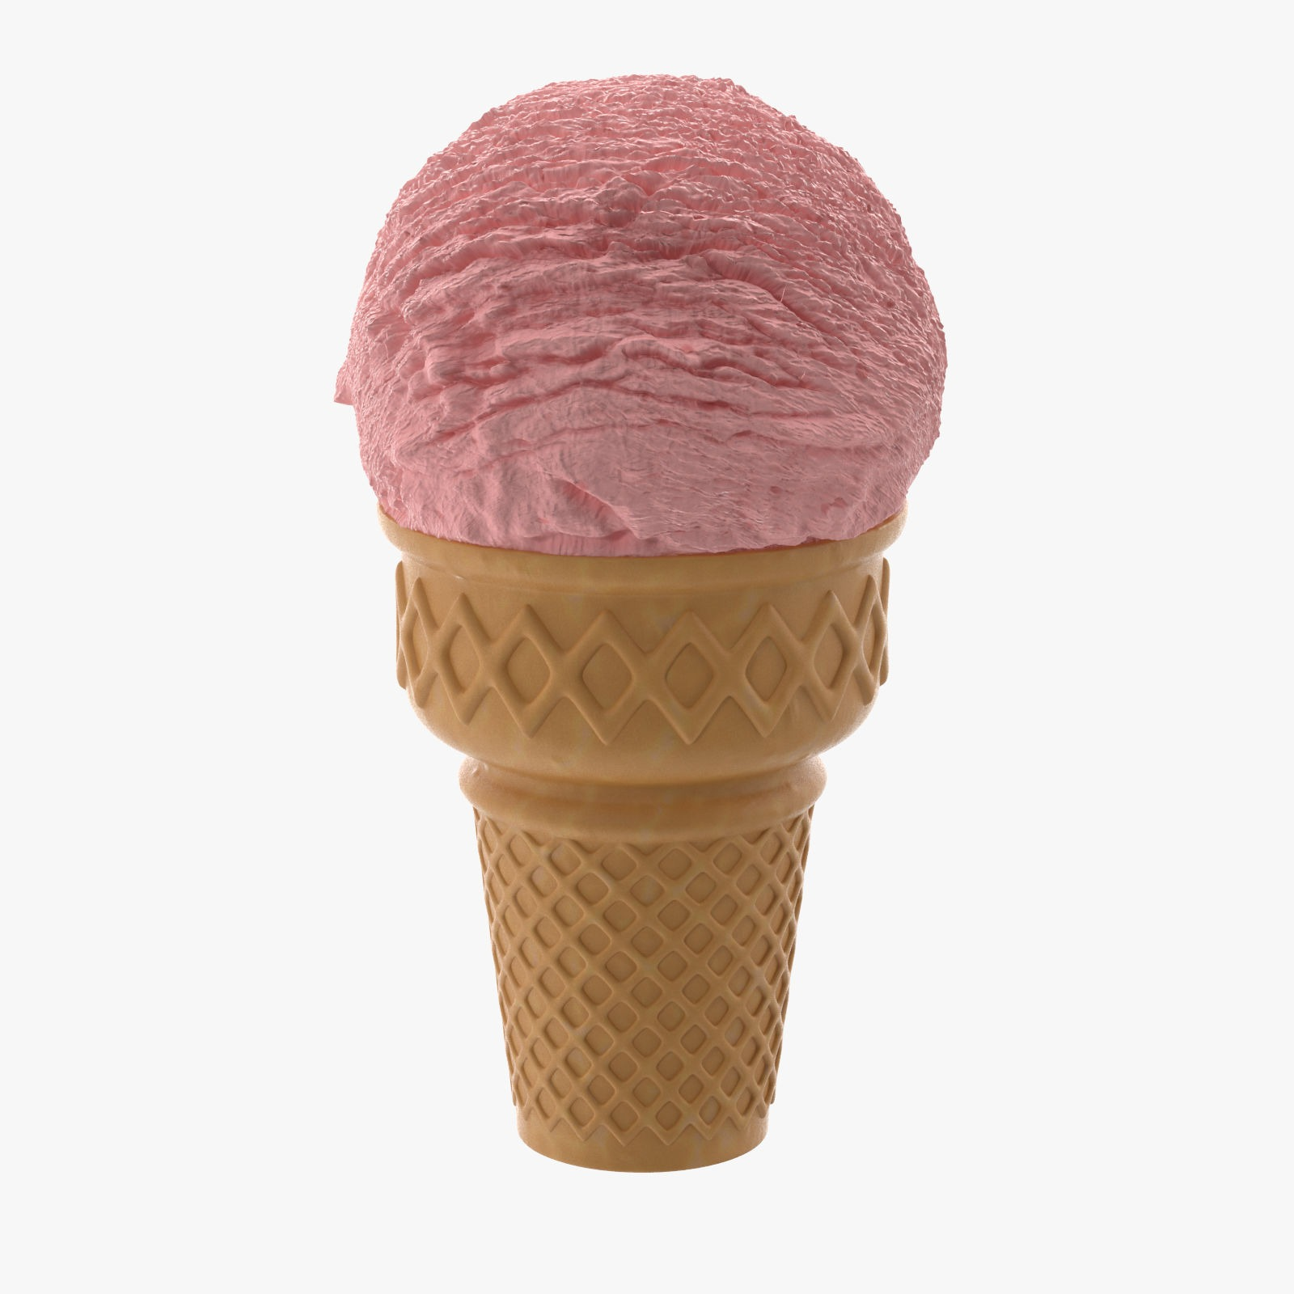
Aesthetics
Beauty?
Can we identify beauty?
Why limit to beauty
Aesthetic but not beautiful e.g. TRIPP TRAPP
Other forms of value, e.g. TRIPP TRAPP, Hughes’ strawberry ice cream

Slide 7
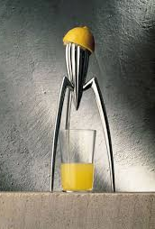
A proxy for distinctiveness?
German approach: aesthetic shapes unlikely to be viewed as TMs
Max Planck Report: could delete ‘substantial value’ and rely on distinctinveness
BUT sometimes they will be seen as TMs – perception changes
Distinctiveness allows for distinctiveness to be acquired – implications for public domain

Slide 8
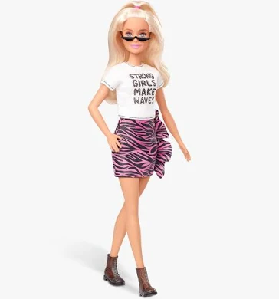
Protecting the public domain?
Quaedvlieg
Substantial value as ensuring what copyright and designs leave in the public domain stay there
Basic styles and ideas
Interesting but narrow

Slide 9
Value as protecting competition
Suthersanen and Mimler: CJEU is developing an ‘autonomous’ approach to functionality across all the intellectual property rights, based on ‘ensur[ing] that protection does not unduly restrict market freedom and competition’
Kur (after B&O): substantial value test should focus directly on competition concerns
Dinwoodie (US): competition as rationale behind both aesthetic and utilitarian functionality – should have a unitary action

Slide 10
The CJEU’s move towards a competition-based view of value

Slide 11
Two steps
Broadening the meaning of ‘value’ to take in non-aesthetic features, the registration of which might interfere with competition
Explicitly recognising competition as the rationale for the substantial value exclusion

Slide 12
Defining value: B&O
‘the fact that the shape is considered to give substantial value to the goods does not preclude other characteristics of the goods, such as the technical qualities here, from also conferring considerable value on the goods at issue.’

Slide 13
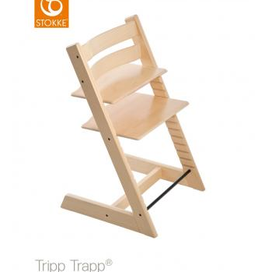
Defining value: Hauck
‘The fact that the shape of a product is regarded as giving substantial value to that product does not mean that other characteristics may not also give the product significant value’
‘The possibility of applying the third indent of Article 3(1)(e) of the trade marks directive [should] not be automatically ruled out when, in addition to its aesthetic function, the product concerned also performs other essential functions’
Unclear if this meant presence of other functions didn’t prevent third indent applying OR presence of non-aesthetic value could be considered substantial value

Slide 14
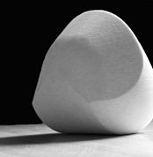
Defining value: Gomboc
‘Tangible form of mathematical discovery’ could add the right sort of value
‘It should be borne in mind …that the concept of a ‘shape which gives substantial value to the goods’ is not limited to the shape of goods having an exclusively artistic or ornamental value. The question as to whether the shape gives substantial value to the goods may be examined on the basis of other relevant factors, including, inter alia, whether the shape is dissimilar from other shapes in common use on the market concerned .’

Slide 15
Digging deeper: a competition-based rationale
Philips v Remington, AG identified policy behind second and third indents as ‘to prevent the exclusive and permanent right which a trade mark confers from serving to extend the life of other rights which the legislature has sought to make subject to limited periods’.
B&O: both about need to avoid monopolies
Hauck: aim of substantial value exclusion as preventing trade mark rights from extending other rights; objective is preventing a monopoly from developing in the essential characteristic of goods.

Slide 16
Digging deeper: a competition-based rationale
Louboutin AG:
  2nd indent: to prevent trade mark protection from granting its proprietor a monopoly on technical solutions or functional characteristics of a product which a user is likely to seek in the products of competitors. The provision enables those essential characteristics of the goods in question which are reflected in its shape to be kept in the public domain.’
  3rd indent: to ‘prevent the monopolisation of external features of goods which are essential to their market success, and thus to prevent the protection conferred by the mark being used to gain an unfair advantage; that is, an advantage which does not result from competition based on price and quality.’

Slide 17
The result?
Overlap between 2nd and 3rd indent both in what they exclude and in justification
  why have two separate provisions?
Does it matter if there are overlapping provisions?
  ‘A candid acknowledgment of the real calculus being performed in functionality analysis might bring some transparency to trademark litigation, and reduce purported reliance on increasingly obtuse doctrinal distinctions and tests that consume the attention of litigants and courts to no great effect on the outcome of a case. The text of the various formalistic tests of functionality does not permit of deductively reasoned conclusions reached without regard to broader concerns’ – Dinwoodie
  Duplicative litigation
  Reflecting the real world

Slide 18
What would a single functionality exclusion look like?

Slide 19
Why look outside the law?
If we want to know what competitors need access to, we need to know what consumers really value
This is not a legal question!

Slide 20

Emotional design: Norman
Three levels of processing:
  Visceral: automatic evolved response to seeking human needs and avoiding danger (pleasant sensory experiences, smiles, smooth surfaces etc)
  Behavioural: automatic how product works
  Reflective consciousness: higher level feelings, emotions and cognition, interpretation, understanding – moulded by culture and experience

Slide 21

Emotional design: Jordan
Holistic view of the user
Four pleasures:
  Physio-pleasure – sensory
  Socio-pleasure – relationship with others
  Pyscho-pleasure - cognitive and emotional reactions
  Ideo-pleasure - from the aesthetics and values that a product embodies

Slide 22
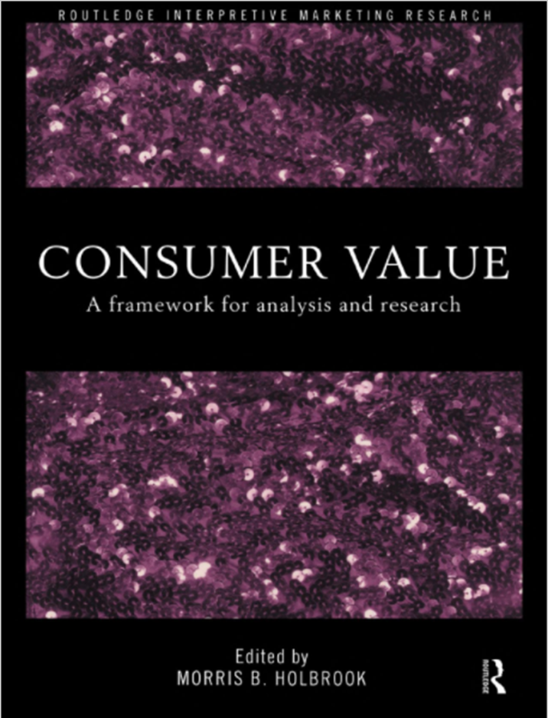
Marketing: Holbrook
Typology of consumer values:
  Efficiency/quality
  Politics/esteem
  Play
  Esthetics
  Morality/spirituality

Slide 23
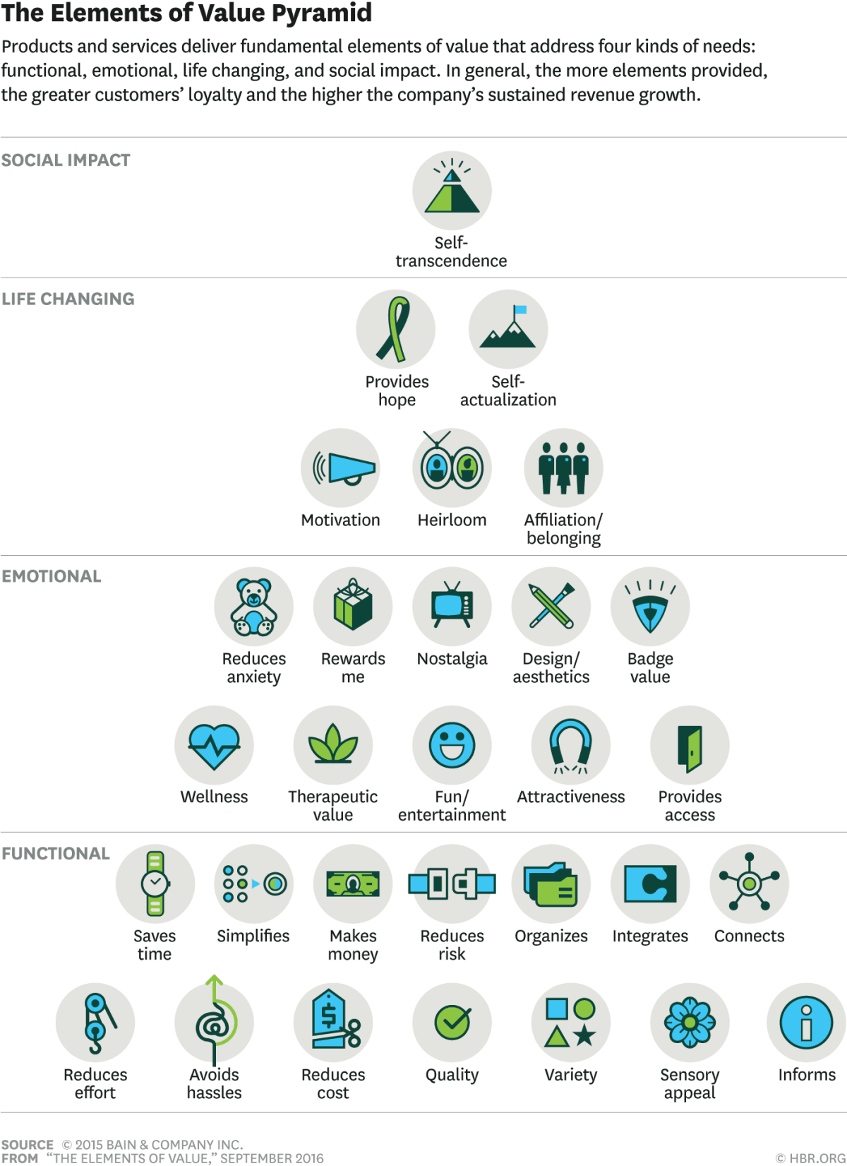
Marketing: Almquist et al

Slide 24
Marketing: Sheth et al
Why people buy what they buy:
functional value – perceived utility from physical performance
social value – perceived utility from association with a particular social group
emotional value – perceived utility from product’s ability to arouse feelings of affective states
epistemic value - perceived utility from product’s capacity to arouse curiosity, provide novelty, and/or satisfy a desire for knowledge.
conditional value – perceived utility of the product derived from the specific situation or set of circumstances facing the choice maker, e.g. a wedding dress will be valuable to a person getting married, but not to others.

Slide 25
What can lawyers learn from design and marketing?
The holistic consumer and the holistic product
It’s a given that a single product will embody multiple values
Functional on the same plane as sensory, cultural etc
Value goes beyond the visual
Value as coming from social and cultural aspects (compare Gomboc, Easter Bunny)

Slide 26
Taking stock…
Cases suggest a single, competition-based justification for all functionality provisions
Competitors need to access what consumers value
Wider literature suggests consumers value a range of things, not just the ‘aesthetic’ or the technical
Also suggests that often there will be multiple values embodied in a single product, but consumers will view the product holistically
→ Points to a single action based on value with competition as the underlying driving force
How can this be achieved?

Slide 27
Options for integrating a single competition based-view of value

Slide 28
The challenges
If a wide definition of ‘value’ is adopted, could rule out all trade dress
How can we work out what value competitors need access to in order to compete?

Slide 29
Solution 1: value as sufficient
Wide definition of value could rule out registration of all trade dress
Not an option - TRIPs

Slide 30
Solution 2: consider alternatives
Less competitive need if it’s possible to identify equally good alternatives for the characteristic where the value inheres
BUT would need a market-based analysis each time
Both US and EU have rejected consideration of alternatives for technical functionality, though has been used as a factor in US aesthetic functionality cases
Is it desirable? – step back from technical functionality’s precautionary principle

Slide 31
Solution 3: emphasise essential characteristics
Purpose behind this is to recognise that competitors can design around product shapes which combine functionality and non-functional features
Unclear this would work
In technical functionality cases – mix of functional and non-functional characteristics – leave out the non-technical to design around
BUT the wider the notion of value, the more likely all elements of a sign are going to be essential characteristics that add value (true even without a single action)

Slide 32
Solution 4: substantial should really mean substantial
Filter value that interferes with competition from that which doesn’t
Potential but needs further work
  More than merely being pleasing or attractive – but how much more?
  Test still rooted in the aesthetic – artistic value mentioned but other forms aren’t
  Circumstantial evidence, e.g. higher selling price – need to be sure isn’t from reputation
  Insufficient attention to consumer perception – inconsistent with design/marketing literature

Slide 33
To conclude
A single action centred around excluding shapes with substantial value is possible and desirable
It’s scope should be informed by needs of competitors
It is in line with the way in which TM law has developed AND the marketing and design literature
BUT need further work on what competitors need – determining when value is substantial may be a way to establish this

Slide 34
Dr Ilanah Fhima
i.fhima@ucl.ac.uk

