Slide 1
Data Protection Reform:
The changing UK landscape
Gavin Freeguard

Slide 2
A campaign for communities to have a powerful say on data and AI
to help create an equitable and sustainable world.

Slide 3
Making data and tech a collective and democratic issue
Not individualised and technocratic
Notes:
Not just left to the market or experts. Collective impact - data not really valuable on its own - relative to others, my data impacts on other people and there data impacts on me, collective voice, democratic process - decide who this all changes - - Examples bill - data subject to decision subject, collective redress, ICO democartcally accountable with proper citizen voice in put esp duty for econ growth!

Slide 4
Changes to the narrative
Changes to practice
Changes to public policy
Working openly/collaboratively
Enabling others to have impact
Notes:
Enabling others - working collectively and coalition, and also supporting affected communities to get their voices heard and have impact - Funding from the JRRT to do this around the DPDPB

Slide 5
What’s working and what isn’t
What DPDIB will do
What should be done
Notes:
So in this talk I’m going to look at what’s going wrong and why, what we need to do instead, and how we might practically get there.

Slide 6
What’s working and what isn’t

Slide 7
We have individualised decisions about data
Notes:
I believe that the root of the problems that we have with data is that in many places we push decisions about data down to the individual. The idea of “informed consent” from the individuals that data is about arose from how data is used in health and social science research. It’s at the heart of the way we think about the use of data, including in our laws. But it just isn’t sufficient for the way in which data is actually used today.
There are three reasons this is problematic:
We’re actually not very good at making these decisions
The way that data is processed in aggregate means our individual decisions affect other people’s experience (and vice versa)
Data has wider societal and collective impacts that we cannot properly factor into our decision making

Slide 8
… but we’re not good at making decisions about data
Notes:
But it just isn’t sufficient for the way in which data is actually used today.
There are three reasons this is problematic:
We’re actually not very good at making these decisions
The way that data is processed in aggregate means our individual decisions affect other people’s experience (and vice versa)
Data has wider societal and collective impacts that we cannot properly factor into our decision making

Slide 9
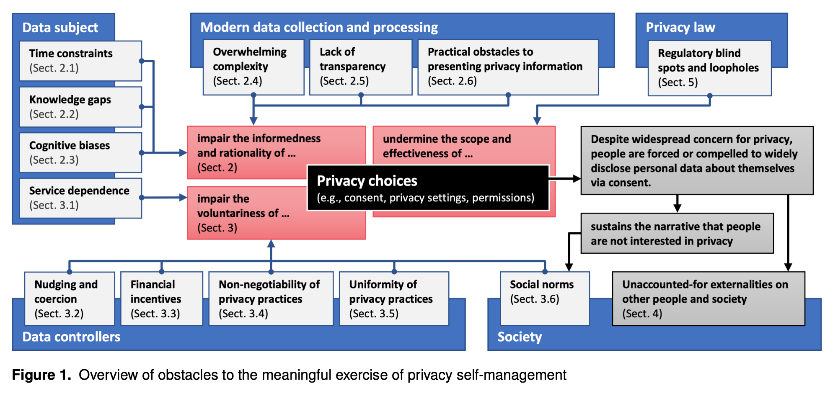
Kröger, Jacob Leon and Lutz, Otto Hans-Martin and Ullrich, Stefan, The Myth of Individual Control: Mapping the Limitations of Privacy Self-management (July 7, 2021). Available at SSRN: https://ssrn.com/abstract=3881776
Notes:
This diagram is from an excellent paper by Kröger, Lutz and Ullrich that summarises many of the issues with individualising choices about data:
Despite widespread concern for privacy, people are forced or compelled to widely disclose personal data about themselves via consent. This sustains the narrative that people are not interested in privacy, which influences social norms around their privacy choices. It also leads to unaccounted-for externalities on other people and society.
The informedness and rationality of privacy choices (e.g. consent, privacy settings, permissions) are impaired by data subject time constraints, knowledge gaps and cognitive biases; and by the overwhelming complexity, lack of transparency and practical obstacles to presenting privacy information in modern data collection and processing.
Privacy choices aren't voluntary because data controllers nudge and coerce, offer financial incentives, make non-negotiable agreements for services data subjects are dependent on, and provide uniform privacy practices.
Finally, regulatory blind spots undermine the scope and effectiveness of those choices.

Slide 10
… but big data is relational

Slide 11
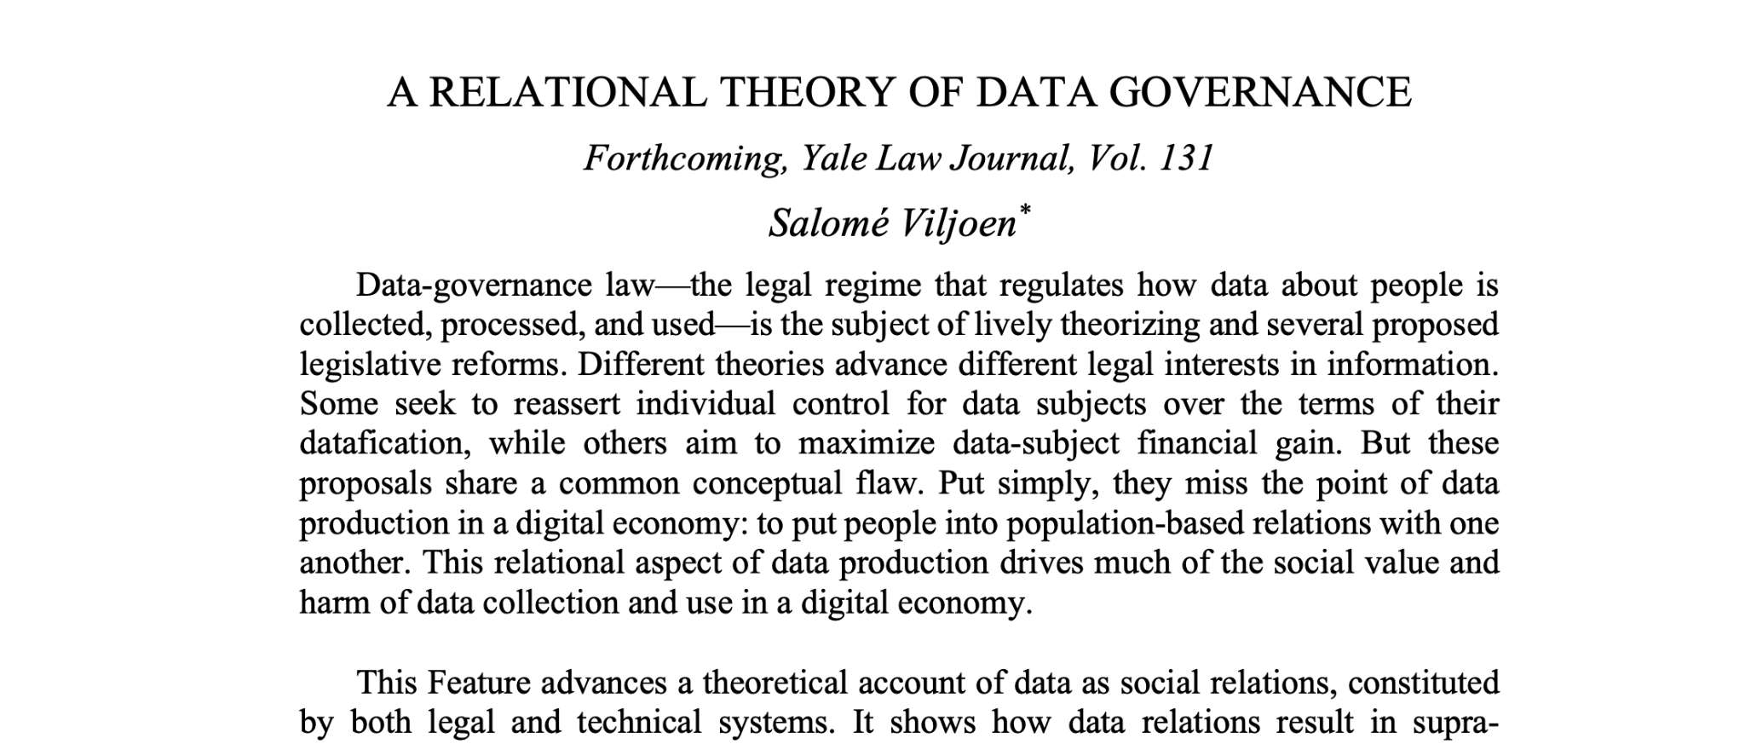
Viljoen, Salome, A Relational Theory of Data Governance (November 11, 2020). Yale Law Journal, Forthcoming, Available at SSRN: https://ssrn.com/abstract=3727562 or http://dx.doi.org/10.2139/ssrn.3727562
Notes:
Salomé Viljoen’s paper on a relational theory of data governance spells out how the nature of data processing has changed since individual-focused data protection regulation was first introduced.
It used to be that organisations would just look at data about one individual when making choices about them, such as their credit rating, as we saw earlier. Now, organisations use data about groups and whole populations when making those decisions. They examine what people who are similar to you have done in the past, and use that to make predictions about what you might do in the future.
This means, while we might not realise it, we have become connected by data: that our individual choices affect others and vice versa.
Our individualised model of data governance means we are asked to make decisions about data in isolation, according to our interests, but we actually need to care about other people as well, and we really want them to care about us!

Slide 12
… but data has collective impacts
Notes:
We know and have seen that the way data is used has broader implications as well: effects on our democracy, our economy, and our environment.
There has been much discussion of the degree to which big political decisions, such as Trump’s election and the Brexit referendum, were influenced by micro-targeted adverts that disrupt the democratic process. Whether or not you believe they were, the fact that they might have been has affected our faith in democracy.
But there are other collective impacts from data too. We have seen how our economies are dominated by big tech companies, whose power is supported by the amount of data they have and how they use it. Think about how Amazon uses data to get into an advantageous position in markets for physical goods. Or how the use of data at an individual level in the insurance market affects our ability to spread risk collectively. Or the impacts of personalised pricing on who gets the opportunity to participate in the market.
And we know that data collection and processing has a wider environmental effect, with about 3.7% of carbon emissions being the result of digital technology (see https://theshiftproject.org/en/article/lean-ict-our-new-report/)
These are broader externalities that need to be addressed collectively. We can’t, as individuals, somehow factor in these collective impacts when we’re making decisions about what digital services we sign up to.

Slide 13
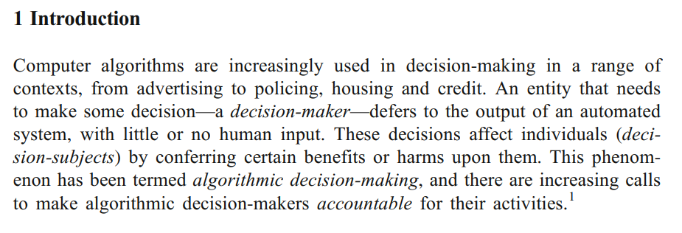
Recognise data subjects AND decision subjects
Binns, Reuben, Algorithmic Accountability and Public Reason (24 May, 2017). Philosophy and Technology, Available at SSRN: https://doi.org/10.1007/s13347-017-0263-5
Notes:
a police force using historic crime data to determine patrol allocations in ways that increase Stop and Search use in over-policed neighbourhoods
a train operating company using algorithms based on historic data to determine surge prices in ways that disadvantage consumers
a social media company removing legitimate content in ways that undermine the free expression rights of those interested in LGBTQ+ or non-English content
‘Vince’

Slide 14
“a new data protection Bill is needed, but perhaps not this one”
Lord Knight (Lab)
existing people, groups, and organisations
new data, stories and other assets you can build together

Slide 15
What DPDIB will do

Slide 16
What the Bill does
Part 1 Changes data protection rules
Part 2 Sets a framework for digital identity verification
Part 3 Focuses on ‘smart data’ initiatives
Part 4 Covers other digital information (including cookies)
Part 5 (with Part 1) Replaces ICO with Info Commission
Part 6 Technical issues including Sec of State powers
Notes:
This means us deciding what data is collected, how it’s used, shared and when it’s deleted collectively rather than individually.

Slide 17
What the Government says
Brexit benefit
Reduces burdens on business while maintaining EU adequacy
Clarifies rules
Supports international trade
Enables innovation
Increases public confidence in eg automated decision-making
Notes:
This means us deciding what data is collected, how it’s used, shared and when it’s deleted collectively rather than individually.

Slide 18
What we’re concerned about
Trades off citizen data rights for minimal, unproven economic benefits
Undermines existing safeguards, parliamentary sovereignty, democratic data governance
Misses a critical opportunity to build public confidence and give citizens and communities a powerful say
Notes:
This means us deciding what data is collected, how it’s used, shared and when it’s deleted collectively rather than individually.

Slide 19
What we’re concerned about
Trades off citizen data rights for minimal, unproven economic benefits
Undermines existing safeguards, parliamentary sovereignty, democratic data governance
Misses a critical opportunity to build public confidence and give citizens and communities a powerful say
Notes:
This means us deciding what data is collected, how it’s used, shared and when it’s deleted collectively rather than individually.

Slide 20
What others are concerned about
Focus on business, not citizens or communities
Threat to EU adequacy
Concerns around automated decision-making
Reduction in rights, reporting and redress
Definition of scientific research
Changes to legitimate interests with no safeguards
Independence of the ICO, Sec of State powers
Notes:
This means us deciding what data is collected, how it’s used, shared and when it’s deleted collectively rather than individually.

Slide 21
What others are concerned about
Abolition of Biometrics and Surveillance Camera Commissioner
Cookie consent
Children’s data rights and coroner access to data
Expanded powers for police and security services
Lack of AI, lack of general policy coherence
Length and complexity
Lack of scrutiny
Notes:
This means us deciding what data is collected, how it’s used, shared and when it’s deleted collectively rather than individually.

Slide 22
Concerning last-minute additions
DWP powers to access bank account data of benefit recipients
Democratic engagement
Notes:
This means us deciding what data is collected, how it’s used, shared and when it’s deleted collectively rather than individually.

Slide 23
What should be done

Slide 24
Amendments
Ensure Automated Decision Making (ADM) provisions apply to decision subjects, not just data subjects
Extend the scope of risk assessment to impacts on groups and society
Require consultation with impacted communities during risk assessment
Provide collective redress mechanisms for collective harms
Increase transparency about the use of AI and ADM and its impacts
Notes:
This means us deciding what data is collected, how it’s used, shared and when it’s deleted collectively rather than individually.

Slide 25
Additional amendments
Remove the concept of “recognised legitimate interests”
Remove the ability of organisations to label requests as “vexatious or excessive”
Remove access by DWP to bank account data of benefit and pension recipients
Notes:
This means us deciding what data is collected, how it’s used, shared and when it’s deleted collectively rather than individually.

Slide 26
“a new data protection Bill is needed, but perhaps not this one”
Lord Knight (Lab)
existing people, groups, and organisations
new data, stories and other assets you can build together
Notes:
Empowered public voice around data needs to be at the heart of this legislation, heard through a combination of meaningful individual rights, powerful collective representation, and proper democratic scrutiny and accountability.

Slide 27
Thank you
gavin@connectedbydata.org

