Slide 1

Reforming Data Protection – Enforcement Perspectives
Prof. Dr. Gloria González Fuster
22 March 2024

Slide 2
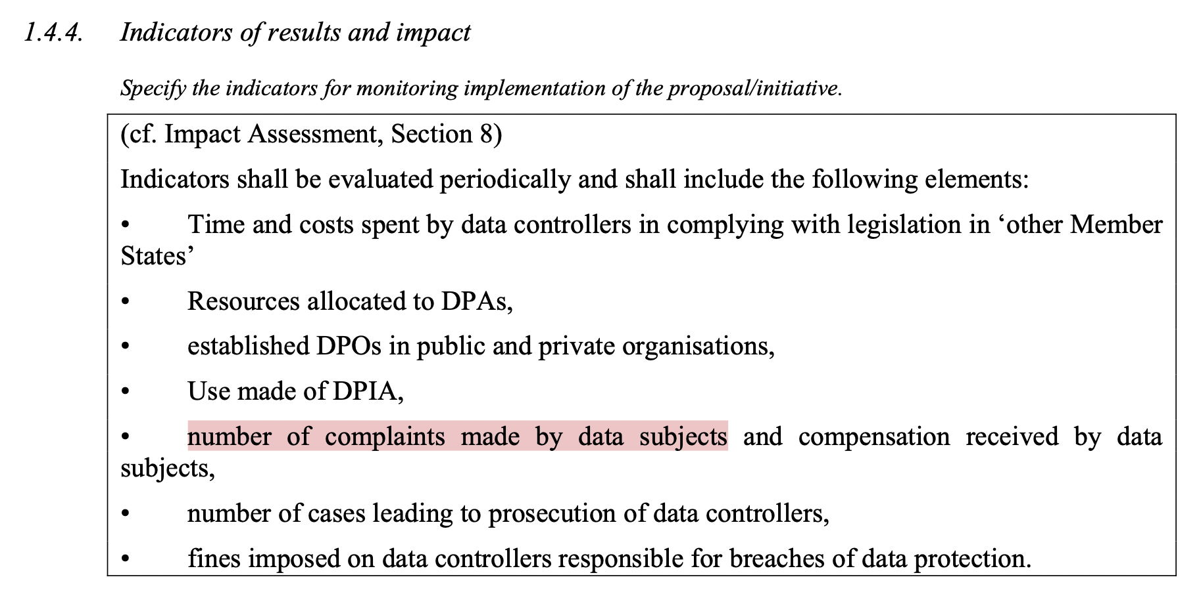
European Commission, Proposal for a Regulation of the European Parliament and of the Council on the protection of individuals with regard to the processing of personal data and on the free movement of such data (General Data Protection Regulation), Brussels, 25.1.2012 COM(2012) 11 final, p. 103.

Slide 3
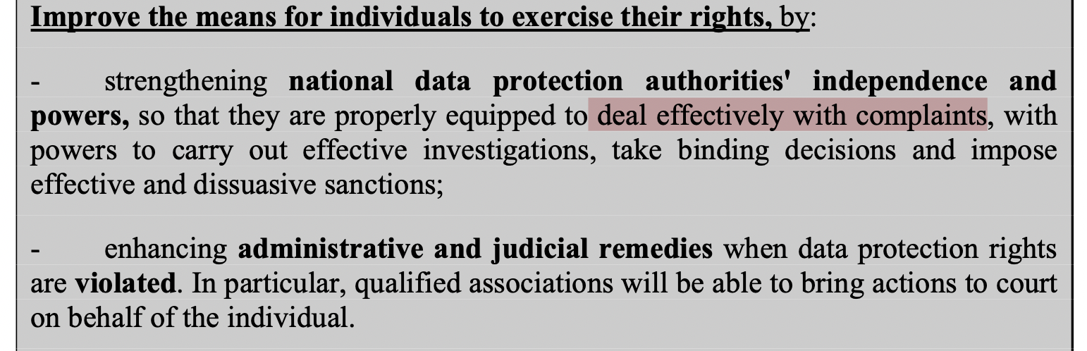
European Commission, Communication Safeguarding Privacy in a Connected World: A European Data Protection Framework for the 21st Century, Brussels, 25.1.2012 COM(2012) 9 final, p. 6.

Slide 4

European digital strategy (2020)
European strategy for data (2020)
DGA proposal (2020)
DGA (2022)
White paper on AI (2020)
DA proposal (2022)
Data Act (2023)
Digital Services Package (2020)
Platform workers proposal (2021)
DSA proposal (2020)
DMA proposal (2020)
AIA proposal (2021)
Common European Data Spaces (14 planned now)
Platform workers Directive (2024) (almost)
Health Data Space proposal (2022)
EHDS (almost there)
Digital Services Act (2022)
Digital Markets Act (2022)
AI Act (2024) (almost there)

Slide 5
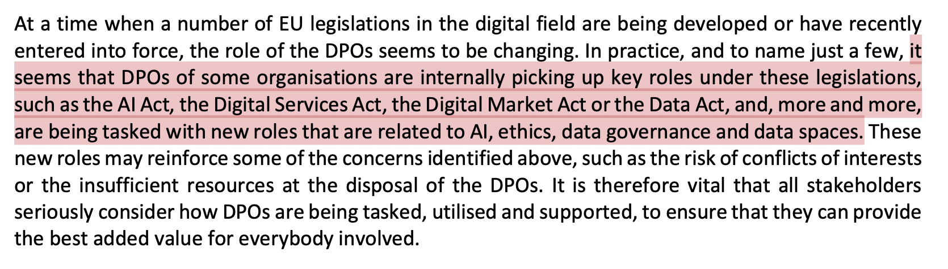
European Data Protection Board (EDPB), 2023 Coordinated Enforcement Action: Designation and Position of Data Protection Officers, adopted on 16 January 2024, p. 37.

Slide 6
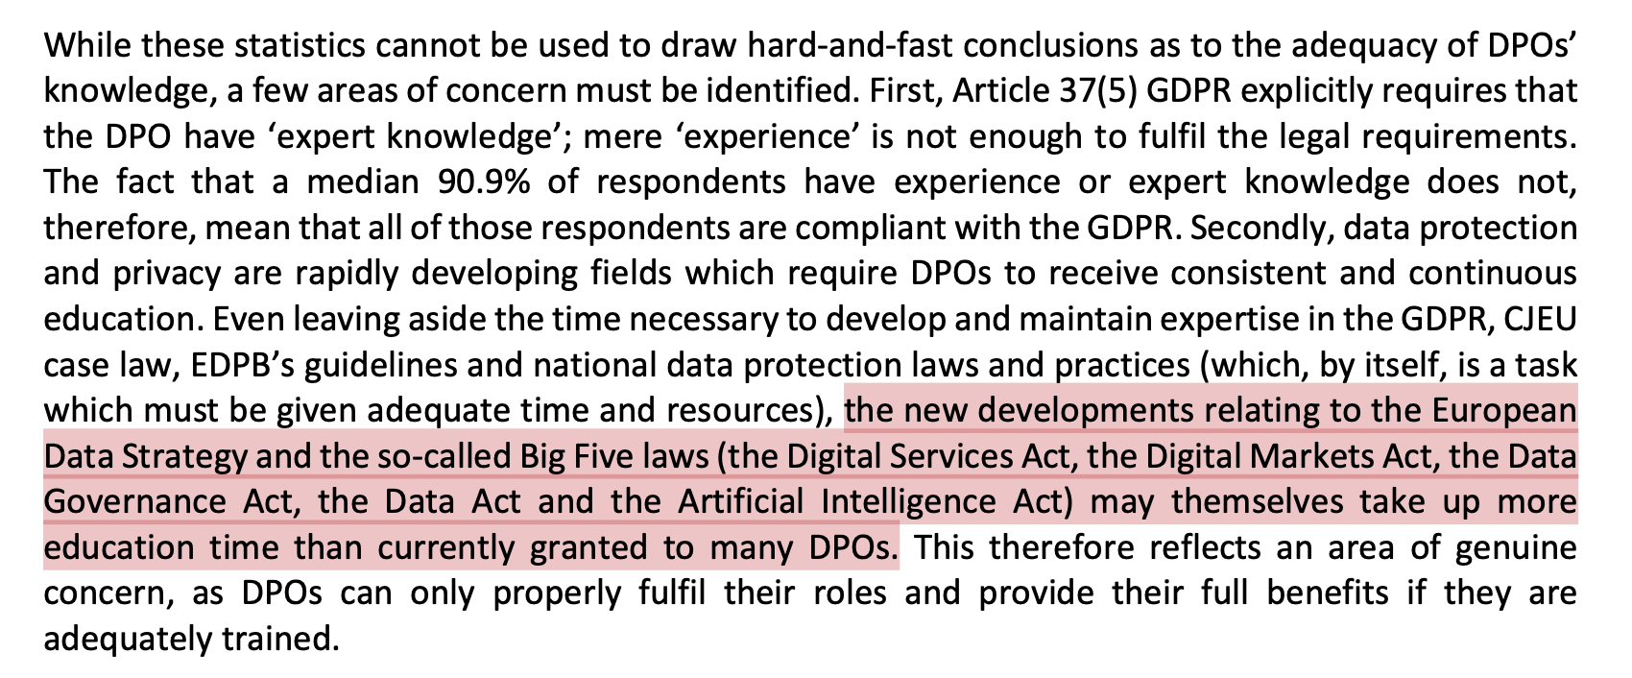
European Data Protection Board (EDPB), 2023 Coordinated Enforcement Action: Designation and Position of Data Protection Officers, adopted on 16 January 2024, p. 37.

Slide 7


Slide 8
personal data under the GDPR that is not data under the DA & the DGA
data under the DA & DGA that is also personal data under the GDPR
data under the DA & DGA that is not personal data under the GDPR

Slide 9
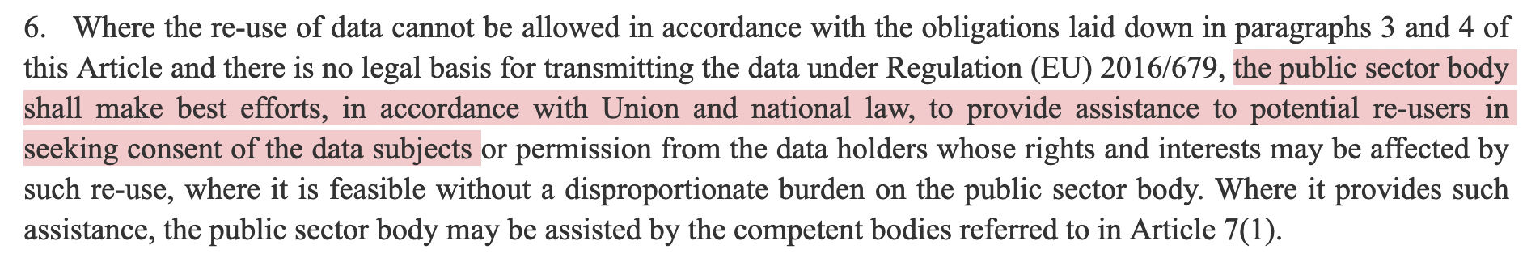

Art. 5(6) DGA

Slide 10
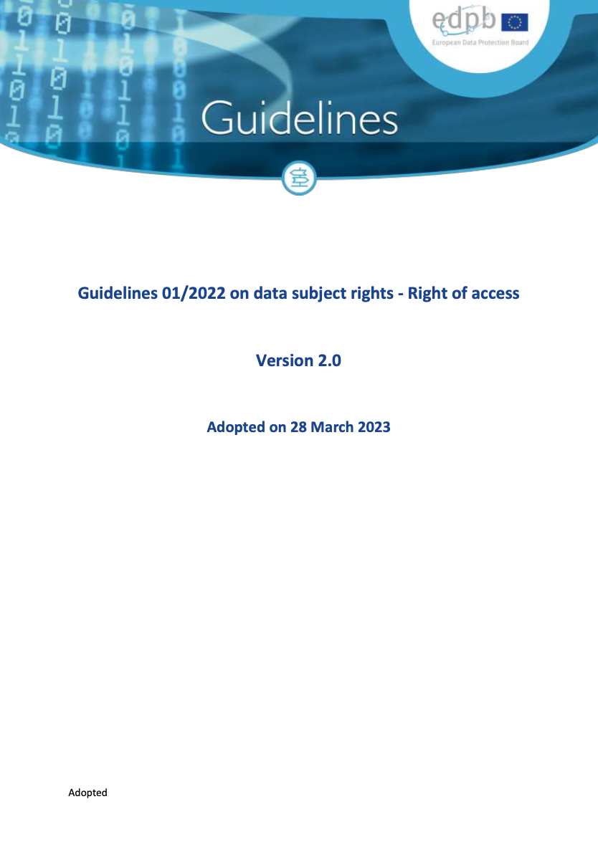
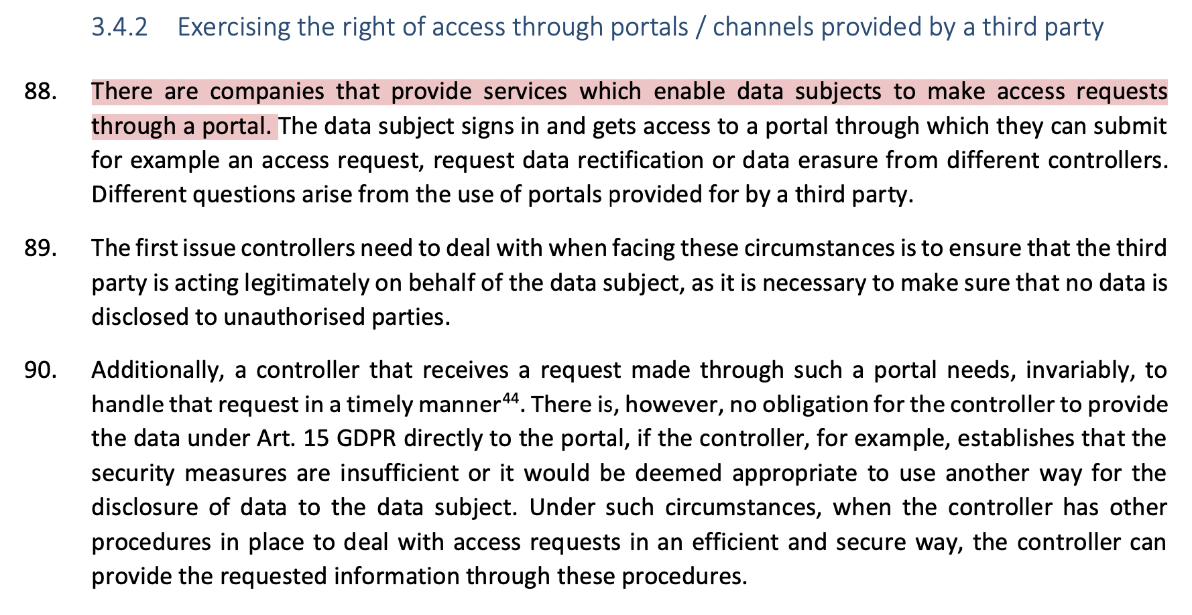

Slide 11



Slide 12
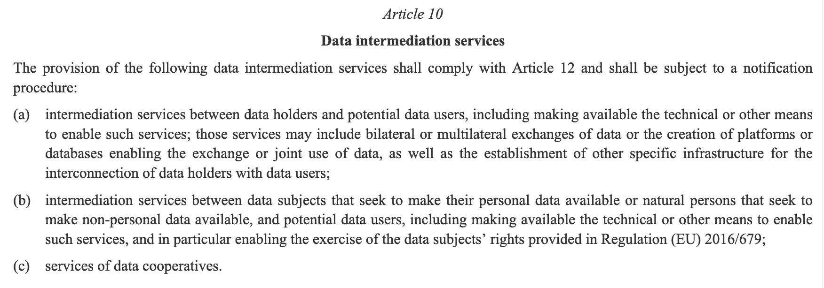
Art. 10 DGA

Slide 13


Slide 14
Art. 10 DGA

Slide 15
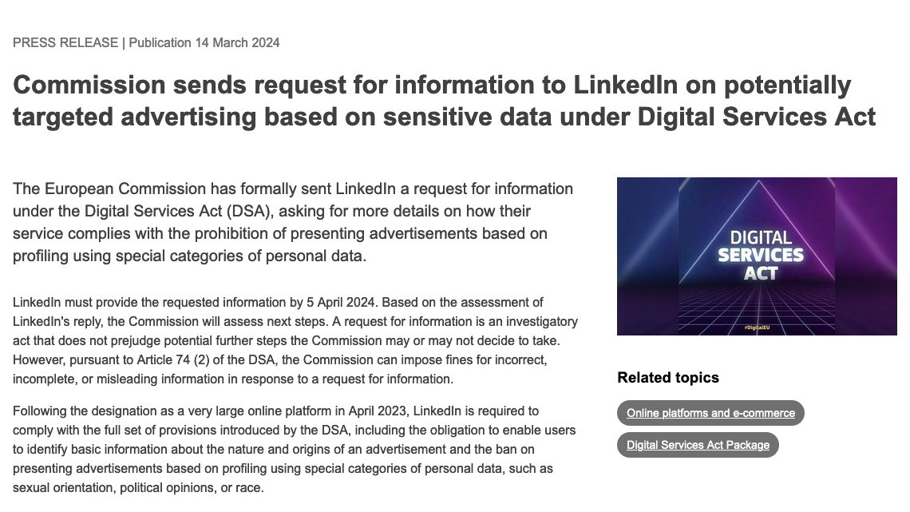

Slide 16
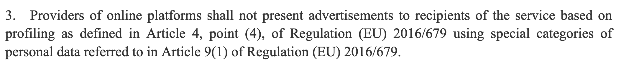
Art. 26(3) DSA

Slide 17
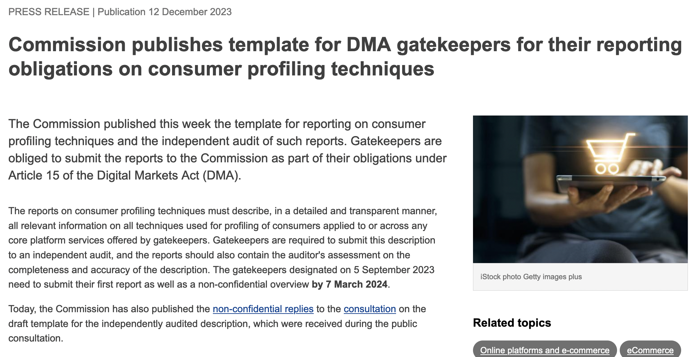

Slide 18

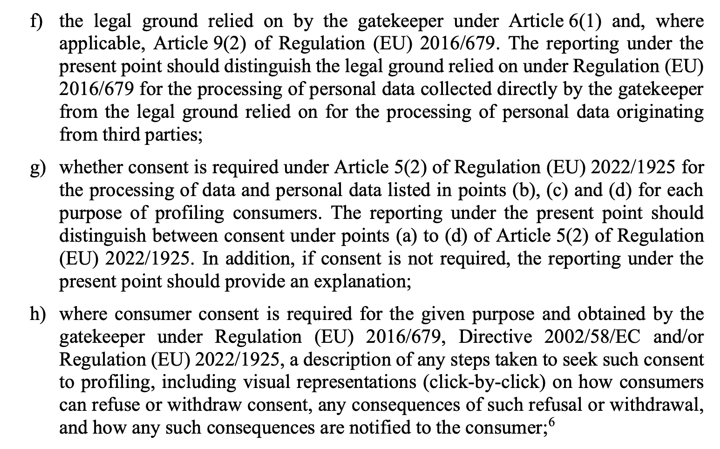



Slide 19
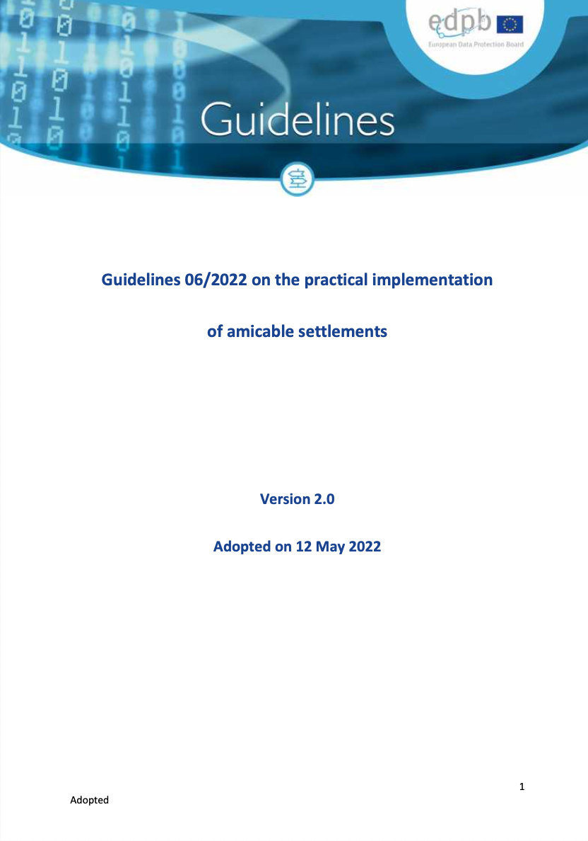
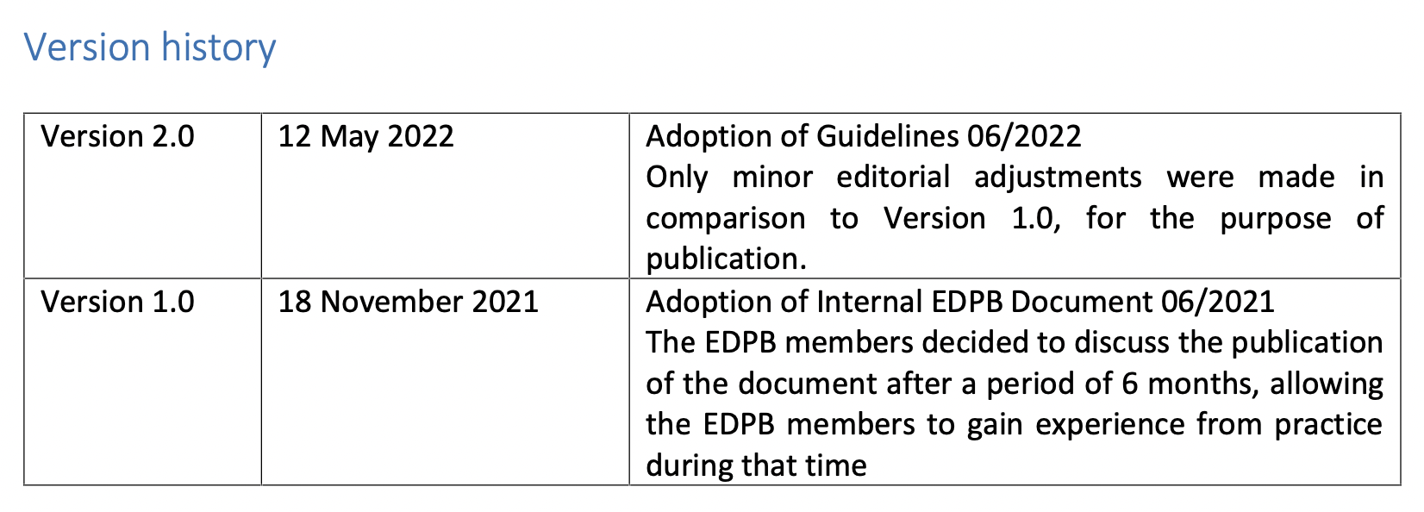

Slide 20
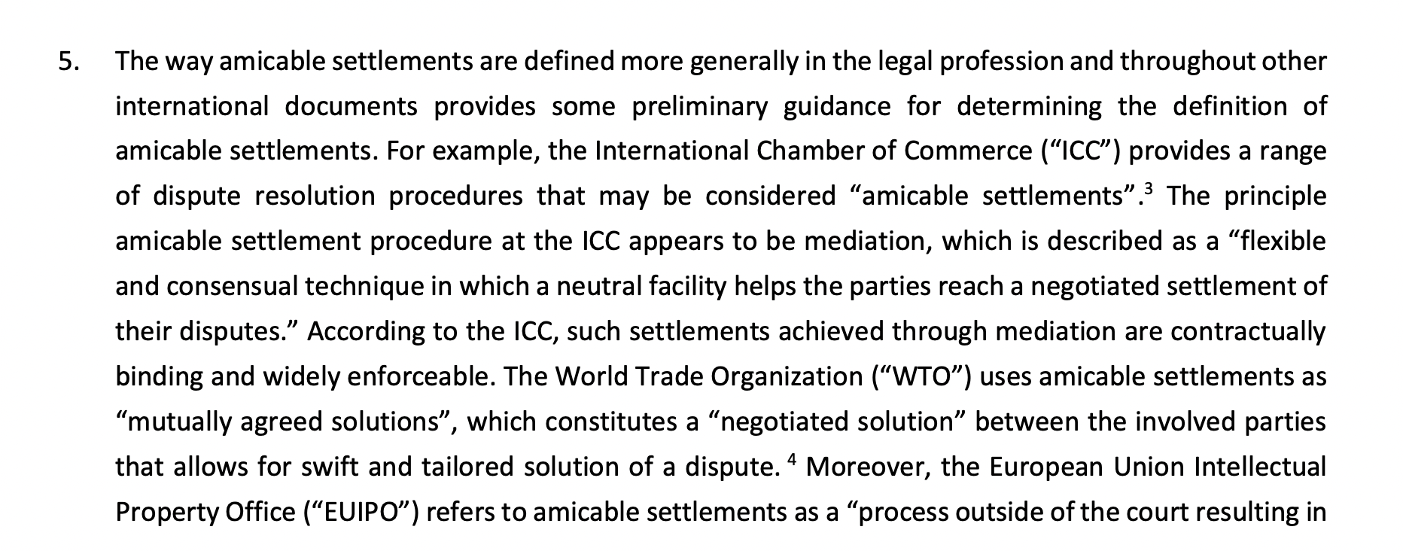
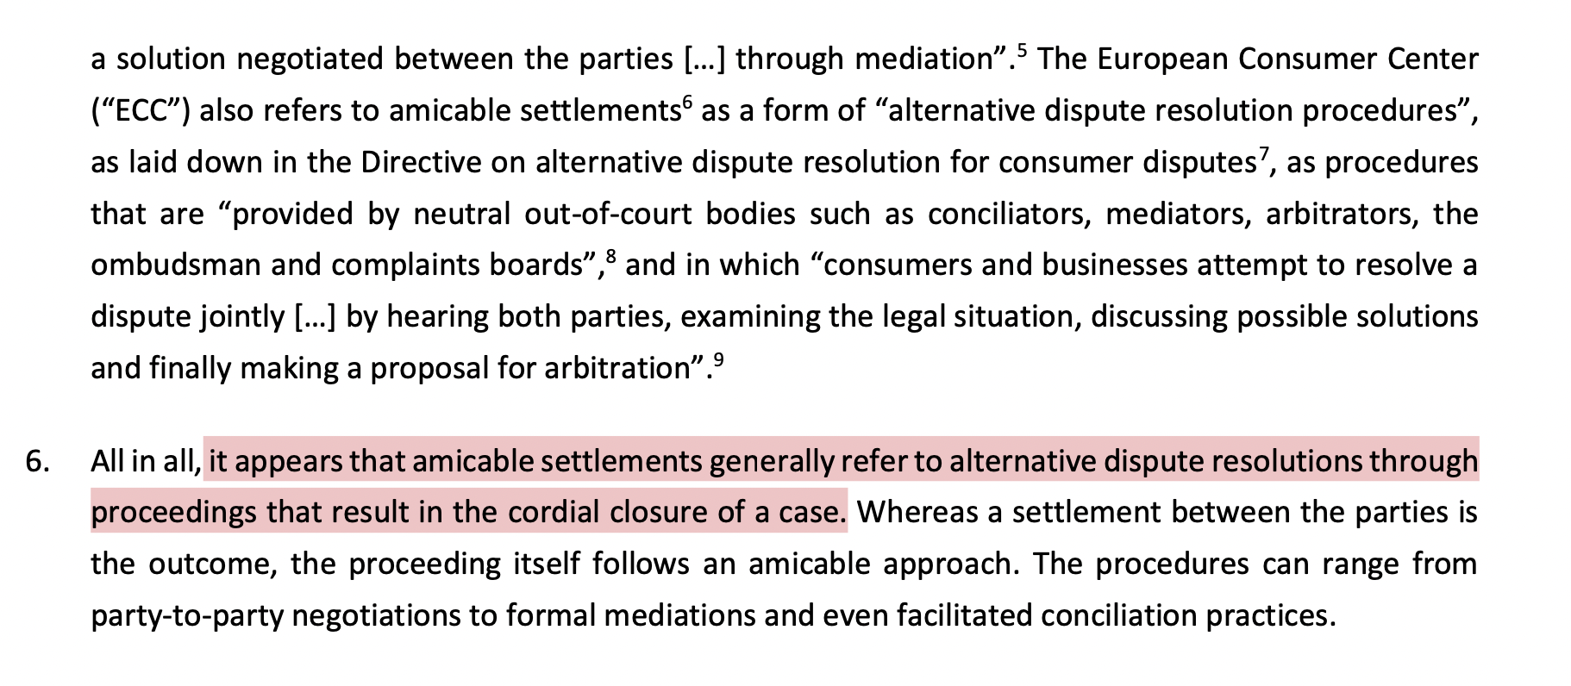
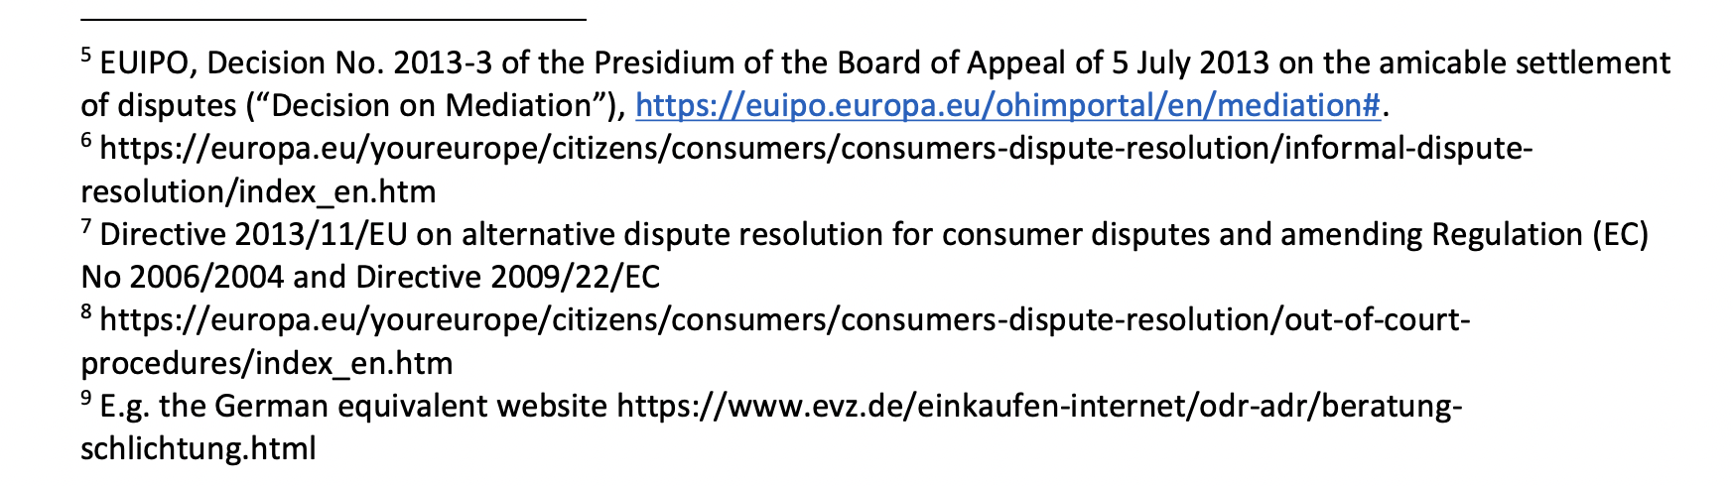

Slide 21
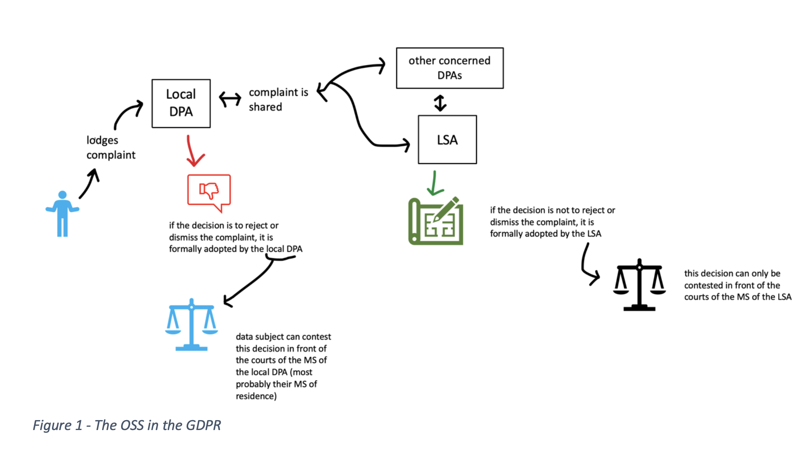

Slide 22
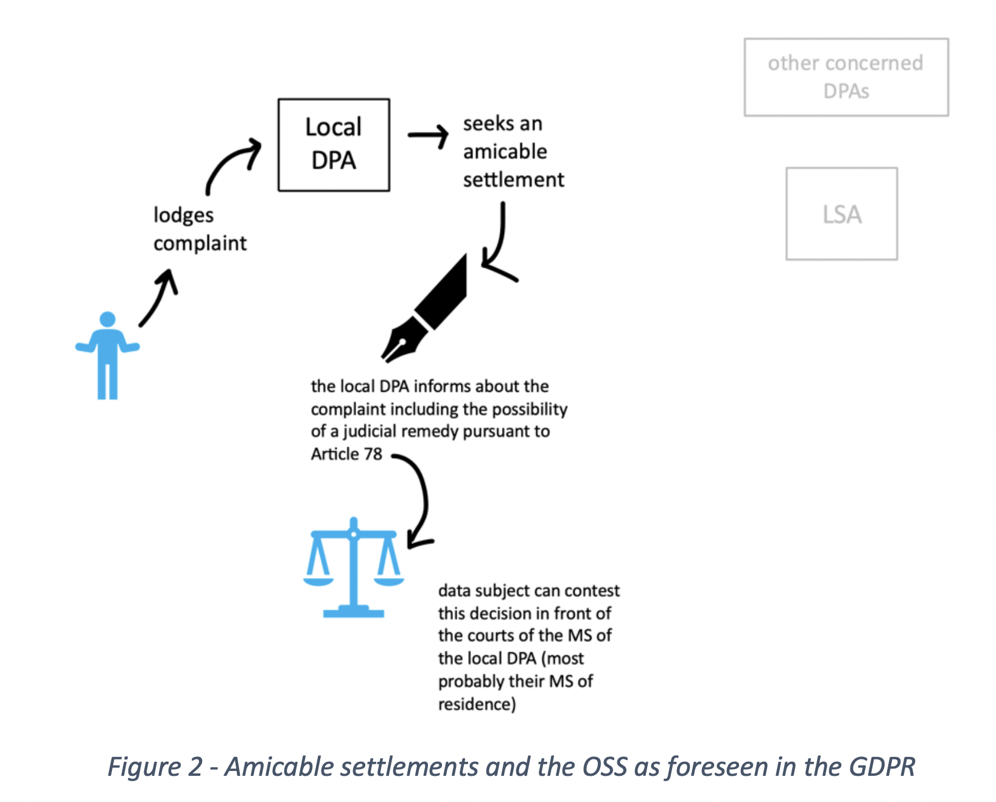

Slide 23
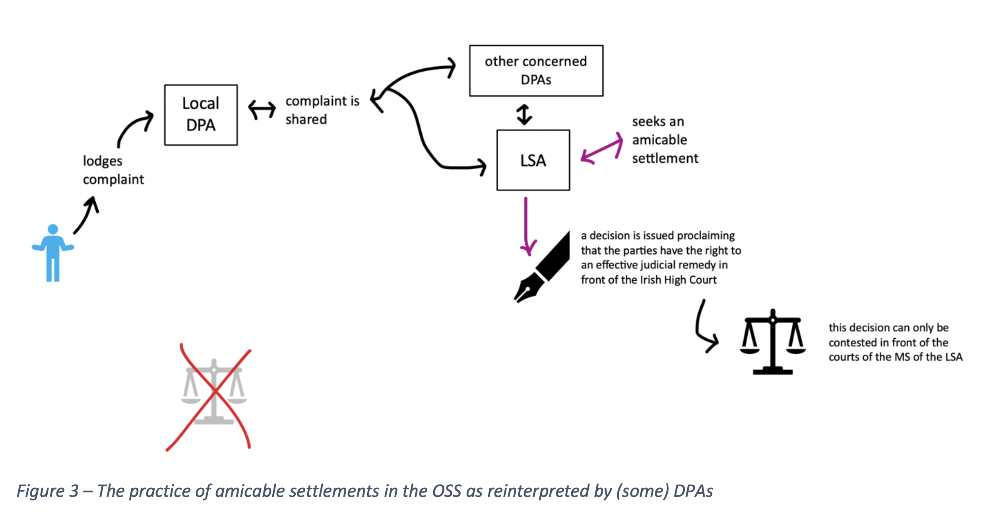

Slide 24
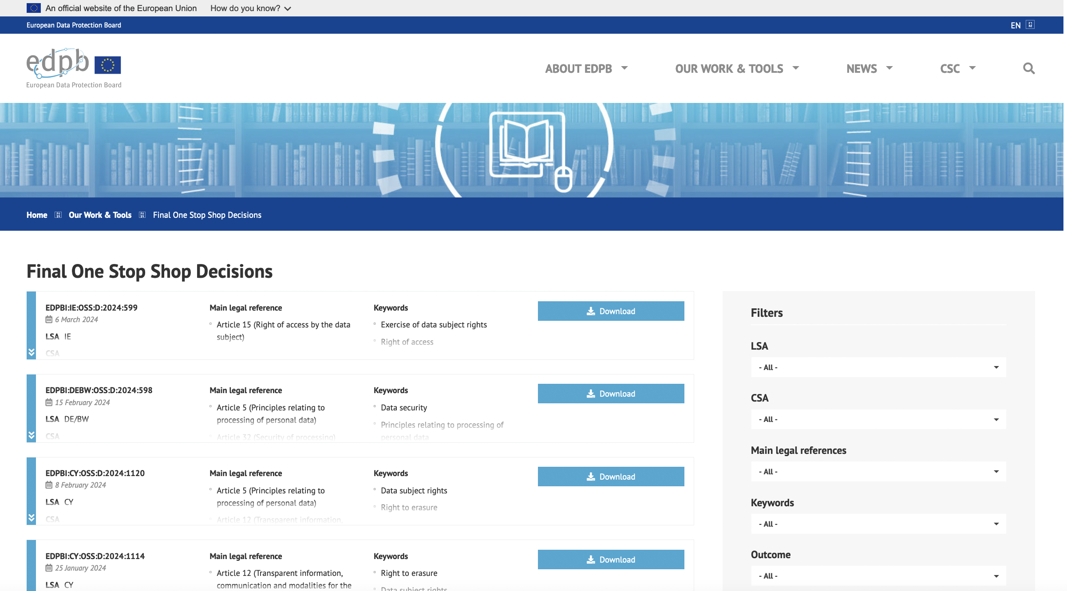

Slide 25

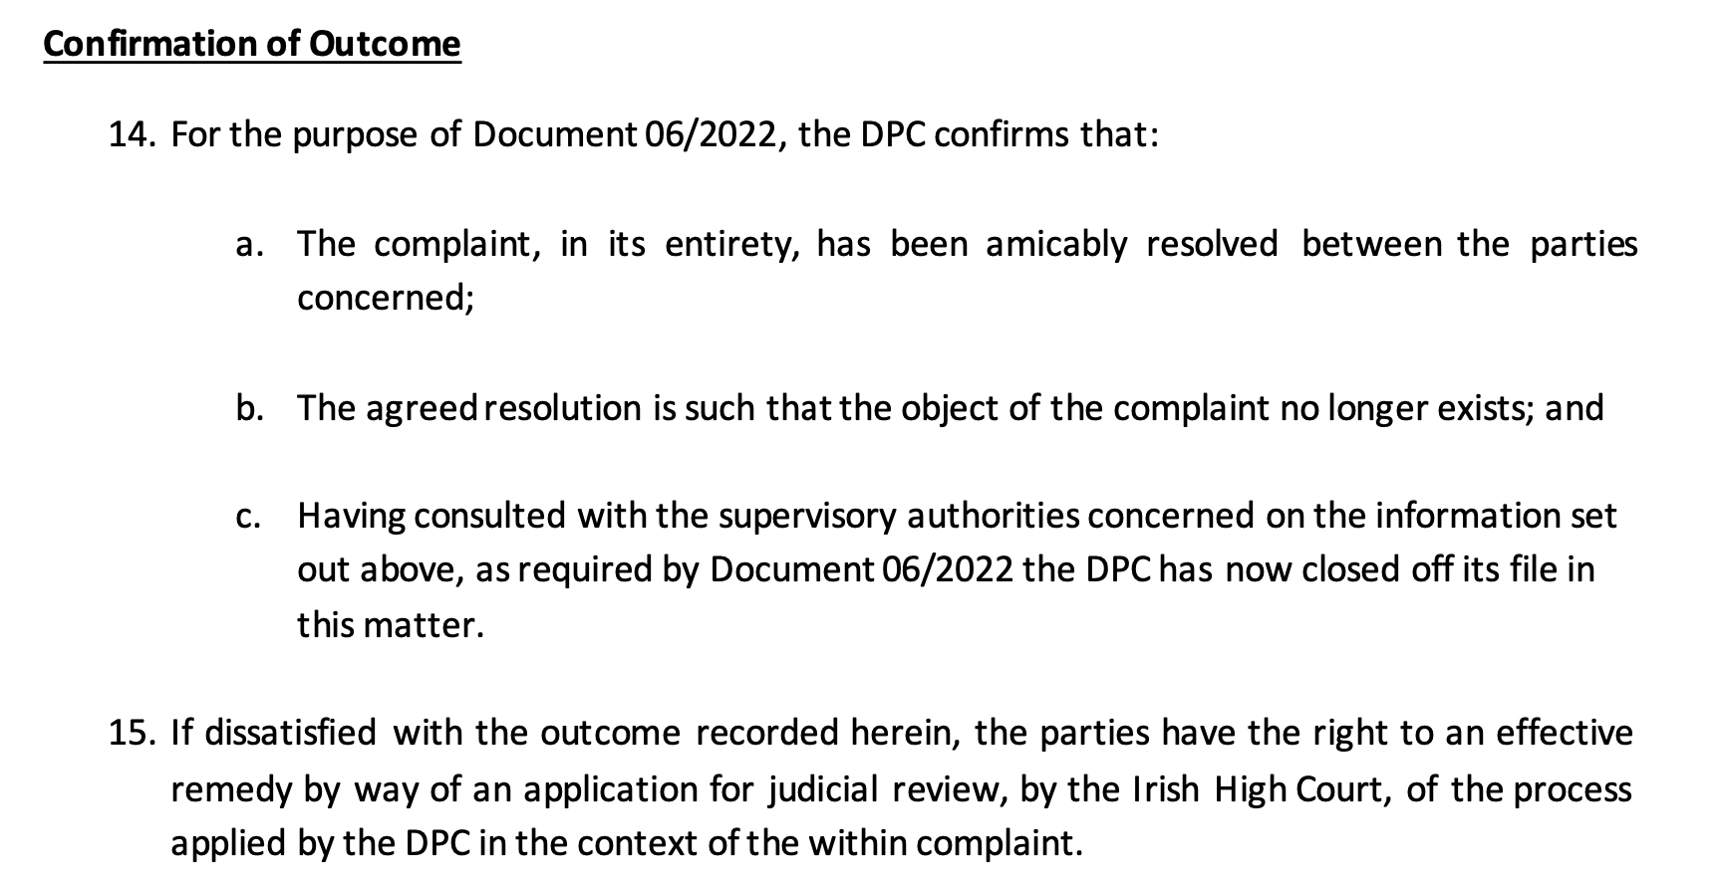

Slide 26


Slide 27



Slide 28
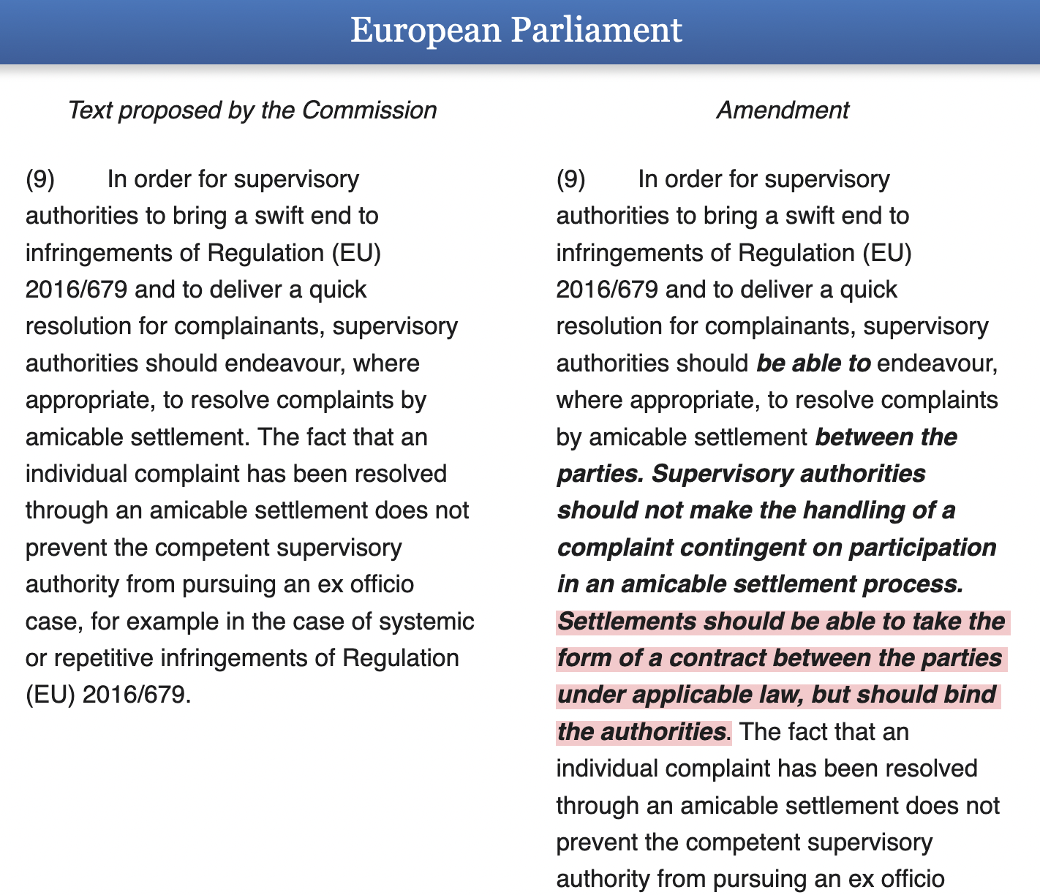

Slide 29
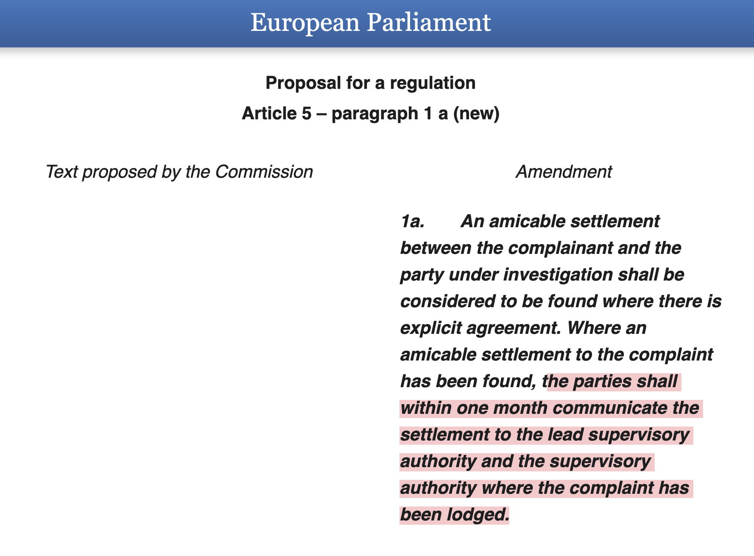

Slide 30
In the meantime, at the CJEU
  C‑132/21, NAIH, 12 January 2023:
  ‘Making several remedies available also strengthens the objective set out in recital 141 of Regulation 2016/679 of guaranteeing for every data subject who considers that his or her rights under that regulation are infringed the right to an effective judicial remedy in accordance with Article 47 of the Charter’ (para. 44).
Joined Cases C-26/22 and C-64/22, SCHUFA Holding (Libération de reliquat de dette), 7 December 2023: that the complaints procedure, which is not similar to that of a petition, is designed as a mechanism capable of effectively safeguarding the rights and interests of data subjects. (para. 58).
C-416/23, Österreichische Datenschutzbehörde, (pending).

Slide 31
Thank you for your attention!
gloria.gonzalez.fuster@vub.be

