Slide 1
The Trouble with European
Data Protection Law
Prof. Bert-Jaap Koops
e.j.koops@tilburguniversity.edu
based on B.J. Koops (2014), ‘The trouble with European data protection law’,
4 International Data Privacy Law (4), p. 250-261, doi:10.1093/idpl/ipu023, http://idpl.oxfordjournals.org/content/4/4/262.full.pdf+html / http://ssrn.com/abstract=2505692
TILT
Tilburg Institute for Law, Technology, and Society

Slide 2
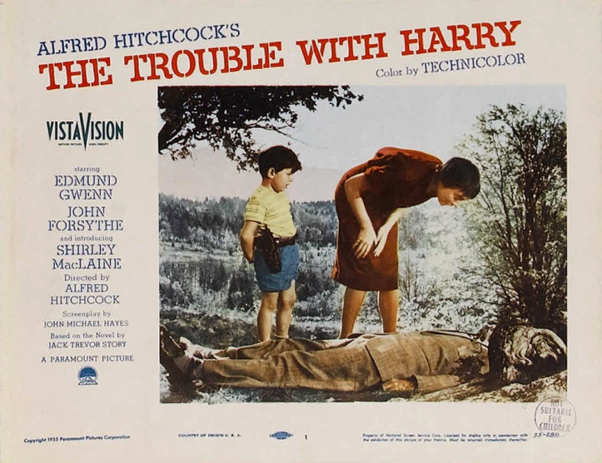
The Trouble with Harry

Slide 3
Outline
GDPR foundations: the 2012 data protection reform objectives
fallacy 1: too much focus on informational self-determination
fallacy 2: too much faith in controller actions
fallacy 3: regulating everything in one statutory law
conclusion: what to do with Harry?

Slide 4
GDPR foundations: the data protection reform objectives
Objectives
1.4.1. The Commission's multiannual strategic objective(s) targeted by the proposal/initiative
The reform aims at completing the achievement of the original objectives, taking account of new developments and challenges, i.e.:
increasing the effectiveness of the fundamental right to data protection and putting individuals in control of their data, particularly in the context of technological developments and increased globalisation;
enhancing the internal market dimension of data protection by reducing fragmentation, strengthening consistency and simplifying the regulatory environment, thus eliminating unnecessary costs and reducing the administrative burden.
In addition, the entry into force of the Lisbon Treaty - and in particular the introduction of a new legal basis (Article 16 TFEU) - offers the opportunity to achieve a new objective, i.e.
to establish a comprehensive data protection framework covering all areas.
source: Proposal for a General Data Protection Regulation, COM(2012) 11 final, p. 102
TILT
Tilburg Institute for Law, Technology, and Society

Slide 5
GDPR foundations: the data protection reform objectives
Objectives
1.4.1. The Commission's multiannual strategic objective(s) targeted by the proposal/initiative
The reform aims at completing the achievement of the original objectives, taking account of new developments and challenges, i.e.:
increasing the effectiveness of the fundamental right to data protection and putting individuals in control of their data, particularly in the context of technological developments and increased globalisation;
enhancing the internal market dimension of data protection by reducing fragmentation, strengthening consistency and simplifying the regulatory environment, thus eliminating unnecessary costs and reducing the administrative burden.
In addition, the entry into force of the Lisbon Treaty - and in particular the introduction of a new legal basis (Article 16 TFEU) - offers the opportunity to achieve a new objective, i.e.
to establish a comprehensive data protection framework covering all areas.
source: Proposal for a General Data Protection Regulation, COM(2012) 11 final, p. 102
TILT
Tilburg Institute for Law, Technology, and Society

Slide 6
GDPR foundations: the data protection reform objectives
Objectives
1.4.1. The Commission's multiannual strategic objective(s) targeted by the proposal/initiative
The reform aims at completing the achievement of the original objectives, taking account of new developments and challenges, i.e.:
increasing the effectiveness of the fundamental right to data protection and putting individuals in control of their data, particularly in the context of technological developments and increased globalisation;
enhancing the internal market dimension of data protection by reducing fragmentation, strengthening consistency and simplifying the regulatory environment, thus eliminating unnecessary costs and reducing the administrative burden.
In addition, the entry into force of the Lisbon Treaty - and in particular the introduction of a new legal basis (Article 16 TFEU) - offers the opportunity to achieve a new objective, i.e.
to establish a comprehensive data protection framework covering all areas.
source: Proposal for a General Data Protection Regulation, COM(2012) 11 final, p. 102
TILT
Tilburg Institute for Law, Technology, and Society

Slide 7
GDPR foundations: the data protection reform objectives
Objectives
1.4.1. The Commission's multiannual strategic objective(s) targeted by the proposal/initiative
The reform aims at completing the achievement of the original objectives, taking account of new developments and challenges, i.e.:
increasing the effectiveness of the fundamental right to data protection and putting individuals in control of their data, particularly in the context of technological developments and increased globalisation;
enhancing the internal market dimension of data protection by reducing fragmentation, strengthening consistency and simplifying the regulatory environment, thus eliminating unnecessary costs and reducing the administrative burden.
In addition, the entry into force of the Lisbon Treaty - and in particular the introduction of a new legal basis (Article 16 TFEU) - offers the opportunity to achieve a new objective, i.e.
to establish a comprehensive data protection framework covering all areas.
source: Proposal for a General Data Protection Regulation, COM(2012) 11 final, p. 102
TILT
Tilburg Institute for Law, Technology, and Society

Slide 8
Fallacy 1: too much focus on information self-determination
starting point of ISD has two main components:
  consent as an important (or primary) legitimating ground
  data subject rights
problem 1: mythology of consent
problem 2: exercising control of data is extremely difficult
problem 3: ISD does not work in the public sector
conclusion
  there is little informational self-determination in the private sector
  informational self-determination is at odds with the public sector
  fallacy of relying on ISD and focusing on user empowerment
TILT
Tilburg Institute for Law, Technology, and Society

Slide 9
Fallacy 2: too much faith in controller actions
problem 1: data protection law is pretty complex
problem 2: more ex ante obligations… on paper
problem 3: more ex post regulation… on paper
conclusion
  complexity of the law has increased rather than decreased
  more ex ante and ex post paperwork and checklist obligations
  controllers are likely to be rule-compliant without understanding much about (or caring for) data protection
  fallacy of creating more rules leads to data protection law being a zombie: it seems to live, but lacks a vital spirit
TILT
Tilburg Institute for Law, Technology, and Society

Slide 10
Fallacy 3: regulating everything in one statutory law
problem 1: huge disconnect between law and reality
problem 2: response to regulatory disconnection is… more of the same law
problem 3: data protection has a communication problem
  wrong frame (‘GDPR says no’)
  poor expectation management
  underlying: too narrow focus on command-and-control law
conclusion
  regulatory disconnection has enlarged by stretching the scope of data protection law
  too little attention for other regulatory tools
  fallacy of believing every problem of internet data flows can be addressed by data protection law
TILT
Tilburg Institute for Law, Technology, and Society

Slide 11
Conclusion
What do to with Harry?
“The trouble with Harry is that he's dead, and everyone seems to have a different idea of what needs to be done with his body...”
(synopsis of Alfred Hitchcock, The Trouble with Harry, 1955)
TILT
Tilburg Institute for Law, Technology, and Society

Slide 12
The future of data protection law
(if it is to have a future)
GDPR: ‘a comedy about a corpse’
TILT
Tilburg Institute for Law, Technology, and Society

Slide 13

The future of data protection law
(if it is to have a future)
GDPR: ‘a comedy about a corpse’ or a zombie horror movie?
source: http://www.fanpop.com/clubs/zombie-movies/images/6425644/title/zombie-photo
TILT
Tilburg Institute for Law, Technology, and Society

Slide 14
The future of data protection law
(if it is to have a future)
GDPR: ‘a comedy about a corpse’ or a zombie horror movie?
with the current GDPR foundations, data protection law risks being moribund (or already dead?)
what to do with data protection law’s body?
  resurrect
    going back to the roots – a framework of basic principles
    showing the spirit of data protection, not the rules – the forest, not the trees
    focus on other regulatory instruments besides command-and-control rules
  or R.I.P. and look for protection elsewhere
    sui generis frameworks for particular challenges, e.g. profiling
    consumer protection, administrative law, public procedure law
    regulating decision-making
  and/or commemorate and keep its spirit alive
    role models
      administrations and regulators showing data collection restraint
      (really) adopt Data Protection Enhancing Technologies and data protection by default
TILT
Tilburg Institute for Law, Technology, and Society

Slide 15

Thank you for your attention
B.J. Koops (2014), ‘The Trouble with European Data Protection Law’,
4 International Data Privacy Law (4), p. 250-261, doi:10.1093/idpl/ipu023, http://idpl.oxfordjournals.org/content/4/4/262.full.pdf+html / http://ssrn.com/abstract=2505692
follow-up questions and suggestions: e.j.koops@tilburguniversity.edu

