Slide 1

Why personal data-centric legal protection against information wrongs fails and what to do about it
Prof. dr. Nadya Purtova, Utrecht University
CIPIL Spring Conference, Faculty of Law, Cambridge
22 March 2024

Slide 2







ERC Info-Leg team

Slide 3
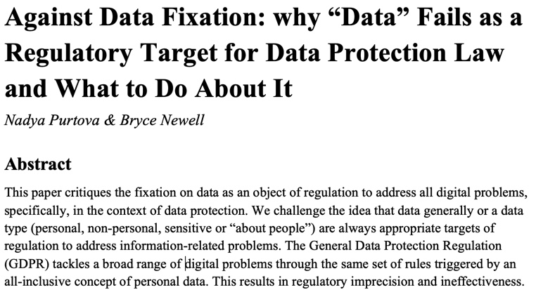

Slide 4
“Personal data” is a trigger concept of European data protection law.

Slide 5

Problems of personal data-centric legal protection
Overinclusiveness
Underinclusiveness
Quality of law / regulatory precision

Slide 6
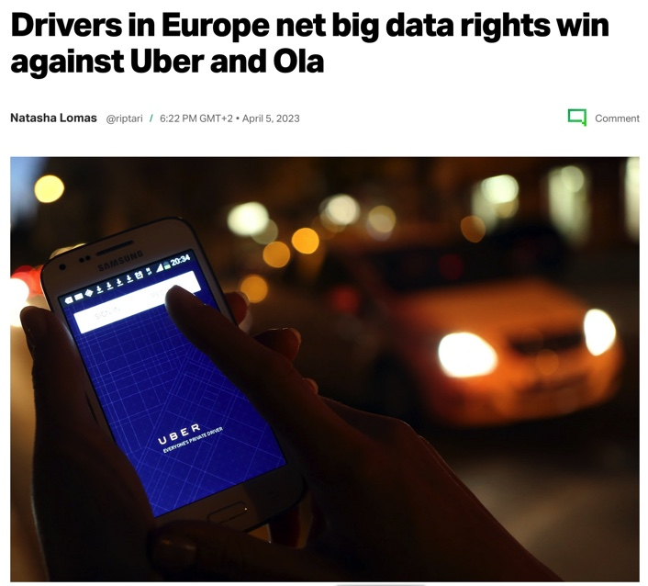
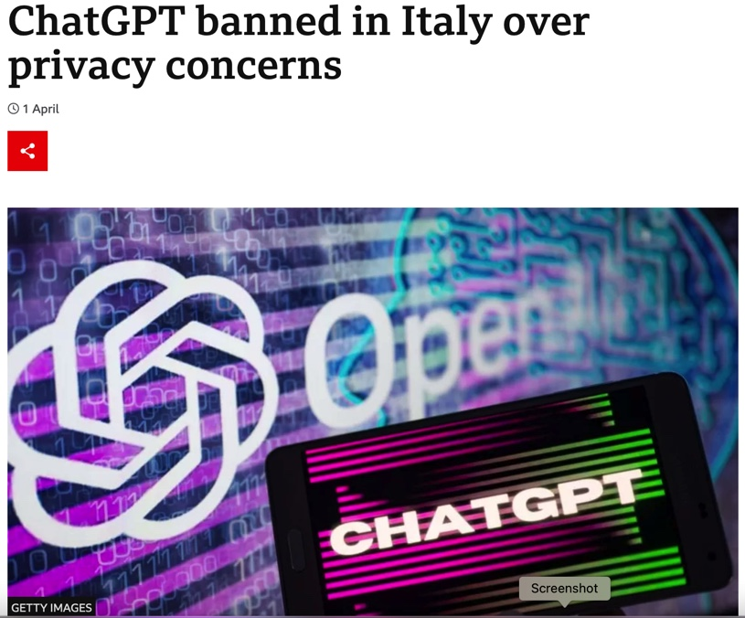

Overinclusiveness: on the one hand, GDPR as a “defence against the dark arts”

Slide 7

Overinclusiveness: on the other, “law of everything”
Everything is personal data
Everyone is a controller
Intensive compliance
“System overload”, or “bad law” (Fuller).

Slide 8
AG Bobek: The GDPR “is gradually transforming the … into one of the most de facto disregarded legislative frameworks under EU law.”
(X, Z v Autoriteit Persoonsgegevens [65])

Slide 9

Underinclusiveness: legal protection is not applied where it should
  Requires (prohibitively) costly expertise
  Controllers strategizing to escape the GDPR reach: PETS, synthetic data, etc. [work of Michael Veale]
  Fuzzy legal boundaries:
    WP29 interpretation not binding
    What is identification?
    YS & others vs Nowak
    OC v European Commission (OLAF) - reversed; SRB v EDPS
Group data

Slide 10

Systemic problem beyond enforcement

Slide 11
Diminished quality of legal protection

Slide 12

“Personal data” is not doing well as a trigger of legal protection / regulatory target.
How can it be done differently?

Slide 13

Approach
Understanding how legal protection is designed → regulatory theory
Understanding information and how it relates to reality → information studies

Slide 14

Design of legal rules
(Black, Schreur, Paun)
To reach a regulatory goal, law should regulate something that is in a causal connection with an intended outcome
Requires an understanding of causal processes
Causal processes change, and understanding evolves
We must constantly re-examine our understanding of reality

Slide 15

Understanding information

Slide 16
Under-theorized use of information concepts in (data protection) law

Slide 17
Based on Capurro and Hjørland (2003) “The concept of information”

Slide 18



Two ways in which information impacts reality: cognitive interpretation & change in reality, ie “causal role in producing a measured function” (Dietterich)

Slide 19
Not all “information-induced wrongs” are created equal: meaning-driven vs meaning-agnostic

Slide 20


Meaning-driven wrongs hinge on meaning
arise when meaningful information about a person or group of individuals is communicated (or is known) to others who access, analyze, or use the information.
Sphere theory of privacy;
Mozaik theory of privacy;
Conventional discrimination by known social categories.

Slide 21

Meaning-agnostic wrongs regardless of meaning
arise as a result of information practices – notably, algorithmic practices that do not rely on cognitive interpretation by a human.
algorithmic discrimination: semantic link is broken; “calculated publics”
surveillance as architecture
consumer manipulation: reconceptualizing digital vulnerability

Slide 22
Two fundamentally different causal processes should be regulated differently.

Slide 23
Regulation targeting meaning-driven wrongs should be separate from regulation targeting meaning-agnostic wrongs.

Slide 24
How is the GDPR doing?

Slide 25
GDPR disregards semantic vs syntactic distinction
Targets a broad range of meaning-driven and meaning-agnostic wrongs;
“Personal data” can be semantic and syntactic information:
“relating to” by reason of content, purpose and effect
Taking syntactic info out takes away already granted protections: IP addresses, cookies, DNA are syntactic information

Slide 26
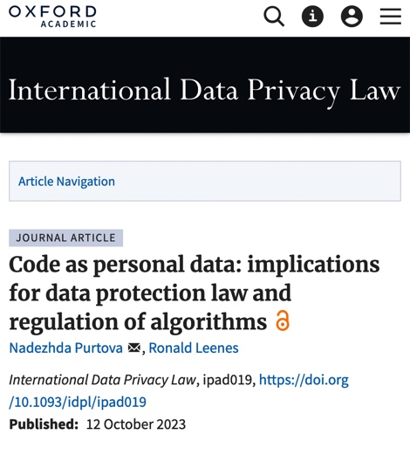
Is it working?
Some provisions clearly target meaning-driven harms (e.g. the accuracy principle calls for a semantic evaluation)
Most provisions make sense & can be reinterpreted with no absurd results when applied to syntactic information
General principles are broad enough to be useful

Slide 27

Is it working?
No absurd results does not mean the GDPR can deal with the various information practices equally well (regulatory precision)
If the GDPR scope is broad, the semantic – syntactic divide is where we can draw the line.

Slide 28

Implications for reform

Slide 29
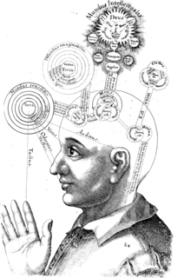
Semantic information as a regulatory target to tackle meaning-driven harms
(e.g. information about something in private sphere, or historically ‘sensitive’: religion, political beliefs)
We cannot regulate cognitive processes → access to & communication of semantic information is the next best thing

Slide 30
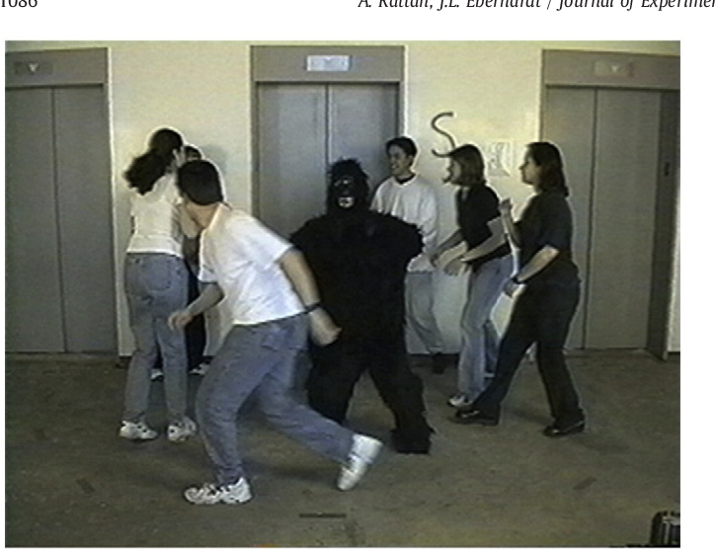
Meaning-agnostic wrongs addressed through regulation of “change to reality”, i.e. problematic practices
Regulating the “flow of information” or “processing of information” is too imprecise and indirect to address the diverse harms, which likely require different approaches.
Focus on PD distracts the debate and regulation away from what is really problematic.

Slide 31

Which practices?

Slide 32

Sectoral legislation
Old but 2.0:
Consumer protection (e.g. Natalie Helberger)
Discrimination (Janneke Gerards, Raphaele Xenidis, Frederik Borgesius)
Admin law (Karen Yeung, Anne Meuese)
New:
Use of AI (the AI Act)
Political targeted ads + new laws for uncovered practices

Slide 33

General principles of design and use of computer code as a baseline
Code-specific problem: scalability & stickiness of outcomes → code amplifies broader societal problems in a unique way

Slide 34
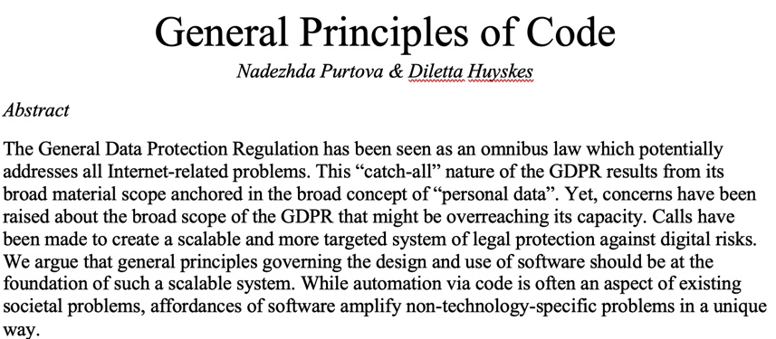
General principles deliver more legal certainty in complex, highly-dynamic contexts with high economic stakes (Braithwaite ‘Rules and Principles’)

Slide 35

What to do about the fundamental right to data protection?
The fundamental right to data protection is entrenched in the EU law, but underdeveloped;
Develop further based on an assumption that all data is personal, but protection of that fundamental right requires measures that do not (only) target data but protect people in an information society;
Efforts of courts and academia.

Slide 36
Thank you!
This project has received funding from the European Research Council (ERC) under the European Union’s Horizon 2020 research and innovation programme (grant agreement No 716971).

