Slide 1

Reforming Data Protection
  Dr. Winfried Veil
  Winfried.Veil@mac.com
  Twitter: @winfriedveil
  https://dataprotection-landscape.com/law
Substantive Perspectives
CIPil Spring Conference
22 March 2024

Slide 2
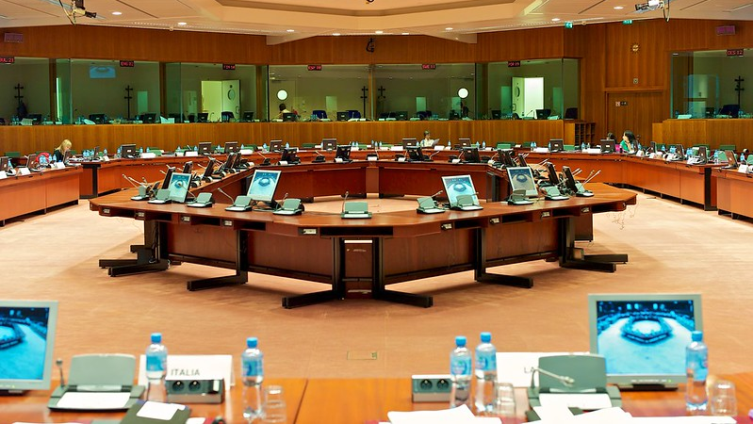
GDPR: Gold Standard or Monster?
II. 12 Structural Deficits
  One size fits all approach
  All or nothing approach
  Prohibition principle
  Focus on input
  Blindness to benefits
  Common good
  Data
  Controller
  Schutzgut misery
  Balancing tests
  Hypertrophy of obligations
  Informational asymmetry
III. Gold standard paranoia
Notes:
Ladies and Gentlemen, good morning.
my engagement with data protection law commenced in the years 2012 and 2013: at that time, I was a member of the German delegation, representing the Federal Government in the negotiations for the GDPR. Back then, the United Kingdom still was a member of the EU. And the UK, the Netherlands, the Scandinavian countries, the Baltic states and Germany had built a like-minded group whose aim it was to create an innovation-friendly, future-proof, reasonable, risk-based data protection law.
As you all know, we failed.
Since then I have developed a sort of love-hate relationship with data protection law.
Since then, my drawers are laden with an array of fundamental critiques of data protection law and numerous ideas on how it could be improved - some half-baked, some more fully developed.
Yet, the majority have remained shrouded in obscurity, for voicing dissent against data protection norms borders on political heresy. Nevertheless I find myself as the last to dispute the necessity of reform.
It is within this context that I find it incumbent upon myself to proffer a disclaimer. Serving under the auspices of the Ministry of the Interior of the Federal Republic of Germany, my perspectives do not echo the official stance of the institution. I am just exercising my liberties of expression and academic inquiry - privileges that, fortuitously, a civil servant in Germany is afforded. Thus, my presence today is of a personal endeavour that requires a day’s leave. Yet, addressing this esteemed assembly at your conference in Cambridge is not so much a sacrifice as it is a distinct honour.
Let us, however, proceed with methodical scrutiny. The imperative for a reform of data protection law must be cogently articulated.

Slide 3
Gold Standard or Monster?
„Biggest catastrophe of 21st century"
(Thomas Hoeren)
„Digital Counterrevolution“
(Christoph Kucklick)
„Perfection of a dead End“
(Niko Härting / Jochen Schneider)
"Frankenstein Monster"
(Caspar Bowden)
„Gold Standard“
(Jan-Philipp Albrecht)
„A new Era“
(Martin Selmayr)
„Trust Centre of the World“
(Paul Nemitz)
„For us the GDPR is a Cathedral“
(Isabelle Falque-Pierrotin)

Slide 4
Politically Correct View
„gold standard“
„fabric of a success story“
„global upward convergence“
„thriving data-driven economy"
„European data space"
Notes:
Upon perusal of the documents issued by the European Commission, one might be led to believe that the General Data Protection Regulation resides in a state of unassailable integrity. Within these documents,
- one encounters assertions characterizing the GDPR as the – quote – “gold standard”,
- described in laudatory terms as the – quote – “fabric of a success story”.
- Further, they extol the – quote – 'global upward convergence' purportedly catalyzed by the GDPR
- alongside proclamations of a – quote – "thriving data-driven economy" and
- and the emergence of a unified – quote – “European data space”.
In stark juxtaposition to this optimistic portrayal, I proffer a perspective grounded in a more critical analysis. It is my considered opinion that the GDPR, notwithstanding its lofty ambitions, necessitates urgent reform and rectification.
But, to commence with a disheartening realization, such reform is unlikely to the point of being impracticable. Nevertheless, the debate must be held and I am therefore very grateful to David Erdos for the invitation.

Slide 5

Voiced GDPR criticism
Displeasure about
the GDPR
Notes:
The GDPR creates tremendous problems. Here is the case for fundamental criticism.
The GDPR creates tremendous problems. Here is the case for fundamental criticism.
- A pervasive legal ambiguity persists even 6 years after the GDPR came into force - evidenced by the excess of round about fifty preliminary decision procedures pending before the European Court of Justice., even sextennially post-enactment of the GDPR,
- The GDPR creates huge bureaucratic burdens.
- We see an impressive unwillingness to comply with the legal regime – and a phenomenon denoted in German as the 'Vollzugsdefizit' — the enforcement deficit.
- Amidst the Corona pandemic, a discord emerged between the imperatives of data protection and public health safeguarding.
My impression is that the criticism expressed about the GDPR is only the tip of the iceberg. There is even more displeasure with the GDPR that remains unspoken.
One reason for the silent displeasure is that the structural deficits of the GDPR are not recognised, and therefore not named.
Let me identify 13 of these structural deficits.

Slide 6
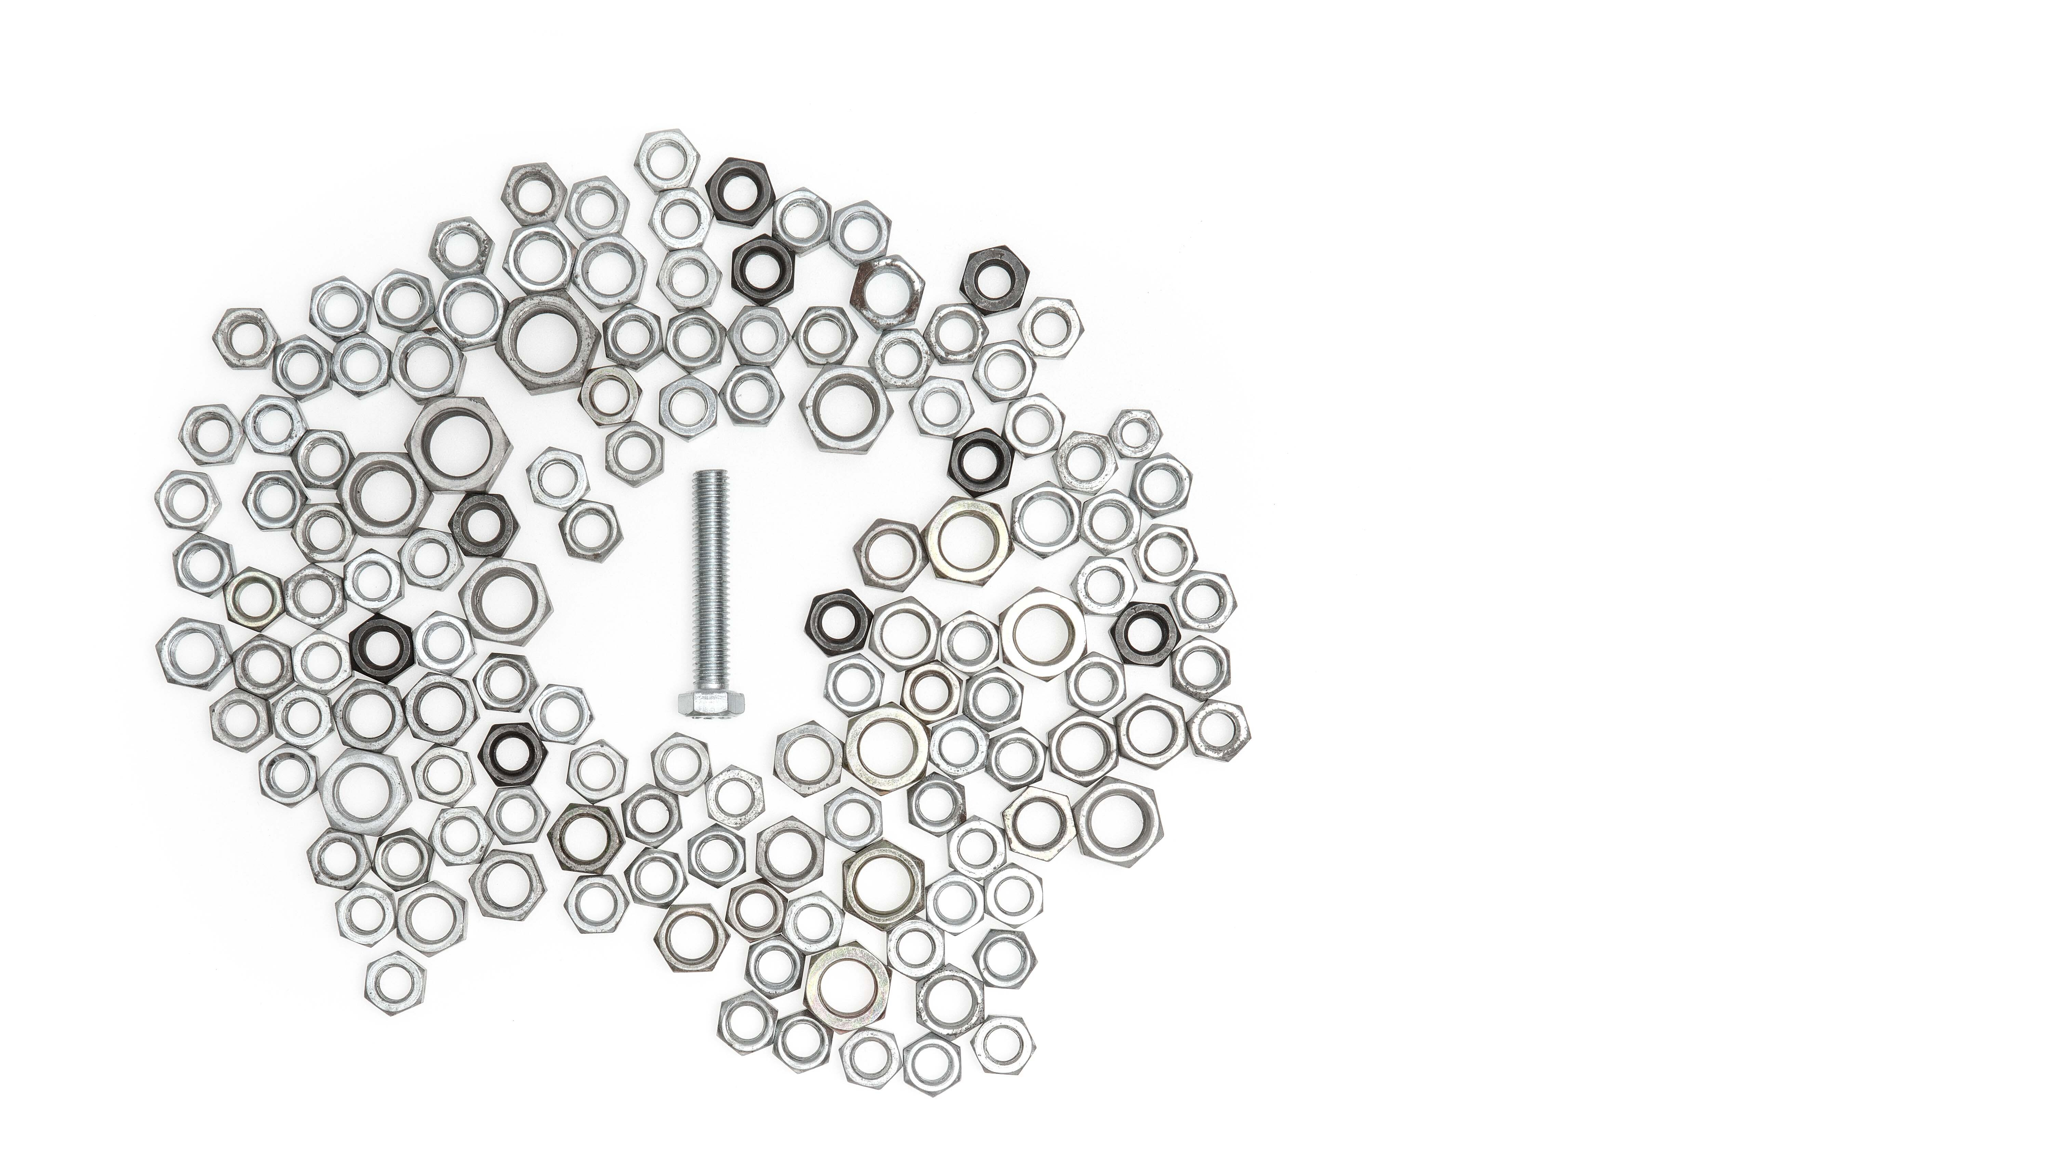
One size fits all
Notes:
1. The GDPR follows a "one size fits all" approach.
The same obligations apply to every controller. GAFA - Google, Amazon, Facebook and Apple - have to fulfil the same obligations as the bakery around the corner. The tax authority has the same obligations as the blogger, the hobby photographer and the sports club. The pharma industry has the same obligations as non-profit organisations.
The same obligations apply to every processing - regardless of whether money is earned with the processing or not, whether the processing is self-interested or serves the common good, whether private or public purposes are pursued, whether it is an everyday process or a complicated algorithm.
This "one size fits all" approach is far too undifferentiated.
And it is unfair:
It does not take into account the capabilities of controllers.
It does not take into account whether the processing itself is protected by fundamental rights.
And it is unnecessary:
It basically treats low-risk and high-risk data processing the same way.
Often the one size fits all approach has the effect of a sledgehammer to crack a nut.
1:44

Slide 7

Notes:
2. The GDPR follows an "all or nothing" approach.
If there is personal data, all rules of data protection law apply.
If there is no personal data, there is no regulation. That is very undifferentiated.
The GDPR more or less knows only two categories of personal data: personal data and sensible personal data.
That I wear glasses is a sensitive date, my credit card number is not.
That is pretty undifferentiated as well.
By extending the concept of personal reference (for example to IP addresses), personal data becomes boundless. There is almost no longer any non-personal data.
On the other hand, the GDPR does not cover if anonymous data are used to enable the re-identification of data subjects or to discriminate against certain groups of people.
1:06

Slide 8

Notes:
3. In the GDPR, the principle of prohibition applies. Processing personal data is generally prohibited unless there is a legal ground for permission:
This regulatory technique requires numerous exceptions. These are regularly the subject of disputes and legal uncertainty.
This regulation technique is, as a matter of fact, hostile to processing. Its basic idea is behaviour control: processing of personal data is somehow regarded as socially undesirable. The consequence is that even processing that is protected by fundamental rights and socially desirable is under constant pressure to justify itself.
The general suspicion against every controller has a symbolic effect that triggers "chilling effects". That means, citizens no longer make use of their fundamental rights, although they would be entitled to do so.
1:15

Slide 9

Chilling Effects
Notes:
Here is an extreme example. That‘s a Kindergarden in the German city of Dormagen. And this picture was part of the documentation the blond girl in the middle was given when she was leaving the Kindergarden.
In this case, technically, the Kindergarden was probably even right to do so. It was a public kindergarden. They did not have a legal ground for processing pictures. And, obviously, they spared the effort of obtaining and documenting consent from 38 parents.
The principle of prohibition inevitably leads to such aberrations, even if they were not intended.
The principle of prohibition also leads to the privatisation of the social.
And it leads to the juridification of the everyday.

Slide 10

Notes:
4. Data protection law is input-focused. It primarily regulates the collection of data and the storage of data.
Therefore, different protection needs of individuals are hardly taken into account.
The input orientation of data protection law prevents the urgently needed political debate on the question of which exact uses of data should be permissible.
We rarely discuss whether a specific data processing operation should be permitted or prohibited.
The input focus also prevents recognition of the output as valuable.

Slide 11

Benefits?
Notes:
5. Focusing on data collection (input) blinds us to the benefits of data processing (output).
The GDPR knows purposes of processing.
It knows interests – legitimate interests by private persons and public interests by authorities.
It knows risks.
And it knows harms.
But the GDPR does not know benefits of data processing. Benefit is not a legal category of data protection law. The term does not appear in the legal text. The GDPR is blind to the benefits of processing personal data.

Slide 12

Notes:
7. The fact that data processing can also have benefits is only recognised in a few recitals of the GDPR.
The focus is on the individual processing interest of the controller and the individual prevention interest of the data subject.
Of course, the public interest appears in the provisions, but in a very incoherent way.
And there is another problem. The public interest cannot be pursued just like that. If public bodies want to serve the public interest, there needs to be a specific law, usually a sector-specific law, that specifies under which conditions the public interest may be pursued.
And if private individuals want to process data in the public interest, it becomes even more difficult. Reporting a criminal offence is just provided for in the GDPR, but not data altruism and data donation. It is only foreseen that a private individual acts in his own interest or in the interest of a third party, but not in the public interest.

Slide 13

… hidden in the recitals
Rec. 4 (2) The right to the protection of personal data […] must be considered in relation to its function in society and be balanced against other fundamental rights, in accordance with the principle of proportionality.
Rec. 4 (1) The processing of personal data should be designed to serve mankind.

Slide 14
… hidden in the recitals
Rec. 4 (2) The right to the protection of personal data […] must be considered in relation to its function in society and be balanced against other fundamental rights, in accordance with the principle of proportionality.
Rec. 4 (2) The right to the protection of personal data […] must be considered in relation to its function in society and be balanced against other fundamental rights, in accordance with the principle of proportionality.

Slide 15
… hidden in the recitals
Rec. 53 (1) Special categories of personal data […] should be processed for health-related purposes only where necessary to achieve those purposes for the benefit of natural persons and society as a whole […]
Rec. 4 (2) The right to the protection of personal data […] must be considered in relation to its function in society and be balanced against other fundamental rights, in accordance with the principle of proportionality.

Slide 16
… hidden in the recitals
Rec. 113 (4) For scientific or historical research purposes or statistical purposes, the legitimate expectations of society for an increase of knowledge should be taken into consideration.
Rec. 4 (2) The right to the protection of personal data […] must be considered in relation to its function in society and be balanced against other fundamental rights, in accordance with the principle of proportionality.

Slide 17
… hidden in the recitals
Rec. 157 (1) By coupling information from registries, researchers can obtain new knowledge of great value with regard to widespread medical conditions such as […]
Rec. 4 (2) The right to the protection of personal data […] must be considered in relation to its function in society and be balanced against other fundamental rights, in accordance with the principle of proportionality.

Slide 18
… hidden in the recitals
Rec. 159 (2) For the purposes of this Regulation, the processing of personal data for scientific research purposes should be interpreted in a broad manner […].
Rec. 4 (2) The right to the protection of personal data […] must be considered in relation to its function in society and be balanced against other fundamental rights, in accordance with the principle of proportionality.

Slide 19
Notes:
Social function, legitimate social expectations, increase in knowledge, new findings, better research results, in the service of mankind - these are all fine words. However, they are also legal prose that can hardly be taken into account in the harsh reality of law.
There, the focus is on the individual processing interest of the controller and the individual prevention interest of the person affected.

Slide 20
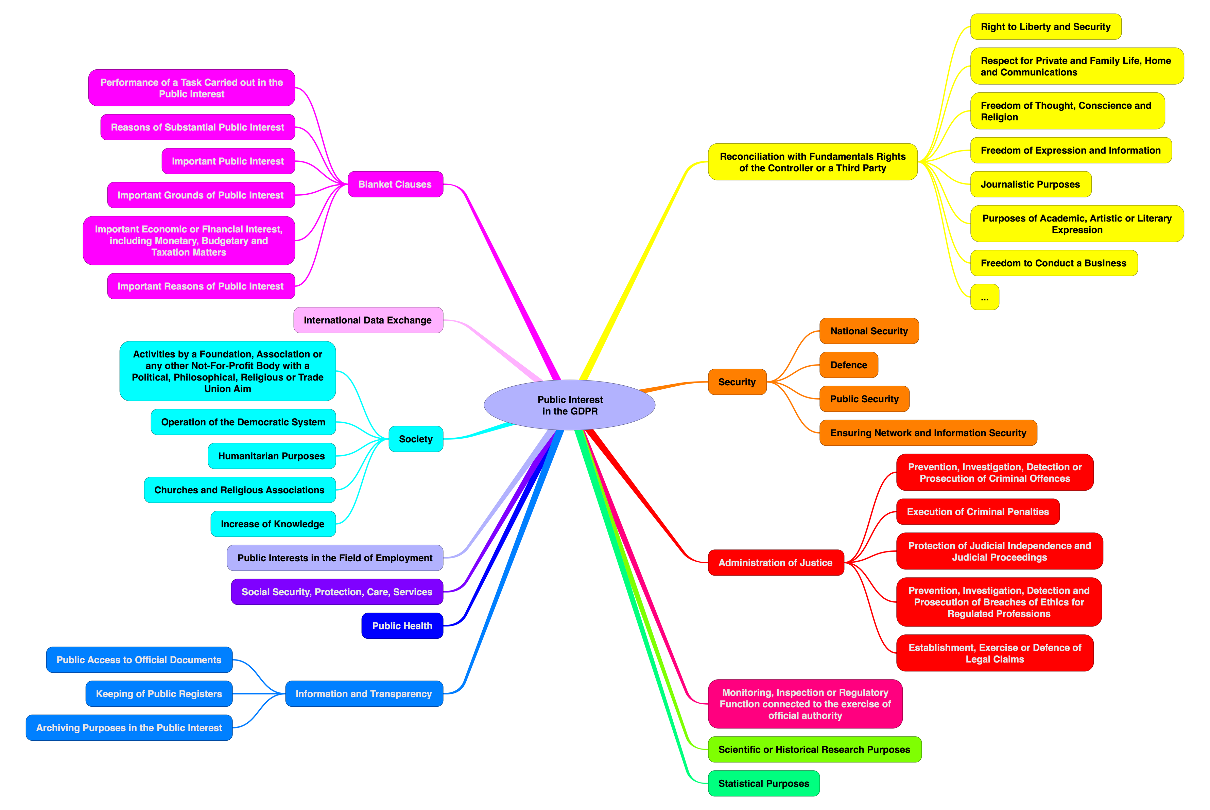

Slide 21

Notes:
Of course, the benefit of data processing appears in the form of public interest in the provisions, but in a very incoherent way.

Slide 22

Objects
Notes:
7 The GDPR is based on old-fashioned concepts that are no longer problem-adequate:
- The GDPR is linked to the processing of individual data.
- They are treated as if they were objects.
- They are treated as if they were a commodity to be kept in short supply.
This invites many misunderstandings:
Thus, all personal data appear to be equally worthy of protection.
And many think “their” data would “belong” to them.
This all fails to recognise the nature of data as information.

Slide 23

Information
Objects
Notes:
However:
Data are incorporeal.
Data are non-consumable.
Data can be reproduced at will.
And data are non-rival.
That means that they can be used by numerous persons at the same time.
The information content and the economic value are context-dependent.
The individual date is irrelevant for many data processing operations - such as big data, algorithms, and artificial intelligence.
Thus, it is not adequate that the GDPR concentrates on the single date.

Slide 24
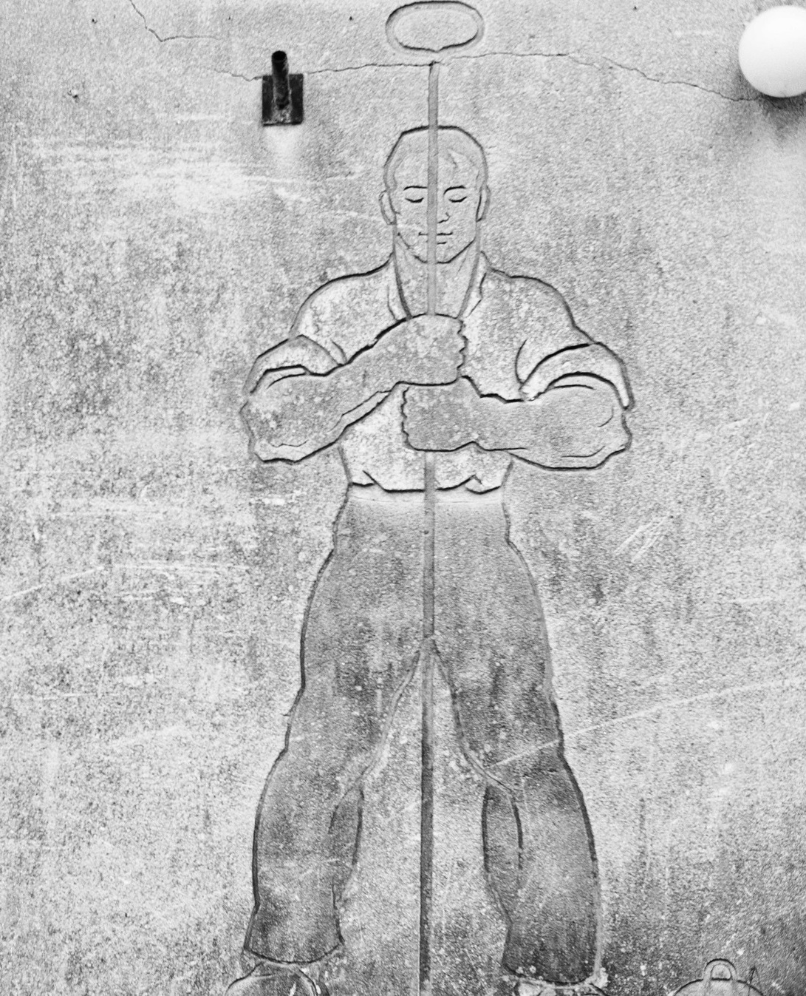
Controller
Notes:
8. The GPDR is linked to processing by a single controller.
The GDPR links to processing in a central, local processing facility.
This is not adequate for today’s data processing.

Slide 25

Complex Actor Networks
Controller
Notes:
Think of cloud computing, the Internet of Things, platforms, blockchain and other complex actor networks.
The legal institutions of the General Data Protection Regulation that regulate responsibilities when multiple actors are involved - processors and joint controllers - are insufficient.
This has become obsolete due to global networking. In many cases, data processing can no longer be attributed to a fixed physical resource.
The principle of purpose limitation excludes accidental discoveries in the field of science (e.g. the discovery of correlations).
The principle of data minimisation excludes a priori processing based on the retention of data that is in the public interest.

Slide 26
Right to data protection
Notes:
9

Slide 27
Right to data protection
Privacy

Slide 28
Right to data protection
Right to personality
Privacy

Slide 29
Right to data protection
Right to personality
Right to informational
self-determination
Privacy

Slide 30
Right to data protection
Right to personality
Right to informational
self-determination
Other rights
Privacy

Slide 31
Right to data protection
Right to personality
Right to informational
self-determination
Other rights
Informational
asymmetry
Privacy
All rights and freedoms
Notes:
1

Slide 32

82 Balancing Tests
Notes:
11. The GDPR contains 82 balancing tests. That means there are 82 provisions in the GDPR according to which every controller has to do a balancing of rights and interests. There are
- 3 fairness tests
- 8 balancing of interest tests
- 2 compatibility tests
- 11 suitability tests
- 30 necessity tests
- 12 appropriateness tests
- 3 proportionality tests
- 13 Risk assessments
The GDPR contains these obligations for every data-processing citizen - and not just for powerful companies and authorities.
In the absence of a precise definition of the protected good of the GDPR there is also a lack of clear standards for the various balancing tests.

Slide 33

Cascade
Of
Preventive Measures
Notes:
12. The basic assumption of the GDPR is that there is no longer any such thing as "trivial" data.
The law therefore never sees the processing of personal data as risk-free. It imposes obligations that must be fulfilled preventively, i.e. before any processing can begin. Controllers must
- determine the purpose of their processing
- define their interest,
- seek a legal basis for their actions,
- balance rights and interests,
- comply with transparency requirements,
- cite legal bases,
- provide information on legal remedies,
- comply with the requirements of written form
- comply with the obligation to state reasons
- meet the requirements of certainty,
- and document everything.
The GDPR has a largely preventive character. If you are a controller and you want to process personal data, there is not just one current legal obligation, but a cascade of 68 legal obligations in total.
It is a hypertrophy of obligations.
Keep in mind the less-is-more paradox: too many obligations lead to the erosion of the will to compliance.
In addition, many information, documentation and verification obligations cause bureaucratic costs for citizens, businesses and administrations that is hardly offset by any measurable benefit.
In summary, it can be said that the obligations of the GDPR probably represent an encroachment on private autonomy.

Slide 34

Informational Asymmetry
Notes:
12 It is true that the economic or social power of a private party can lead to threats to fundamental rights.
This is particularly debatable because of the information power of certain internet companies, but also of insurance companies, credit agencies, etc.
However, in the GDPR the existence of informational asymmetry is irrelevant. Market dominance, discrimination in mass transactions or the provision of public communication spaces do not create stricter rules for the controllers
The GDPR does not contain any regulations that are specifically linked to an imbalance of power between the controller and the data subject.
On the contrary: the GDPR even strengthens the large companies:
Established and large companies obtain consent more quickly and easily than newcomers and SMEs.
And they have the money and the manpower to fulfil the rather prescriptive obligations of the GDPR.

Slide 35

Legislative Tsunami
DGA
DMA
DSA
DA
AIA
EHDS

Slide 36
Does “one size fits all“ have a future?
AI systems (AIA)
IoT services and products (DA)
Exceptional need (DA)
Health data (EHDS)
High value data sets (HVD)
Users, consumers, traders, recipients (DSA)
Very large online platforms (DSA)
…
Re-use of public sector information (DGA)
Data Intermediation Services (DGA)
Data altruism (DGA)
Gatekeepers (DMA)
Intermediary Services (DSA)
Hosting Services (DSA)
Online Platforms (DSA)

Slide 37
„without prejudice to GDPR“
Gold Standard Paranoia
DA, AIA, EHDS shall “not affect“ the GDPR
DGA, PSI, DSA, DMA, DA, AIA are „without prejudice“ to GDPR
DA: In the event of conflict between provisions GDPR shall „prevail“
AIA, DA, ePrivacy, EHDS „complement“ the GDPR
EHDS „further develops“ the GDPR

Slide 38

Notes:
What can be done in the face of this unfortunate legal situation?
Well, the law is what it is.
A major data protection overhaul or reform, or even revolution, is unlikely. It is politically unenforceable. Unfortunately, it also fails because of the European Commission's monopoly on legislative initiatives.
Perhaps a creeping process of rethinking will begin.
At least we can currently see a move away from the one-size-fits-all solution. Rules that treat all data-related matters the same are definitely not sensible. Sector-specific regulations would be better. The EU data spaces point in this direction.
In the legal policy debate, I also observe a shift towards the benefits of data processing. Data trusts, data donation, data altruism are the keywords. These are all still tender shoots. But the opening clauses of the GDPR allow for the enactment of sector-specific regulations.
Data use regulations could be enacted.
Data use in the public interest could be privileged.
Benefit could be introduced as a category of data protection.
The GDPR can also be interpreted differently.
Perhaps it will be possible to see data protection law not only as a right to prevent, but to transform it into a right to enable. It is to be hoped.

