Slide 1
Geographical Indications Protection in UK
Implications Post-Brexit
Sanaz Javadi
Consultant to International Organizations/EUIPO
Geneva,Switzerland

Slide 2
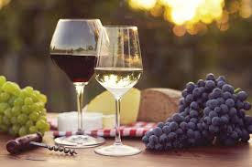
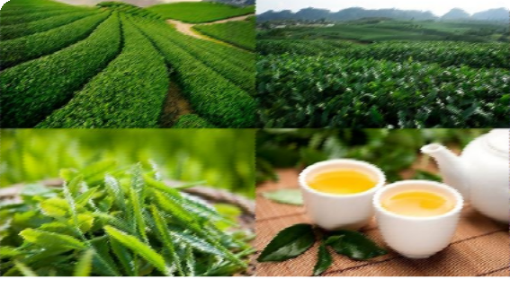
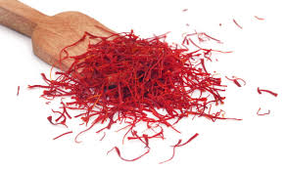
What is a GI
(Geographical Indications) ?
PRODUCTION AREA
(indigenous varieties, influence of the environment/climate on the product development)
PRODUCERS' KNOW-HOW
(selection techniques, traditional production methods, connection to the local wisdom and heritage).
An origin-linked product with a name,quality, specification and reputation associated to its place of origin

Slide 3
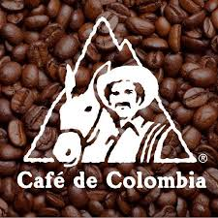

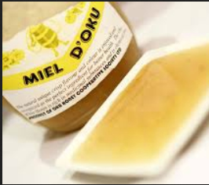

Some World-Renowned GIs
Café de Colombia Ceylon tea (Sri Lanka)
Oku white honey (Cameroon) Darjeeling Tea (India)

Slide 4
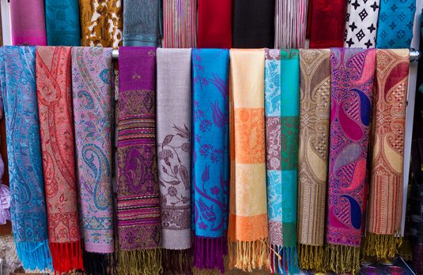

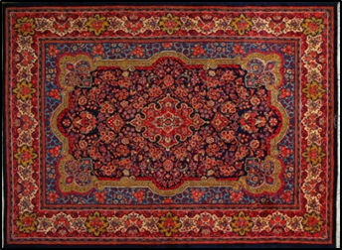

Not only agrifood products
Kashmir Pashmina (India) Bohemia Crystal and Glassware (Czech Republic)
Handmade Carpet(Iran) Thai Silk

Slide 5


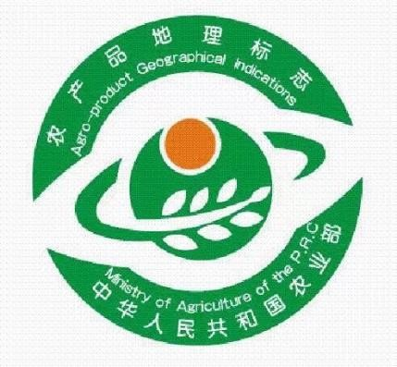


GI : A flagship for the Promotion of National Products
National GI Labels
Cambodia
Lao PDR
China
European Union

Slide 6
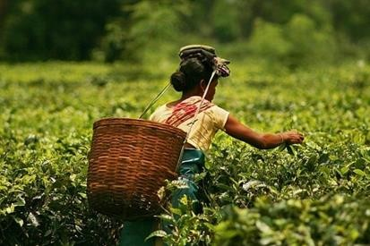
Geographical Indications
A Flagship for Local Communities Development
Link a product to a particular region: agriculture,handicrafts
Indicate qualities, attributes, reputation associated with geographic origin
Suggest connection to region’s inherent characteristics (e.g., soil, climate,
people)
May also imply production skills/processes/traditional knowledge associated
with region (GI relation with traditional knowledge)
Permanently Protectable
Major component of quality management and access to niche markets

Slide 7
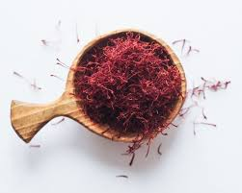
Why GIs matter
  contribute to a reorientation towards quality as opposed to quantity;
  provide producers with a higher income in return from genuine efforts to improve quality;
  provide consumers with high quality products with the guarantee of their mode of production and origin: food safety/Organic products
  Direct and indirect benefits linked to the GI for the development of the localities and national and international reputation

Slide 8
        Why do GIs matter?
  Allow for a better redistribution of the added value in the production chain esp. to main producers; boost agri-food local supply chain
  Prevent migration to urban areas
  Add value to the land of origin;
  Encourage diversification in production, thus preserving the biodiversity, local traditional knowledge and natural resources;
  Have a positive impact on rural/tourism development
GI protection guarantees a product’s characteristics or reputation,
authenticity and origin.
It protects the product name from misuse or imitation.

Slide 9
Sustainable Advantages for
Local Producers / Local Communities
Economic Sustainability: rise in the production and higher prices spill over effects to other products/sectors
Social Sustainability: social inclusion and reduce barriers to women entrepreneurship in rural areas
Environmental Sustainability and Food Security : sustainable production/sustainable agriculture

Slide 10
Based on TRIPS Agreement
Articles 22,23,24
Exceptions:
When a name has become the common (or “generic”) term (for example, “cheddar” now refers to a particular type of cheese not necessarily made in Cheddar, in the UK), and
When a term has already been registered as a trademark
In the UK 88 products with GIs, these include food products, wine, beers, ciders, spirit drinks and wool.
Scotch lamb, Scotch beef, Welsh(Beef & Lamb), Cornish sardines, English Wine, Welsh Wine
Scotch whisky, Dorset Blue cheese or Traditional Cumberland sausages, Herefordshire cider Cornish sardines

Slide 11
Relevant treaties administered by WIPO
Paris Convention
Madrid Agreement for the Repression of False or Deceptive Indications of Source on Goods
Lisbon Agreement(Geneva Act)
Madrid Agreement
Protocol Relating to the Madrid Agreement
Source:WIPO

Slide 12
Geographical Indications and Trademarks
GIs are closely related to trademarks; both indicate product origin
GIs and trademarks differ in two ways:
  A trademark belongs to a particular company; it distinguishes that company’s products. GIs are shared by all producers in the region identified by the GI.
  Because of its link with the place of origin, a GI can’t be assigned or licensed to someone outside that place or who don’t belong to the group of authorised producers

Slide 13
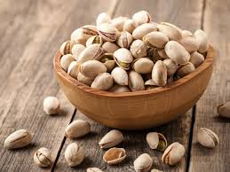

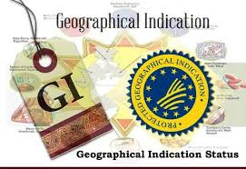
Territorial nature of GIs
GI protection is territorial
International measures:
  Bilateral Agreements
  Multilateral Agreements (Paris, Madrid ,Lisbon)
  National UK Scheme 2021
  Regional Application Mechanism: EU

Slide 14
How are GIs protected?
In accordance with international treaties and national laws under a wide range of concepts:
  special laws for the protection of geographical indications or appellations of origin(sui generis system)
  trademark laws in the form of collective marks or certification marks
  laws against unfair competition
  consumer protection laws
  Specific rules of GI associations/organizations

Slide 15
Benefits of GI protection
Economics
production, price, localization
link to tourism
Structure of the sector
Employment
Direct & indirect
employment
Job qualification
Rural Development
Benefits of GI protection
Environment
Environment preservation
Quality improvement
Book of Specification
Culture Preservation of traditional know- how

Slide 16
5 Pillars of GI registration
"GI ORGANIZATION",
an inter-professional organization bring together producers, operators and traders of GI Product
BOOK of SPECIFICATION
describe the good and the production methods. The GI name shall be used only for goods produced in compliance with these specifications
DELIMITATION
of the production area. The GI name shall be used
only by producers and operators within the delimated area
GI
PRODUCT
PROVEN LINK
between the specificity of the good and its origin, based on natural, geographical, historical or human factors.
CONTROL and TRACEABILITY
system
guarantee that all the goods sold with the GI names have been produced within the delimited area and according to the Book of Specifications

Slide 17
The Main Content of Code of Practice
CoP
FAO Definition: The code of practice (CoP) is a document establishing the
rules for the use of a geographical indication (GI).
Its elaboration is a very important step, leading to the voluntary “standard” or specifications with which local producers who want to use the GI have to comply.
Description of the product
Ingredients and raw materials
Definition of the process
Demonstration of the specific quality linked to geographical origin
Definition of the production area
Name(s) of the product and labelling rules
Control plan - verification system

Slide 18
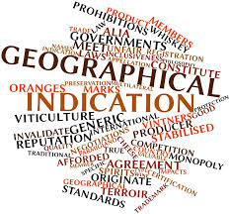
Components for GI success
Government/Private Sector Role
Strong organizational and institutional structures
Training /awareness of local producers
Active participation among the producers and enterprises in GI region
Strong market partners
Effective legal protection(Government role)

Slide 19
1 January 2021, the UK GI scheme
Managed by the Department for Environment, Food and Rural Affairs (DEFRA)
The scheme open to producers from the UK and other countries
The scheme adhere to (WTO) obligations
Protect registered product names sold in Great Britain (GB) (England, Scotland and Wales).

Slide 20
On the expiry of the transition period, the EU GI scheme ceased to have effect in England, Scotland and Wales from 2021 .
At present, no significant differences between the UK and EU GI schemes (other than the territories which they protect).
Four separate GI schemes for; agri-food products, wines, aromatised wines and spirit drinks.
The EU GI schemes protect registered products names when they are sold in
Northern Ireland (NI) and the EU.

Slide 21
The new UK schemes use these designations:
Protected Designation of Origin (PDO)
Protected Geographical Indication (PGI)
Traditional Specialty Guaranteed (TSG)
All existing UK products registered under the EU’s GI schemes by the
end of the transition period will remain protected under the UK GI schemes.
Registered GIs that can be produced anywhere on the island of Ireland,
will continue to be fully protected in the UK and the EU. These include:
Irish Whiskey
Irish Cream
Irish Poteen

Slide 22
DEFRA Guidance on UK GI schemes
The guidance explains how the UK trade marks system will interact with GI protection in the UK after 1 January 2021.
Separate information on the priority between trade marks and GIs for rights filed within 9 months of the transition period can be found in the trade mark business guidance.

Slide 23
Guidance on UK GI schemes
Product names on the UK GI scheme registers
Other protected products: United States of America (USA) wines and spirit drinks
Apply for UK GI scheme protection of a new product name
Use a UK GI scheme registered product name
Change a product specification on the UK GI scheme registers
Cancel a product name from the UK GI scheme registers
UK GI schemes consultations, decisions and appeals
UK GI schemes logos and product labelling

Slide 24

Three UK GI logos to mark the UK designations
Producers and retailers of existing GI products will have until 1 January 2024 to make changes to incorporate the new UK GI logos on all packaging and marketing materials.

Slide 25
What will happen to outstanding applications for EU GIs at the end of the transition period?
The EU GI application will continue to progress and, if granted, will apply to EU member states and Northern Ireland. The applicant will be required to apply separately to DEFRA for protection in England, Scotland and Wales.

Slide 26
Who can apply to have registered a UK GI from 1 January 2021?
Any entity is entitled to make an application for a UK GI, however, applicants which are not based in England, Wales, Scotland or Northern Ireland will be required to have a registered GI under the scheme which governs their home nation, prior to making an application to DEFRA for a UK right.

Slide 27
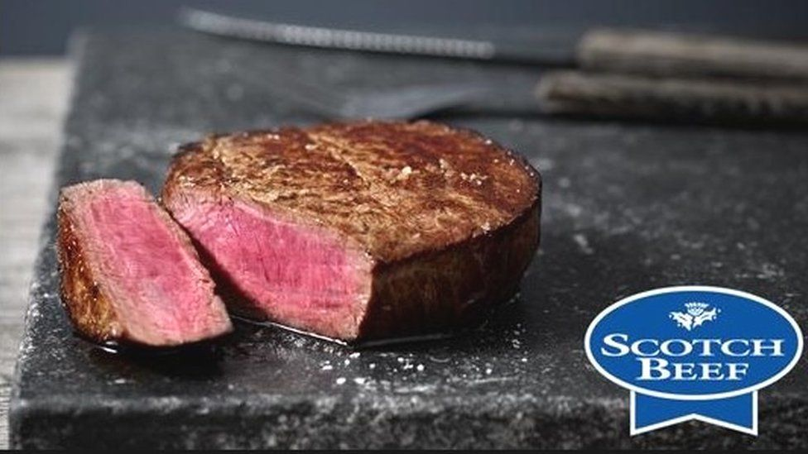
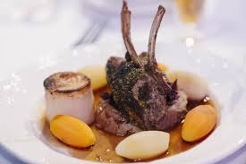
Free Trade Agreement UK-Japan
New protection in Japan for UK goods – increasing the number of GIs from just seven under the terms of the EU-Japan deal to potentially over 70
Goods covered:
Yorkshire Wensleydale, Scottish salmon, beef and lamb
and Welsh lamb, Conwy mussels and Anglesey sea salt.

Slide 28
The UK-EU Trade and Cooperation Agreement
Provisionally applicable since 1 January 2021, after having been agreed by EU and UK negotiators on 24 December 2020.
Covering IP aspects including GIs.
GI protection will continue after 1 January 2021 for products currently named in:
EU free trade agreements where the UK has signed a continuity agreement, for example
the Andean Community, Chile and Switzerland
Other EU third country sectorial agreements where the UK has signed a continuity agreement

Slide 29

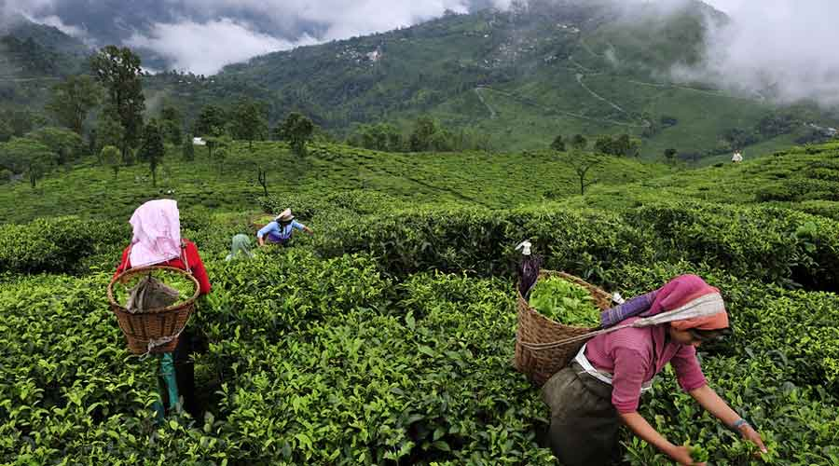
Darjeeling tea, a well-known flavour and quality
Plantation goes back to 1830’s
Statutorily controlled by the Government as part of the Tea industry from 1933 under various enactments (Tea Act, 1953)
The Tea Board is vested with the authority to administer all stages of tea cultivation, processing & sale through various orders
Cultivated currently in 87 designated gardens in the hills of Darjeeling district

Slide 30


Unique and complex combination of agro-climatic conditions:
The quality, flavour, reputation and characteristics of the tea is essentially attributable to its geographical origin and cannot be replicated elsewhere.
Source:WIPO

Slide 31
Actions Undertaken by the Tea board
Legal – establishment of statutory to protect Darjeeling in case of misuse/ abuse/ infringements
Administrative – Establishment of mechanism to protect supply chain integrity to determine the authenticity of teas sold as Darjeeling
1986 – The DARJEELING Logo created and registered in UK, USA, Canada, Japan, Egypt and under the Madrid Agreement covering Germany, Austria, Spain, France, Portugal, Italy, Switzerland
Darjeeling Certified Trademark Protection Scheme 2004 – DARJEELING TEA registered as Geographical Indication

Slide 32
Marks opposed:
include DIVINE DARJEELING, DARJEELING, DARJEELING NOVEAU, - relating to diverse goods and services such as clothing, lingerie, telecommunication and internet services, coffee, cocoa etc. Use by BVLGARI, Switzerland of the legend “Darjeeling Tea fragrance for men” agreed to be withdrawn pursuant to legal notice and negotiations

Slide 33
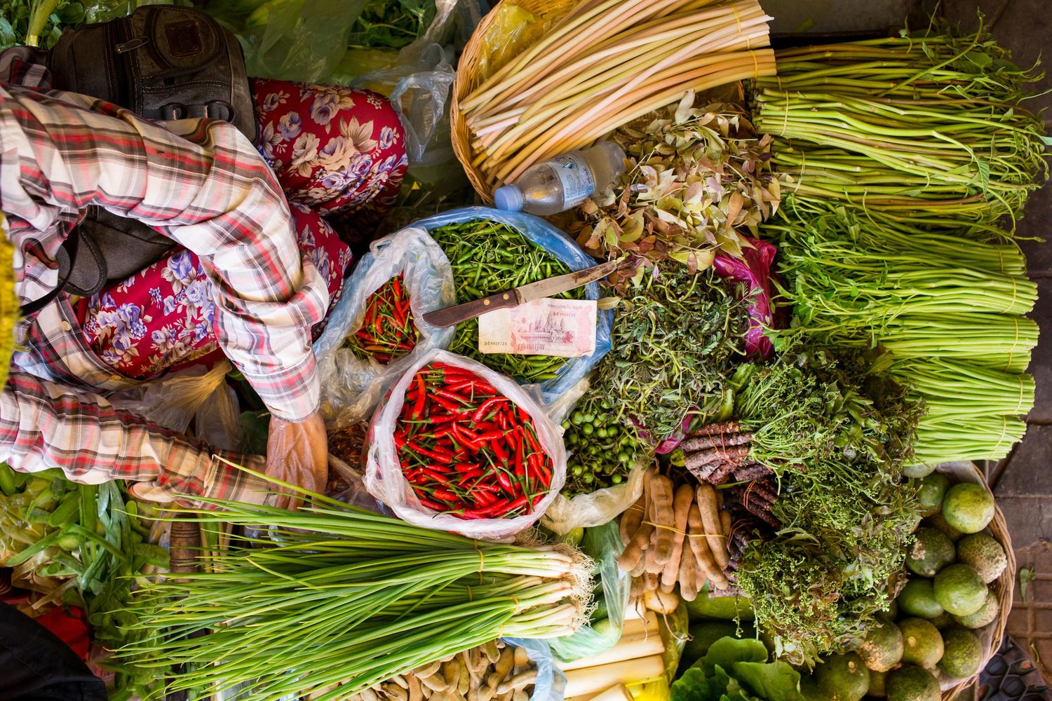
One Village One Product (OVOP) Program 2006
Promote Rural Economic Growth
Improving the living standard of the people through improvement of local products
Preventing urban job hunting and produce products with export potentials

Slide 34



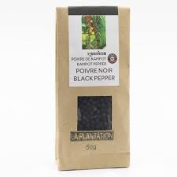
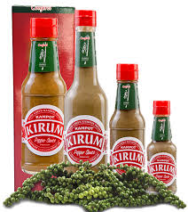
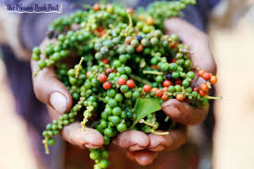
A Decade of GI Status
Kampot Pepper Cambodia
The crop currently covers a cultivation area exclusively in Kampot and Kep provinces.
Registered with Kampong Speu palm sugar by the Ministry of Commerce
April 2010 , first GI product in the country
Recognised as a GI product by WTO in 2010.
Registered in Vietnam and Thailand in 2016 & 2017
Registered as GI in Europe in 2016
Green,Red,Black ,white pepper

Slide 35
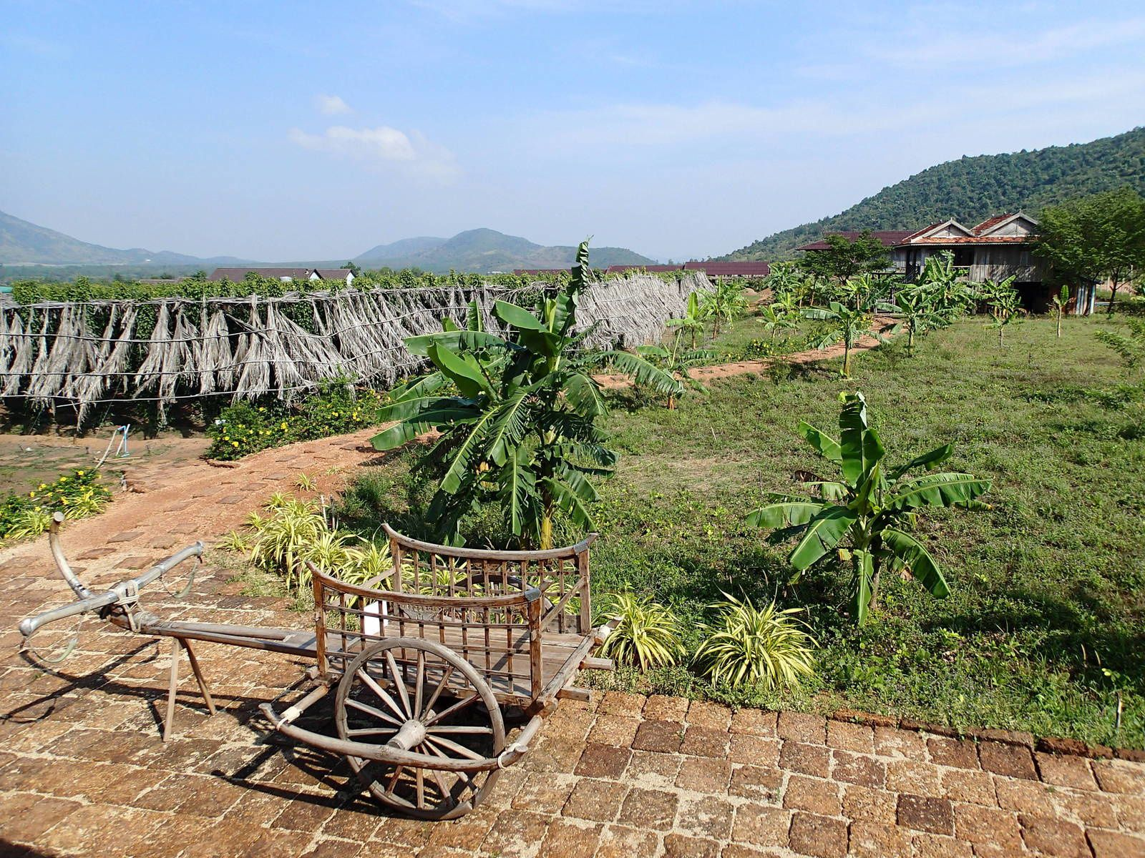
Positive Aspects of GI in the Region
Income Increase of small
scale farmers
70% export
30% Local use/tourists
Created more jobs
plantation
Packaging ,hospitality, tourism ,etc.
Sustainable agriculture
production Promoted
Increased recognition of
GI by consumers

Slide 36
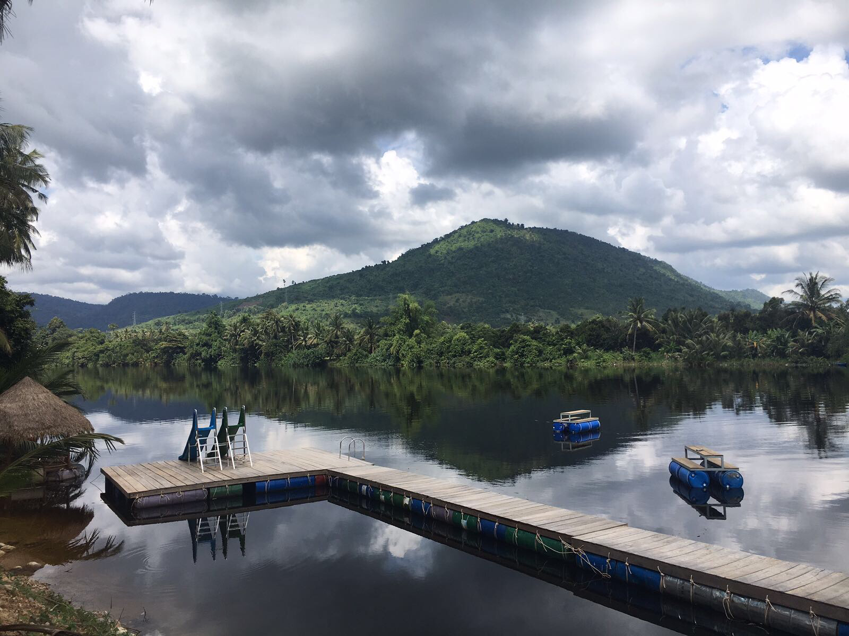
Between mountain and sea, Kampot province is renowned for the quality of its fruits , sea salt and pepper
The special climate and soil type of Kampot & the experience from several generations of pepper farmers make this pepper unique and very sought-for by gourmets worldwide.
Tourism discoveries in the region; la Plantation discovering tour ,Cooking
Class ,Caving, Climbing

Slide 37
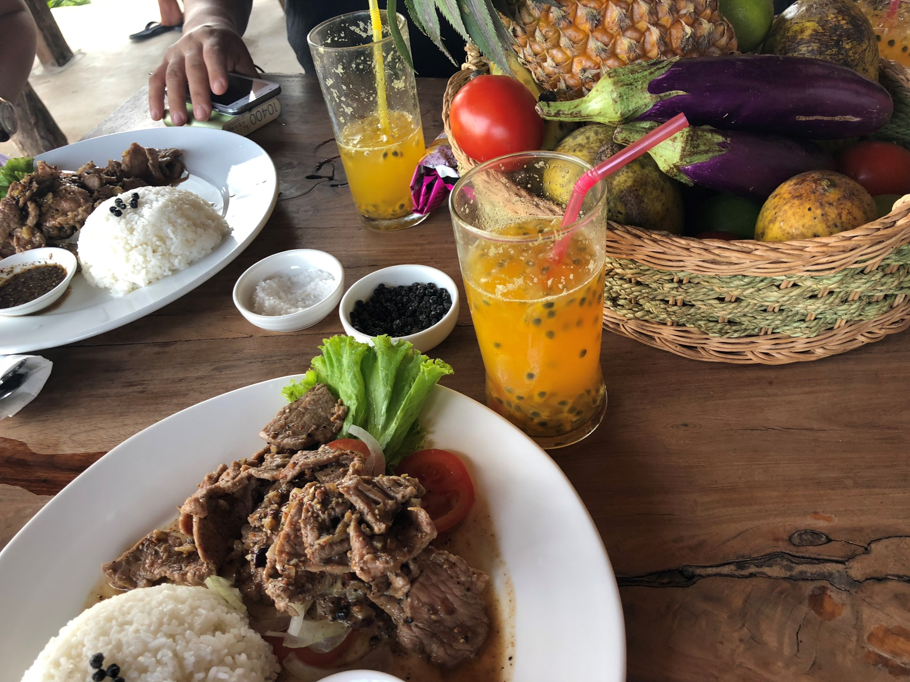
Promotion of Sustainable Gastronomy Tourism
Renewed interest in and nostalgia for culinary heritage
Kampot pepper nowadays described as a pepper of the finest quality, in many tourism and culinary related guides, e.g.: “Lonely Planet Cambodia” (by Lonely Planet, Nick Ray, Greg Bloom. 2014), “Gordon’s Great Escape Southeast Asia” etc.
Protect and sustain the local food as a part of traditional life and culture, through GIs.

Slide 38

Café de Colombia: Protecting and promoting a well-known origin
Today Colombia is one of the most well-known origins for coffee. It wasn’t always this way…
During the late 50’s the price of Colombian coffee was so low to an excessive supply of coffee in the world market.
Only 4% of consumers recognized Colombia as a coffee origin.
Roasters dominated the market and they tended to hide origin in order to gain more flexibility in blends.

Slide 39
National Federation of Coffee Growers of Colombia (FNC)
Started registration of certification marks which was difficult
and expensive.
Needed an alternative that would help us defend
and protect the Colombian origin

Slide 40
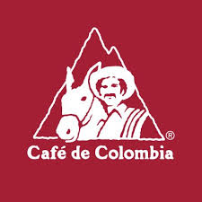
In December 2004, the FNC presented the Colombian government with
an application for the recognition of “Café de Colombia” as a Geographical
Indication.
In February 2005, the Colombian government ratified Café de Colombia as a “G.I.”
In June 2005, “Café de Colombia” became the first product from a non-EU nation to apply for the Protected Geographical Indication recognition to the EU.

Slide 41
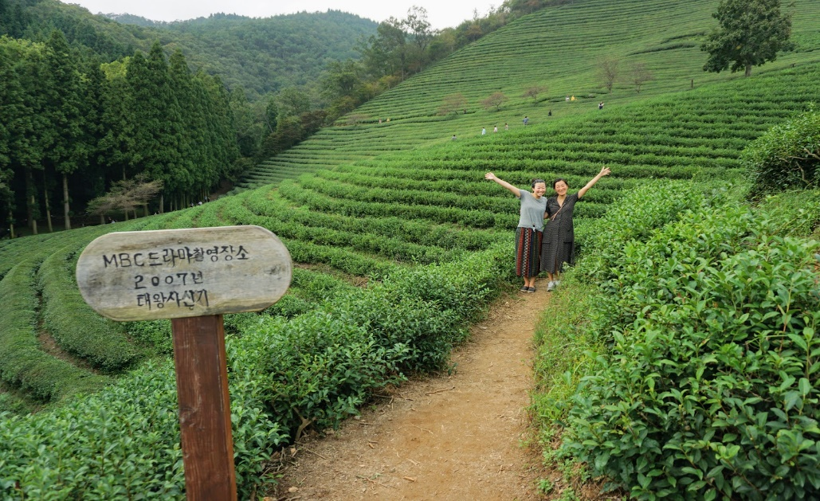
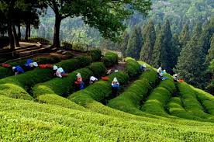
Boseong County
Largest Tea Plantation and the only tea tourist farm in South Korea
Agricultural Product Quality Control Act of 1999
‘Boseong’ green tea the first product officially registered as a geographical
indication in South Korea in 2002,also as a certification mark
A remarkable success story

Slide 42
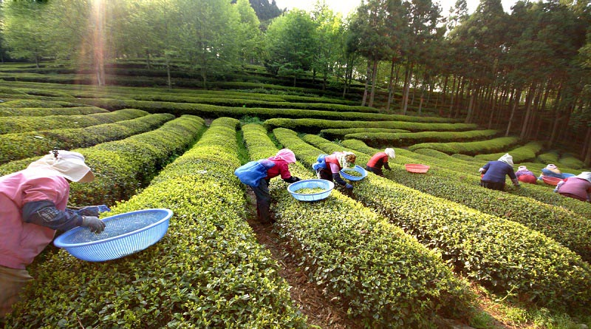
Geographical Indications an efficient method for place marketing in South Korea
Tourism linked to green tea one of the largest sources of income for the country
Green Tea Festival & Light Festival
Every May in Boseong Tea Plantation
Representative tea culture festival in Korea.
Green tea
the jewel of
Boseong culture

Slide 43
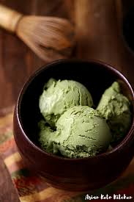
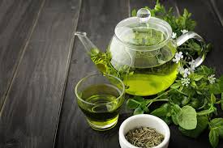
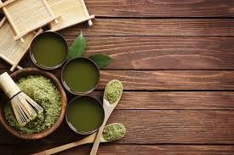

Green Tea Promotion Strategy
Promoted the product image, Doubled production and increased tea prices with 90%, the number of tourists to the Boseong region tripled
GI positive impacts on :
Primary (cultivation)
Secondary (processing) and
Tertiary industries in Boseong (tourism: green tea festival, the green tea resort town and train tours, tea museum
Diversification of the products: Cosmetics & medicinal products

Slide 44
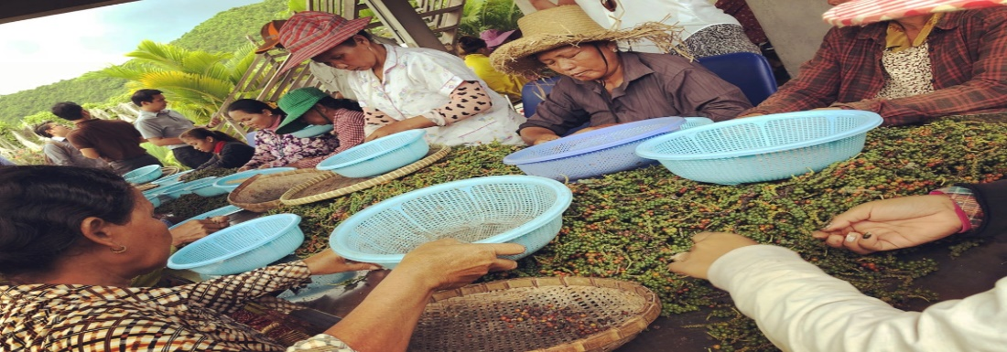
Challenges:
Oversupply of the crop in spite of stable market demand
Counterfeiting brands
Climate Change negative impact on characteristic of the products
Outbreak of Covid-19.
Continued mechanization and automation negative impact on local employment opportunities
and product quality
Investment decisions by local producers determined by a global-market trend
Relative lack of bargaining power of small scale producers

Slide 45
Few Observations
Geographical Indication major role
not only for product marketing but also for place
marketing.
Establishment of a UK system for non-agricultural GIs, handcrafts “Artistic and Traditional Crafts with prior assessment of the impact of protection on job creation and employment and export volume
Would empower the business competitiveness of UK producers and
SMEs through GI system and
Help the UK in bilateral negotiations with countries seeking protection for their non-agricultural GIs in the UK market

Slide 46
Thank you
Sanaz Javadi Farahzadi
Intellectual Property/trade Lawyer
Advisor to International
Organizations /EU
Sanaz.javadifarahzadi@unifr.ch
Resources,WIPO,FAO,EUIPO,EC,UK Gov

