Slide 1

“The ‘work’ in United Kingdom copyright law (post Brexit)”
Professor Jonathan Griffiths
Department of Law, Queen Mary, University of London
University of Cambridge, Faculty of Law, CIPIL Seminars, 21st November 2024

Slide 2
“The ‘work’ in United Kingdom copyright law (post Brexit)” – Structure of my presentation
“Dematerialization, pragmatism and the European copyright revolution” (2013) OJLS 767-790 – outline and context
“Dematerialisation” in UK copyright law - 2013-24?
  Originality, protected forms, fixation, authorship, infringement
Current situation - potential problems and solutions

Slide 3
“Dematerialization, pragmatism and the European copyright revolution” (2013) OJLS 767-790 - Argument
Over a long period, UK copyright law had come to be organized around the idea of an “immaterial essence” – “labour and skill”, “expression”, “work” and/or latterly, “creativity”
A touchstone for resolving questions relating to subsistence, authorship and infringement (see over)
Claim for copyright infringement a trespass-like cause of action – a quasi-scientific enquiry

Slide 4
“Dematerialization, pragmatism and the European copyright revolution” (2013) OJLS 767-790 - Argument
“ ... [The CDPA 1988] protects an original artistic work and says that there may be infringement by the copying or other taking of the work 'as a whole or any substantial part of it'. If it is borne in mind that the author's original work is not a drawing, sculpture or other artefact, but the mental skill and labour embodied therein, it is not difficult to work out that something will be an infringement of the copyright reproduces a substantial part of the author's said mental skill and labour.”
(Laddie, Prescott & Vitoria, 4th ed (2011)[my italics])

Slide 5
“Dematerialization, pragmatism and the European copyright revolution” (2013) OJLS 767-790 - Argument
Function of this abstract property model
No space for considerations of policy / proportionality (only in relation to exceptions/limitations)
Role of European harmonisation in accelerating dematerialisation process – (C-5/08) Infopaq
(Remaining tension with “material” aspects of the “work” – closed list, infringement cases in which courts rejected the “millefeuille” argument)

Slide 6
“Dematerialization, pragmatism and the European copyright revolution” (2013) OJLS 767-790 - Context
YH Lee, “The persistence of the text: the concept of the work in copyright law” [2018] IPQ 22-44, 107-139
Scholarship on abstract property in IP – eg Peukert (critique of “abstract IP object”), Bracha (critique of IP “physicalism”)
Challenging definitions, normative position

Slide 7
“Dematerialisation” process in UK copyright law
1 Identifying protected form as an intangible abstraction (independent/regardless of the tangible/material boundaries in which form is embodied/instantiated)
2 Assessing infringement as a quasi-scientific enquiry to determine whether protected form reproduced by the defendant
3 Excluding alternative rationales/factors
Normative perspective - process is problematic because it reduces the possibility of imposing reasonable boundaries on the cause of action (and thus potentially maximises protection)

Slide 8
UK Copyright Law 2013-24
1st January 2013 to 23rd June 2016 – Beginning of period under review until the Brexit referendum
24th June 2016 to 31st December 2020 – Referendum until the end of the transition period
1st January 2021 to 31st December 2023 – End of the transition period until the coming into force of the Retained EU Law (Revocation & Reform) Act 2024
2024 onwards – Retained EU Law (Revocation & Reform) Act 2023
24 onwards

Slide 9
Originality
A prerequisite for the protection of literary, dramatic, musical and artistic works (CDPA, s 1)
(C-5/08) Infopaq standard – “author’s own intellectual creation”/”creativity”
Diversity of usage [until recently] dispelled by reiteration of “creativity” as the relevant touchstone – THJ Systems Ltd v Sheridan [2023] EWCA Civ 1354
Application of the concept of creativity as a threshold – “free and creative choices” indicating “personal touch”

Slide 10

Lidl Great Britain Ltd v Tesco Stores Ltd [2023] EWHC 873 (Ch); [2024] EWCA Civ 262

Slide 11
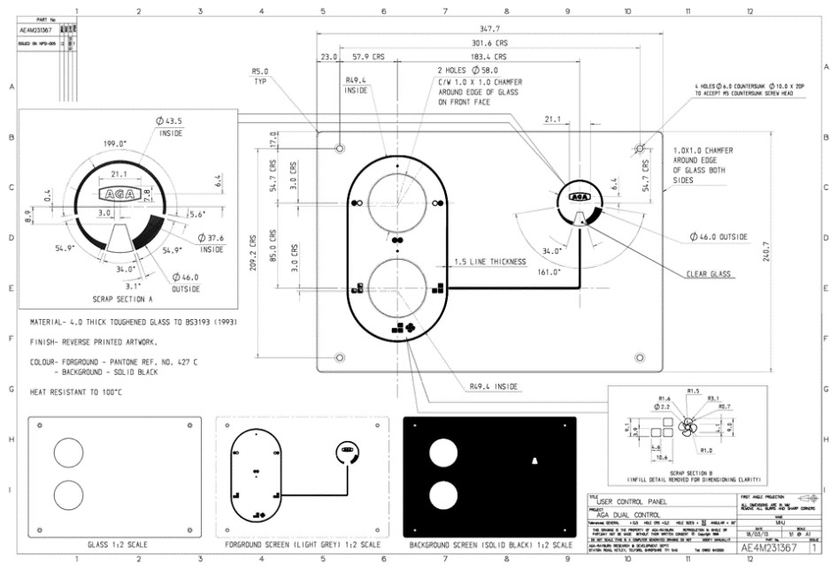
AGA Rangemaster Group Ltd v UK Innovations Group Ltd [2024] EWHC 1727 (IPEC)

Slide 12
Subject-matter – the “closed list”
“Copyright is a property right which subsists… in the following descriptions of work:
(a) original literary, dramatic, musical or artistic works;
(b) sound recordings, film or broadcasts, and
(c) the typographical arrangement of published editions.” (CDPA 1988 (s 1(1))
Threatened by harmonization? – see, SAS Institute Inc v World Programming Ltd [2013] EWHC 69 (Ch) [27]; Response Clothing Ltd v The Edinburgh Woollen Mill Ltd [2020] EWHC 148 (IPEC) [52]-[64]; Shazam v Only Fools the Dining Experience [2022] EWHC 1379 (IPEC); Waterrower (UK) Ltd v Liking Ltd [2022] EWHC 2084 (IPEC) [58]-[64].

Slide 13
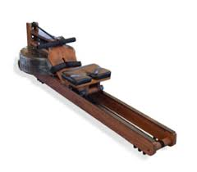
Subject-matter (2)
Retained EU Law (Revocation & Reform) Act 2023
Waterrower (UK) Ltd v Liking Ltd (t/a Topiom) [2024] EWHC 2806 (IPEC)

Slide 14
Subject-matter (2)
Protection within subject-matter categories:
  Shazam Productions Ltd v Only Fools the Dining Experience Ltd [2022] EWHC 1379 (characters)
  Wright v BTC Core [2023] EWHC 222 (Ch); [2023] EWCA Civ 868 (file format)
  Banner Universal Motion Pictures Ltd v Endemol Shine Group Ltd [2017] EWHC 2600 (Ch) (game show format)

Slide 15
Fixation
Wright v BTC Core [2023] EWCA Civ 868:
  “…[T]he judge’s statement that ‘no relevant “work” has been identified containing content which defines the structure of the Bitcoin File Format’ confuses the work and the fixation.” [68]
  “Copyright in a literary work protects the work as an intangible abstraction, not the particular tangible medium in which that work may happen to have been fixed. It is not necessary for the copyright owner to prove that the fixation relied upon for the purposes of subsistence has been copied, only to prove that the work has been copied” [74]

Slide 16

Authorship

Slide 17
Authorship
Joint authorship - Kogan v Martin [2019] EWCA Civ 1645 (Floyd LJ)
  “It is the skill and effort involved in creating, selecting or gathering together the detailed concepts or emotions which the words have fixed in writing which is protected in the case of a literary or dramatic work, whether the work is one of sole or joint authorship. Too much focus on who pushed the pen is likely to detract attention from what it is that is protected, and thus from who the authors are.” [41]

Slide 18
Authorship
Joint authorship - Kogan v Martin [2019] EWCA Civ 1645 (Floyd LJ):
  “The question of what is enough of a contribution is to be judged by the Infopaq test, i.e. whether the putative joint author has contributed elements which expressed that person’s own intellectual creation. The essence of that term is that the person in question must have exercised free and expressive choices. The more restrictive the choices the less likely it will be that they satisfy the test.” [53]

Slide 19
Infringement
England & Wales Cricket Board Ltd v Tixdaq Ltd [2016] EWHC 575
Exact reproduction required where creativity low - Lidl Great Britain Ltd v Tesco Stores Ltd [2023] EWHC 873 (Ch), [2024] EWCA Civ 262; THJ Systems Ltd v Sheridan [2023] EWCA Civ 1354
Pasternak v Prescott [2022] EWHC 2695
Evans v John Lewis plc [2023] EWHC 766

Slide 20

Pasternak v Prescott [2022] EWHC 2695

Slide 21
Pasternak v Prescott [2022] EWHC 2695
“[229]. In summary…, my overall conclusions in relation to chapter 5 of Lara are as follows:
1. The selection of the specified Events in chapter 5 of Lara, as set out in Annex 2, is protected by copyright as a substantial part of the literary work that is Lara. The same is true of the selection of these Events which is alleged to have been copied……”
(per Edwin Johnson J)

Slide 22
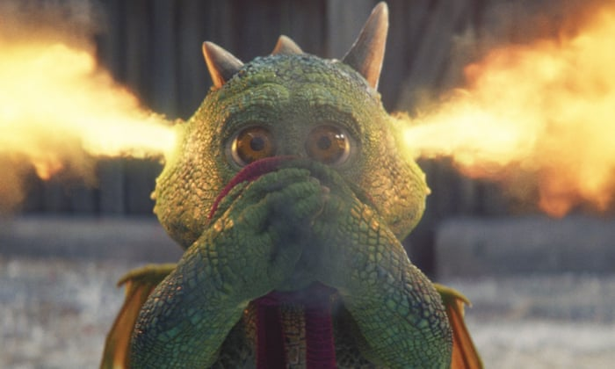
Evans v John Lewis plc [2023] EWHC 766

Slide 23
Evans v John Lewis plc [2023] EWHC 766
“[92] Accordingly, although I am satisfied that the choice of Fred’s size is protected by copyright, I am not satisfied that there is a sufficient similarity in the size chosen for the TV Dragon and Edgar such as to raise a presumption of copying.”
(Per HHJ Melissa Clarke)

Slide 24
Conclusion – potential problems?
Does “originality”, as currently defined, provide a useful threshold?
Protection of creativity divorced from a work’s recorded form – character, format, for example. Boundaries?
Authorship – recognition of minor contributions (joint authorship, derivative authorship?)
Infringement – identification of “elements of creativity” potentially oppressive and wasteful

Slide 25
Conclusion – potential solutions?
More policy and less “science”?
Originality – return of “labour”?
Re-confirmation of the “closed-list”
Authorship – rejection of minor contributions?
Infringement – the return of the “substantial part”? Need for a rough filter / sense of proportion

