Slide 1
Rethinking International Intellectual Property through the Third World Approaches to International Law
CIPIL Evening Seminar Faculty of Law, University of Cambridge
14 November 2024
Dr. Pratyush Nath Upreti
Senior Lecturer in Law, School of Law
Email: P.upreti@Qub.ac.uk

Slide 2
Outline
The Context
Third World Approaches to International Law (TWAIL)
TWAIL, (IP) Reforms and Responsibility

Slide 3
The Context
Much has changed in the past 29 years since the establishment of the World Trade Organization (WTO) and the adoption of its Agreement on Trade-Related Aspects of Intellectual Property Rights (TRIPS).
The expansion of IPRs has been accompanied with a shift in the operation of IP largely due to:
i) the economic shift from tangible to intangible products
(ii) the geopolitical shift from West to East and
(iii) the political shift from State to non- State (Gurry, 2021).
Thus, what we have witnessed over 29 years since the adoption of TRIPS is that the construction and the use of IP laws have also shifted in pursuance of market adaptability and the changing nature of international IP.

Slide 4
Changing Nature of International Intellectual Property
Constitution Law
Environment Law
International Trade Law
Policy Question/choice
Intellectual Property Law
Human Rights Law
Public Health/Access to Medicines
Sustainability
International Investment Law and Arbitration

Slide 5
The Shifting Contours of International IP: Four Episodes

Slide 6
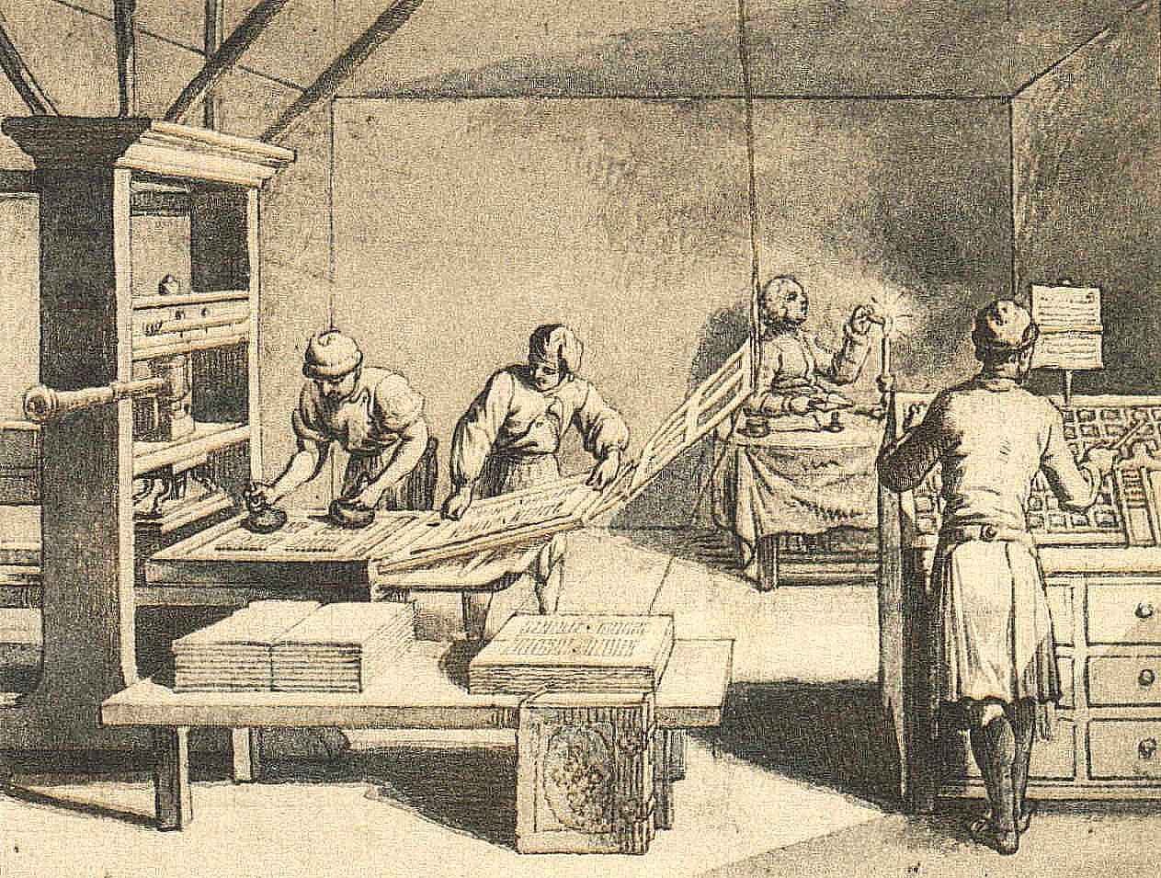
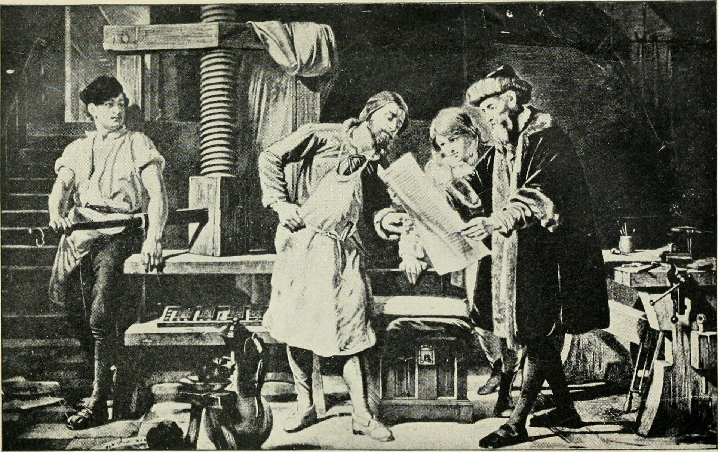
Episode I: The rise of Printing Press
Disrupted market structure - piracy
Resulted in recognition of author’s rights
Development of International Copyright law to tackle the problem

Slide 7
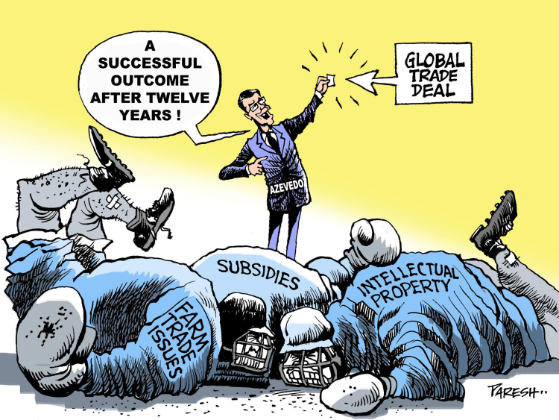
Episode II: The (uneasy) Marriage of IP with Trade
IP linked with Trade through TRIPS Agreement

Slide 8
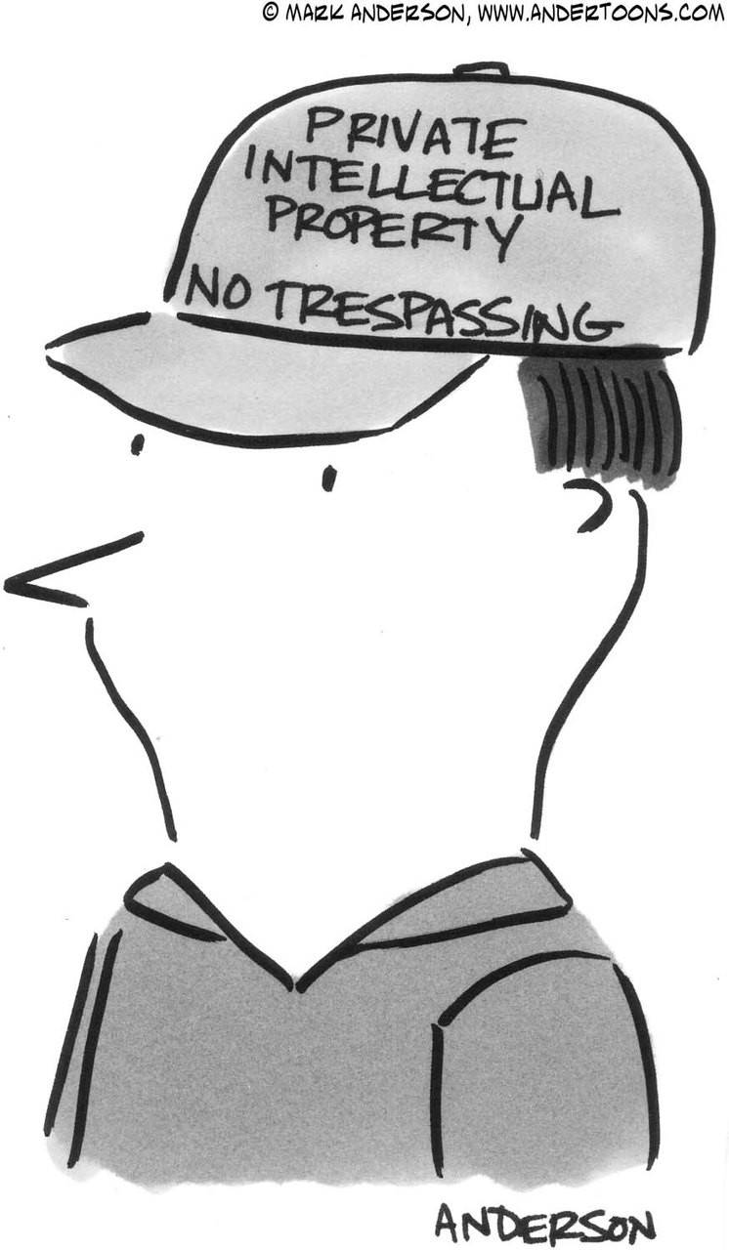
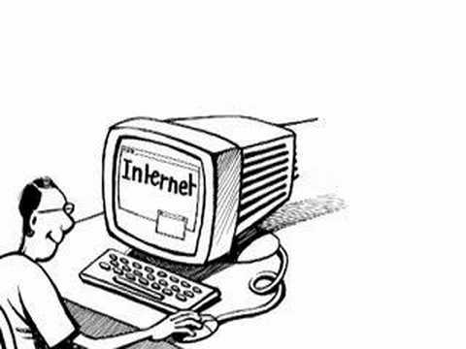
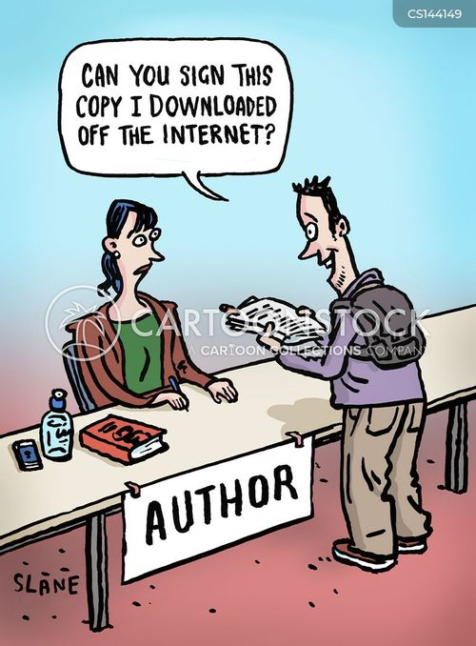
Episode III:
The rise of internet
Risk of unauthorized copying, adaption and piracy

Slide 9
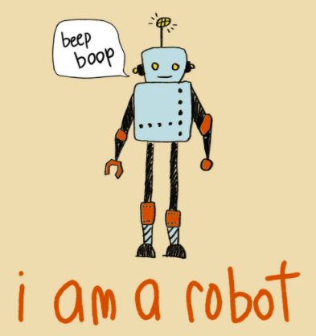
Current: Episode IV
The rise of Artificial Intelligence and Automation
Non- Human Inventor
Incentive to innovate v Instructed to Innovate

Slide 10
The COVID-19 pandemic and the debate surrounding the in equitable distribution of vaccines further exposed the tension between IP norms vis- a`-vis the public interest.
Lessons from Vaccines and TRIPS waiver debate:
The WTO cannot respond quickly to crisis
Efforts to restructure pharmaceutical R&D and distribution should be revitalized
Flexibilities can (not) play an important role
Intellectual Property and (COVID-19) Crisis

Slide 11
After 29 Years of TRIPS: Two Narratives
It seems that the IP system is creating two kinds of narratives, namely ‘‘IP for all’’, and ‘‘IP is all’’.
Here ‘‘IP for all’’ refers to the scholarship that views IP’s primary act as an incentive in order to serve the public interest.
Whereas ‘‘IP is all’’ highlights the private property regime of IP protection that emphasizes exclusivity.
The globalization of IP was not envisioned to be a substitute for international public good and instead it was hoped to prevent market failure through incentive justification.

Slide 12
IP Scholarship
Some scholars have introduced the concept of the commons into the IP regime (Dusollier, 2012)
Authors have used freedom of expression as a tool to address digitization challenges to copyright protection in order to find a balance between users and rights holders (Izyumenko, 2016)
Human rights principles have often been used when IP conflicts with public health or other public interests reminding us that IP should not be read as anti-social (Geiger, 2013)
The use of human rights as a framework for IP has been equally contested (Yu,2019: Okediji, 2018)
Scholars have engaged in the emerging discourse on global constitutionalism to examine the development of IP through ‘‘new constitutionalism’’. (Griffiths and Mylly 2021)

Slide 13
Intervention

Slide 14
II. Third World Approaches to International law
TWAIL is a movement that seeks to oust Western hegemony in international law and give voice to Third World countries.
TWAIL's objective is to deconstruct and expose international law that is transformative and regressive.
The transformation of ‘international law from being a language of oppression to a language of emancipation’ is needed to achieve and promote global justice (Anghie and Chimni, 2003).
This can be achieved by bringing interest to the Third Word/Global South and developing a narrative that is based on colonial history, power, identity and concerns of Third World countries.
It aims to create a system of international law that acknowledge and serves interest of the people of Third World.
The diversity of TWAIL scholarship is one of its more striking features.

Slide 15
TWAIL scholarship evolved in response and in resistance to the discourse of the Western industrialised and colonial population, examining how international law further helps to legitimise imperial policies that have resulted in the transplantation of colonial practices in Third World countries.
TWAIL scholarship has faced criticism for ‘not creating a vessel for their reimaging international law’ (Naz Khatoon Modirzadeh, 2024)

Slide 16
TWAILER’s Reading of Intellectual Property
First, IP as colonial transplant.
International IP evolved through the agency of colonial rule. The colonial transplants of IPRs were designed to expand commercial relations by controlling the colonial markets and achieving uniformity in territories under colonial rule.
The colonial powers negotiated on behalf of their colonies in drafting the first multilateral treaties – the Paris Convention for the Protection of Industrial Property (1883) and the Berne Convention for the Protection of Literary and Artistic Works (1886) to maintain their imperial control over IP within their expanding empires as part of their colonial policy.
Although formal imperialism came to an end, many countries’ IP laws were influenced by the former colonial power.
Although the colonial power transplanted norms in their colonies, they did not invest in developing local expertise and institutions to cater for and to nurture IP development. As a result, many countries emerged with a lack of expertise and weak institutions.

Slide 17
Second, Internationalisation of [intellectual] property rights. TWAILers have questioned the propertisation of IP for monopolising knowledge, which has been further commodified through the TRIPS Agreement.
For TWAILers, TRIPS is an idealistic project that strengthens private property rights at the international level.
TWAILers believe that elevating property regulations to the international level will result in a loss of state control over property regimes.

Slide 18
Third, the role of industrialist lobbyist coalitions. TWAILers are against the universalisation of IP through the hegemonic power of developed countries.
Fourth, TRIPS agreement as a compromised text. The developing countries had the option of either accepting the trade sanctions, which could have meant they were denied market access or accepting the TRIPS Agreement. They opted for the latter since they perceived it to be the lesser of two evils.

Slide 19
TWAIL as a Methodological Tool
TWAIL is a reformist methodology that addresses IP counter hegemony from the Global South's viewpoint.
TWAIL critiques international IP rights and pinpoints how actors and interests impact IP functions in the Global South.
TWAIL has been used as a framework to understand how pharmaceutical patents in Brazil, India and Nigeria were conceptualised, resisted and reformed according to their legal policies within the structural framework of TRIPS (Vani, 2020).
TWAIL, in general, could be a useful framework to rethink the role of IP at the local and grass‐root levels.
TWAIL framework allow us to understand how different actors’ function at local levels, as well as their viewpoints on IP and their functions vis‐à‐vis international IP rules.

Slide 20
So Far…. And moving head
Many developing countries are building a stronger digital infrastructure and are regulating a digital agenda to ensure first-mover advantage.
The developed world continues to use IP to maximize wealth creation, whereas then TRIPS opponents but now major emerging national economies of BRICS - Brazil, Russia, India, China, South Africa and others (to some extent) have now reached a level of exporting IP rights globally.
Many developing countries are parties to TRIPS-plus agreements in the form of trade and investment agreements which they had viewed as threats to international IP.
This development further increases the gap between least developed countries (LDCs) and developing and developed countries.

Slide 21
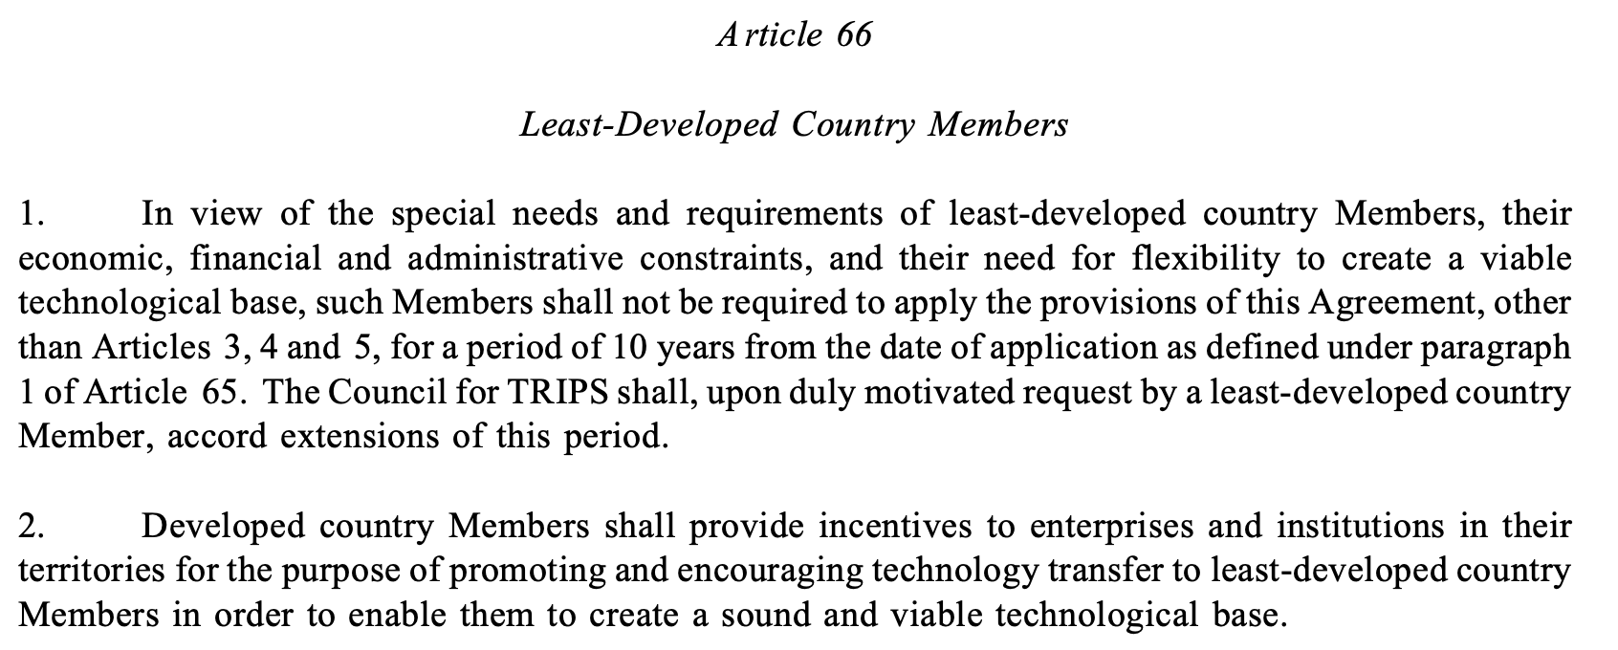
The Promise of TRIPS: an LDCs perspective
“Recognizing also the special needs of the least-developed country Members in respect of maximum flexibility in the domestic implementation of laws and regulations in order to enable them to create a sound and viable technological base” (Preamble, TRIPS)

Slide 22
TRIPS and Least Developed Countries Struggle
Institutional Struggles
Policy Struggles
Implementation Struggles
Innovation-Incentive Struggles

Slide 23
In the context of the Global North and South debate on international IP, developing countries that were a voice for LDCs during the TRIPS Agreement have now also become exporters of IP, so the question is who owns responsibility towards LDCs?
How can LDCs minimize the increasing gap between them and developing and developed countries?

Slide 24
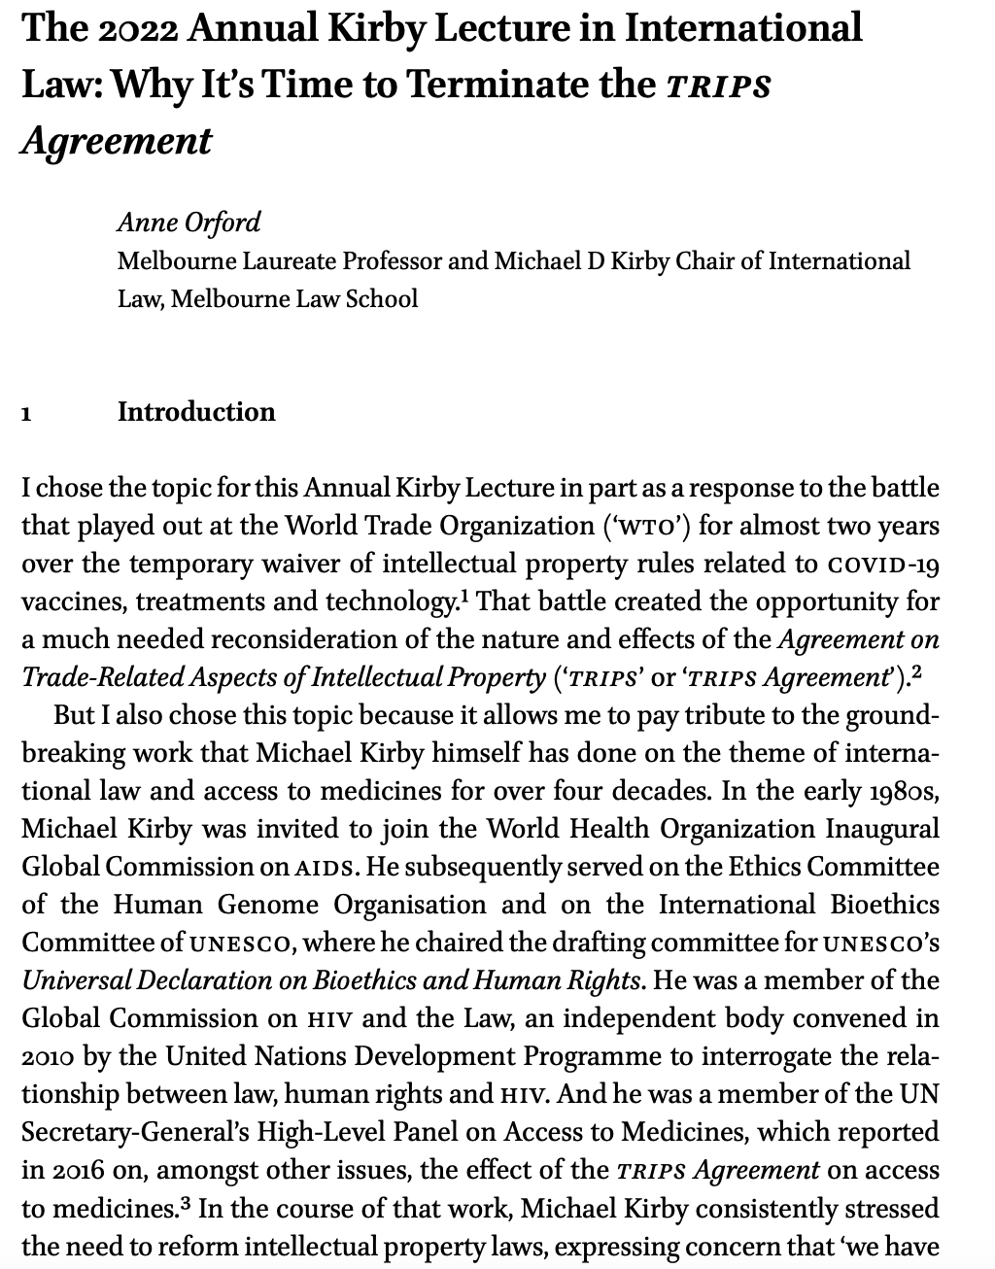
What should we do? Where can we find the solution—within the system or outside the system?
Fundamental change of circumstances of VCLT (Article 62)
1. A fundamental change of circumstances which has occurred with regard to those existing at the time of the conclusion of a treaty, and which was not foreseen by the parties, may not be invoked as a ground for terminating or withdrawing from the treaty unless:
(a) the existence of those circumstances constituted an essential basis of the consent of the parties to be bound by the treaty; and
(b) the effect of the change is radically to transform the extent of obligations still to be performed under the treaty.

Slide 25
III. TWAIL, Reforms and Responsibility

Slide 26
Reformist Approach- within the system
Within the reformist approach of correcting international IP law, one way is to safeguard balancing tools and flexibilities enshrined in TRIPS.
In other words, how can we safeguard principles that allow countries to develop their national IP policies based on their needs in a way that would result in innovation and development?
Engaging in free trade deals, IP chapter to bring lost bargain (reaffirming importance of Art 7 and 8, exceptions and limitations). (RCEP, 2020) (UK-Australia FTA, 2021)

Slide 27
Alternative Reading of IP through Responsibility Lens

Slide 28
The Premise…
Theoretical Contestation: Does IP theories justify responsibility?
Normative Approach: Does international IP embrace responsibility as a concept?
IPRs are duty-bearing privileges and therefore there is a need to adopt an instrumentalist approach to IP that promotes duties and responsibilities.

Slide 29
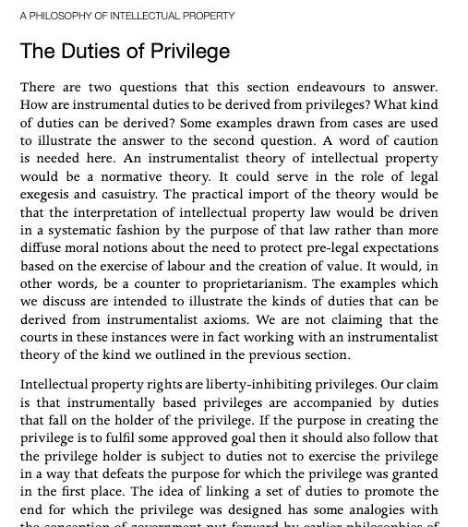
Intellectual property rights are liberty-inhibiting privileges. Our claim is that instrumentally based privileges are accompanied by duties that fall on the holder of the privilege. If the purpose in creating the privilege is to fulfil some approved goal then it should also follow that the privilege holder is subject to duties not to exercise the privilege in a way that defeats the purpose for which the privilege was granted in the first place. The idea of linking a set of duties to promote the end for which the privilege was designed has some analogies with the conception of government put forward by earlier philosophies of democratic radicalism.
Granting a privilege is to fulfil a goal then that privilege holder must be subject to duties. Or else the privilege will defeat the goal itself.

Slide 30
The COVID-19 pandemic can be used as a springboard
The COVID-19 pandemic can be used as a springboard to assess whether the regulations providing incentives for innovation and creativity is prepared to meet not only other equivalent unpredictable crises in the future but also known-challenges facing the world (eg – climate change).
The instigated the urgency to understand the investment paradox in IP in innovation, particularly re-examining the competing interests.
the investment (protection) incentive,
the incentive to share.
the innovation incentive, and
Does ‘inclusivity’ is part of exclusivity?
Does ‘investment’ part of exclusivity?

Slide 31
IP (Access) as a Responsibility
How do we embed responsibility in the IP system so that it allows IP holders to act responsibly?
From a normative point of view, one way to embed responsibility is by conceptualizing a duty of self-moderation ( Li, 2021)
A duty of self-moderation arises when an imbalance is created by IP protection vis-a`-vis the public interest.
In that case, the IP holder should self-moderate to facilitate access.
For example, by a willingness to participate in patent and technology access pools, offering reasonable licensing, setting lower prices for drugs, and so on.

Slide 32
IP and Access to Climate Change Technologies
IP system as part of the climate change solution
Some argue that climate change technologies should unpatented because they benefit the environment.
This will disincentive and promote climate-unfriendly technologies…
Finding a balance?
Restriction
Striking a balance
Regulatory autonomy and response to climate change

Slide 33
Regular Innovations v Social Innovations
the innovation incentive, and
the incentive to share.

Slide 35
TRIPS….
Article 27 of the TRIPS Agreement states that a ‘‘patent shall be available for any inventions, whether products or processes, in all fields of technology’’
However, WTO members can exclude inventions from patentability to ‘‘protect ordre public or morality, including to protect human, animal or plant life or health’’.
Therefore, the possibilities of excluding social innovation that improves the lives of humans could be excluded from the patent system, and other forms of incentives, such as a prize system, could be offered.

Slide 36
Faith- Based IP
The consequentialist argument - assuming that rewards in some sector will increase productivity.
How do we challenge this argument?
Mark A. Lemley, Faith-Based Intellectual Property (2015)

Slide 37
Developing Soft law approaches to International IP
In the 1970s, developing countries adopted a soft law approach as a strategy to support the New International Economic Order (NIEO), which aimed to correct the economic imbalance between developed and developing countries but did not achieve as much as it thought it would when the movement started.
But the movement did put developing countries’ agendas at centre stage.
Whether LDCs should use soft norm strategies through a declaration in international IP institutions to ensure that the developing and developed world is responsible for empowering LDCs in order to create a sound and viable technological base?

Slide 38
Conclusion
The COVID-19 pandemic has provided an opportunity to reshape the debate not only from a normative point of view but also from how we use different frameworks to examine contemporary issues.
TWAIL allows us to rethink IP by framing arguments within the IP system and offering alternative perspectives that reimagine IP through reforms and a focus on responsibility.

Slide 39
MANY THANKS FOR LISTENING –
QUESTIONS?

