Slide 1
Seeing Trade Mark Reputation With Fresh Eyes: Lessons From Consumer-Based Brand Equity Models
Ms Luminita Olteanu
Fellow, LSE Law School
10 November 2022

Slide 2
Structure of the presentation
Background of the paper
Seeing trade mark reputation with fresh eyes
Consumer research decision-making insights
Proposals to reconceptualise the test for infringement

Slide 3
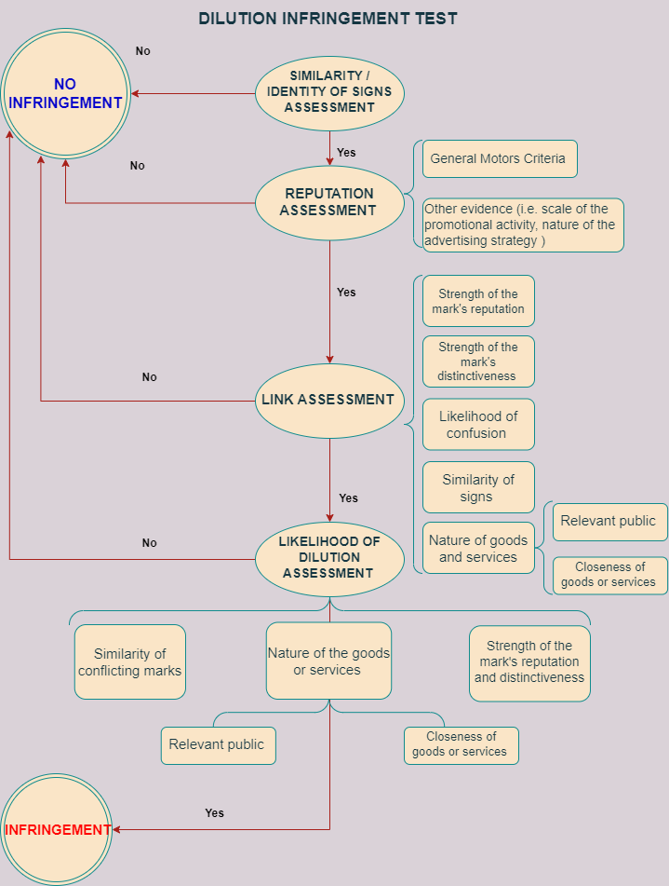
Background of the paper
Is the current dilution infringement test ensuring an adequate level of predictability?

Slide 4
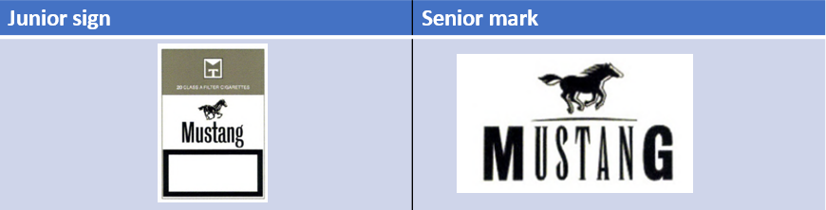
Background of the paper
Case T-71/14 Case T-606/13 Mustang v OHMI - Dubek [2015] ECLI:EU:T:2015:862, [54]
With respect to the link:
‘the tobacco products covered by the mark applied for and the clothing covered by the earlier mark are dissimilar because of their difference in nature. It is certainly undisputed that large companies grant licenses for a wide variety of products. However, as the Board of Appeal points out, that fact alone is not sufficient to find a closeness between the goods in question. The goods covered by the marks in question are so dissimilar that the mark applied for will be unlikely to evoke the earlier mark in the mind of the relevant public’.

Slide 5
Background of the paper
Case T‑669/19 Novomatic v EUIPO [2020] ECLI:EU:T:2020:408
Senior trade mark | Junior sign
PRIMUS Having a reputation for lager beers in Class 32 | PRIMUS Registered for casino fittings, namely roulette tables, roulette wheels; Casino games with or without prize payouts, automated gaming machines and amusement machines etc in Class 28

Slide 6
Background of the paper
Case T‑669/19 Novomatic v EUIPO [2020] ECLI:EU:T:2020:408, [99]
With respect to the link:
‘[…] there is a difference in nature between the goods in respect of which the reputation of the earlier marks has been established and those covered by the mark applied for. Lager beers, which convey the idea of refreshment and relaxation, do not appear to be directly and immediately related to the goods covered by the mark applied for, which are intended to encourage the player to play, including for financial gain. Despite the differences in the nature of those goods, there is nevertheless a certain link between them […]. In establishments where beer is offered, such as pubs, it is not unusual to find terminals, machines or equipment for playing games of chance, including if they are likely to provide the player with a financial gain’.

Slide 7
Background of the paper
Case T‑369/10 You-Q BV v OHIM and Apple Corps Ltd [2012], [72]
With respect to the risk of free-riding:
‘[T]hat very positive image portrayed by the earlier marks could benefit the goods covered by the mark applied for, since the relevant public, on account specifically of the handicap in question [emphasis added], would be particularly attracted by the very positive image of freedom, youth and mobility associated with the earlier marks, especially since, as the intervener stated at the hearing, a part of the public targeted by the goods concerned by the mark applied for belongs to the generation of persons who knew the goods bearing the earlier marks in the 1960s and some of whom may now be concerned by the goods covered by the mark applied for’.

Slide 8
Background of the paper
Case T-131/09 Farmeco v OHMI [2010] II-00243, [94] & [97]
BOTOX v BOTUMAX
Ref free-riding: ‘the consumer faced with those goods [i.e. bleaching preparations for laundry use] may think that they clean a surface or the laundry as if wrinkles were removed’.
Ref blurring: ‘the existence of another mark that appears to be a derivative of the widely known earlier marks will dilute its distinctive character’.

Slide 9
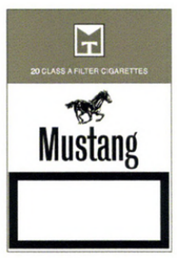

Background of the paper
Case T-606/13 Mustang v OHMI - Dubek [2015] ECLI:EU:T:2015:862, [64]
‘[I]t cannot be assumed that, because tobacco is harmful to health, there is a risk of losing the attractiveness of a mark which is associated with tobacco’.
Junior sign | Senior mark

Slide 10
Background of the paper
Potential causes for lack of an adequate level of predictability
unclear normative justifications for dilution protection
quantitative nature of the General Motors criteria
proof of actual dilution is not mandatory
no CJEU test for tarnishment & free-riding
bizarre assumptions about consumers’ decision-making process

Slide 11
Background of the paper
How should courts and intellectual property offices assess the likelihood of dilution to avoid legal uncertainty in dilution cases?
In a manner informed by marketplace realities, which involves:
use of qualitative criteria & metrics for evaluating trade mark reputation
consumer research informed assumptions on consumers decision-making process

Slide 12
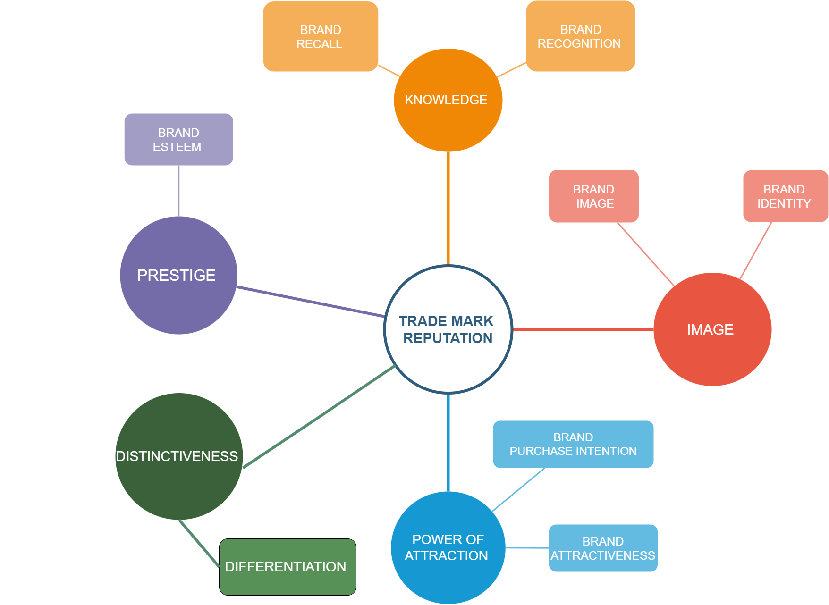
Seeing trade mark reputation with fresh eyes

Slide 13
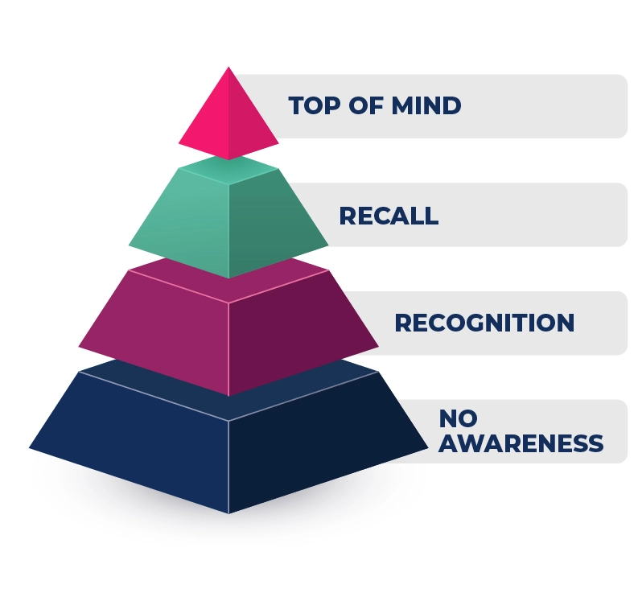
Seeing trade mark reputation with fresh eyes
Trade mark reputation as brand awareness
‘Legal’ definition of reputation = ‘a certain degree of knowledge of the earlier trade mark among the public’ does not distinguish between various types of ‘knowledge’
Brand awareness = the result of awareness of a variety of brand components which depend on ‘the different ways in which consumers remember a brand ranging from recognition (Have you been exposed to this brand before?) to recall (What brands of this product class can your recall?)’

Slide 14
Seeing trade mark reputation with fresh eyes
Trade mark reputation as brand awareness
Brand Awareness Depth v Brand Awareness Breadth
(i.e. soft drinks have great breadth awareness in that they come to mind in a variety of different consumption situations’ while milk has ‘much more limited perceived consumption situations’
Logos v Words
brand names and brand URLs, slogans or jingles can ‘enhance brand recall and recognition’ while logos, symbols, characters, packaging or signage are generally more useful for brand recognition

Slide 15
Seeing trade mark reputation with fresh eyes
Trade Mark Distinctiveness and Brand Differentiation
Trade mark distinctiveness from the perspective of blurring = ‘trade mark identity’ or ‘hold upon the public’
Brand Distinctiveness = a brand’s ‘distinctive qualities, in themselves’ which ‘provide easy and automatic identification of the brand through all of its consumer touchpoints ranging from advertising, packaging, in-store activities to, where relevant, staff uniforms’.

Slide 16
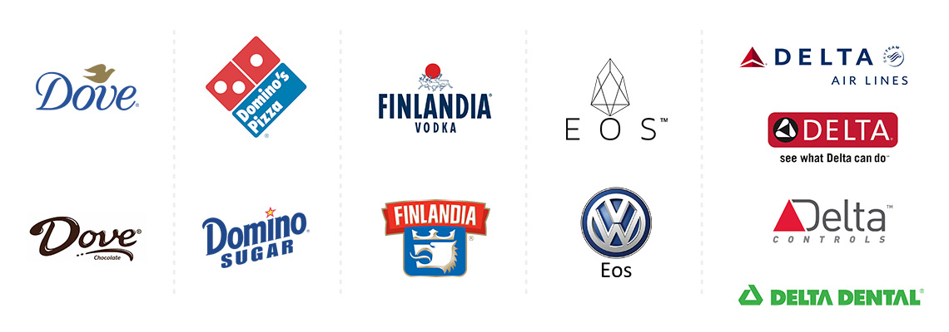
Seeing trade mark reputation with fresh eyes
Trade Mark Distinctiveness and Brand Differentiation
Brand Differentiation = unique brand associations or ‘brand superiority, where the consumer knows other brands have the same attribute, but perceive one brand to be better than the others’

Slide 17
Seeing trade mark reputation with fresh eyes
Trade Mark Distinctiveness and Brand Differentiation
Measuring brand associations/differentiation: determining brand-as-product (value), brand-as person (brand personality) and brand-as-organization (organizational associations)
Unique attributes will only be effective if they are perceived and used by consumer in decision-making

Slide 18
Seeing trade mark reputation with fresh eyes
Trade Mark Image v Brand Image
Brand Image = what is ‘reflected by the brand associations held in consumer memory’
Brand Identity = ‘only reflects the way in which the brand owner wishes their brand to be perceived’

Slide 19
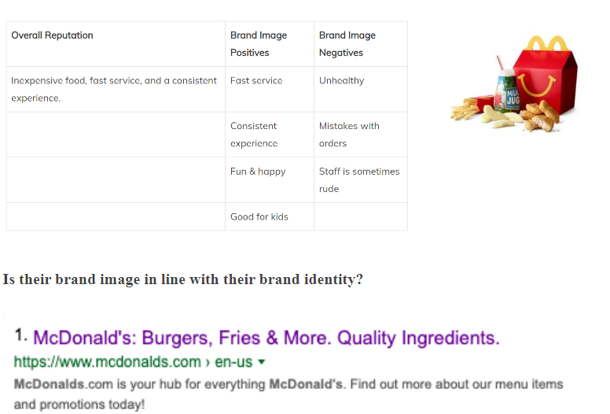
Seeing trade mark reputation with fresh eyes
Trade Mark Image v Brand Image
Notes:
Image from: Jacob Landis-Egisti, ‘Brand Image vs Brand Identity -With Examples & Explanation’, <https://www.linkedin.com/pulse/brand-image-vs-identity-with-examples-explanation-landis-eigsti> (accessed 2 November 2022)

Slide 20
Seeing trade mark reputation with fresh eyes
Trade Mark Image v Brand Image
Brand Image = ‘the personal value that consumers attach to the products or service attributes’, ‘consumers’ overall evaluation of a brand’ and the favourability of brand association
Not all associations ‘will be relevant and valued in a purchase or consumption decision’
For example if the brand sells itself as ‘speedy and efficient’ which might be of relevance to consumers that are subject to time constraints, this does not mean that consumers happy to proceed at a more leisurely pace will be enticed by the brand’s identity

Slide 21
Seeing trade mark reputation with fresh eyes
The Power of Attraction of the Mark v Brand Attractiveness
Brand Attractiveness = ‘brand’s ability to attract customers’¹
I like what [Brand X] stands for
[Brand X] is an attractive brand
I like what [Brand X] represents
[Brand X] is a favorable brand
Notes:
1 Glossary, ‘Brand Attractiveness’ <https://www.brand-trust.de/en/glossary/brand-attractiveness.php#:~:text=Brand%20attractiveness%20manifests%20in%20a,the%20brand's%20degree%20of%20awareness.>

Slide 22
Seeing trade mark reputation with fresh eyes
The Power of Attraction of the Mark v Brand Purchase Intention
Brand Purchase Intention = Consumers’ willingness to purchase the brand
Keller points out however that ‘purchase intentions are most likely to be predictive of actual purchase when there is correspondence between the two in the following dimensions:
action (buying for own use or to give as gift)
target (specific type of product and brand)
context (in what type of store based on what prices and other conditions) and
time (within a week, month or year)’.

Slide 23
Seeing trade mark reputation with fresh eyes
Trade Mark Prestige v Brand Esteem
Brand Esteem = ‘a measure of how highly regarded a brand is and how well it delivers on its promises’
Driven by:
perceptions of quality
Popularity
Can be measured via consumers’ ‘rating - often on a scale of 1-5 or 1-7 - of a given brand’s product when compared with others in its category or market’

Slide 24
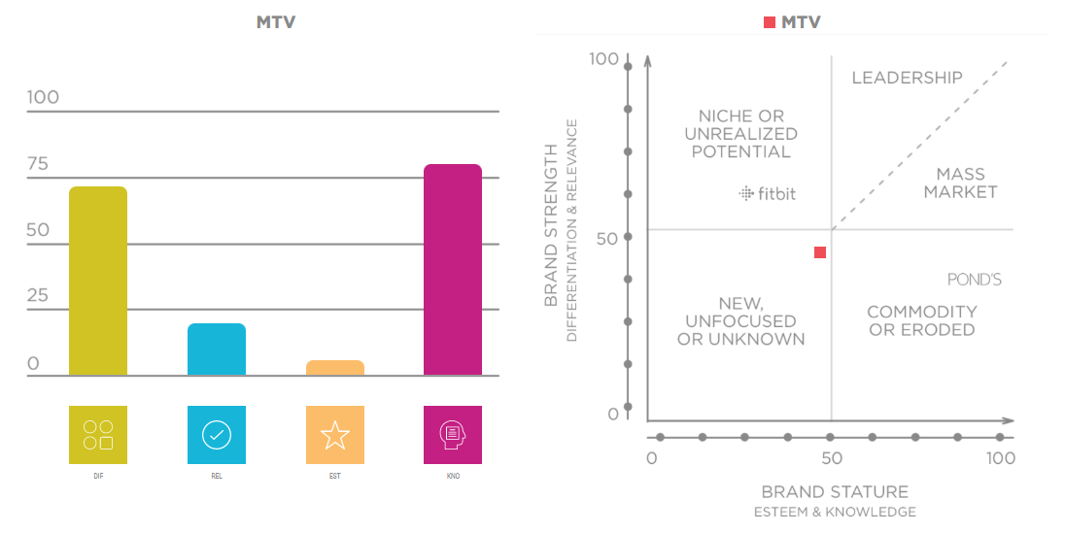
Seeing trade mark reputation with fresh eyes
Trade Mark Prestige v Brand Esteem
The relationship between esteem and awareness is different for different brands

Slide 25
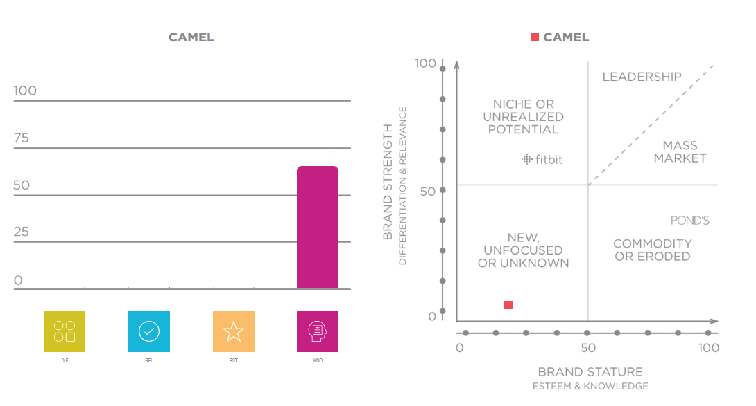
Seeing trade mark reputation with fresh eyes
Trade Mark Prestige v Brand Esteem
The relationship between esteem and awareness is different for different brands

Slide 26
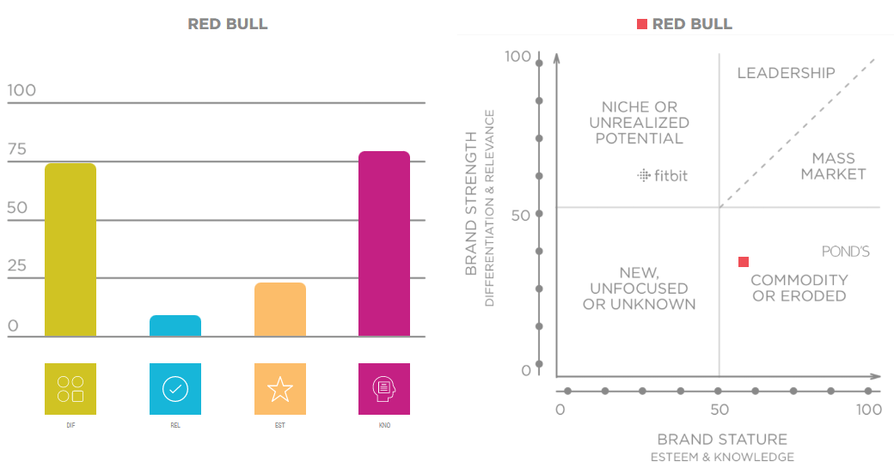
Seeing trade mark reputation with fresh eyes
Trade Mark Prestige v Brand Esteem
The relationship between esteem and awareness is different for different brands

Slide 27
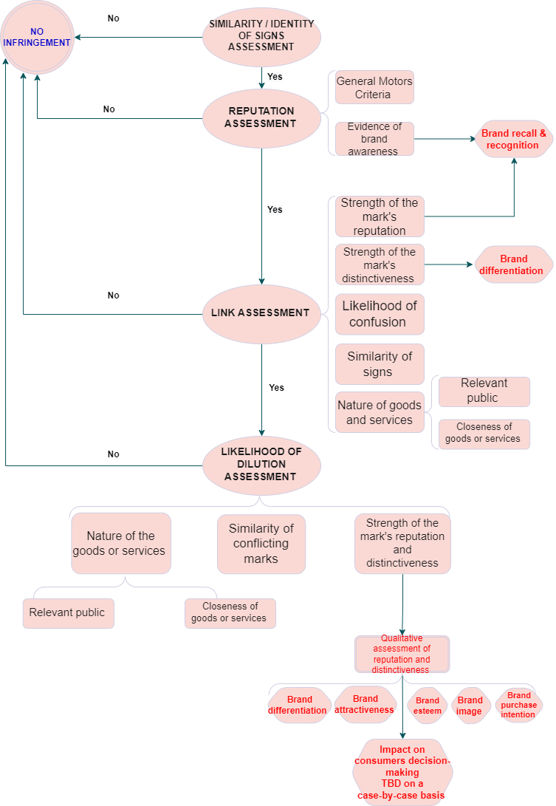
Seeing trade mark reputation with fresh eyes
The application of the brand dimensions theoretical and methodological framework to the test for assessing dilution infringement could be conducive of a higher degree of predictability
The methods used for measuring and evaluating brand dimensions require rigorous determinations of consumer perceptions which, if adopted in trade mark law practice, would lead to more stringent requirements for proving trade mark reputation

Slide 28
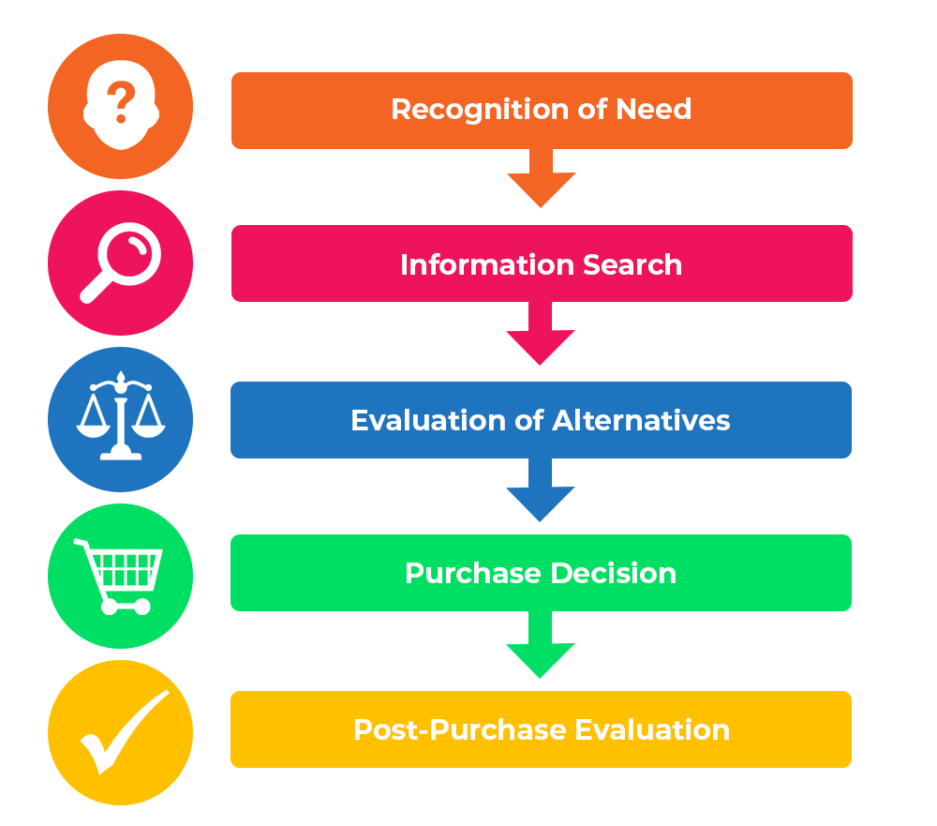
Consumer research decision-making insights
The consumer decision-making process
The degree of involvement in the information search stage and evaluation of alternatives varies
Notes:
Image taken from: https://www.professionalacademy.com/blogs/marketing-theories-explaining-the-consumer-decision-making-process/

Slide 29
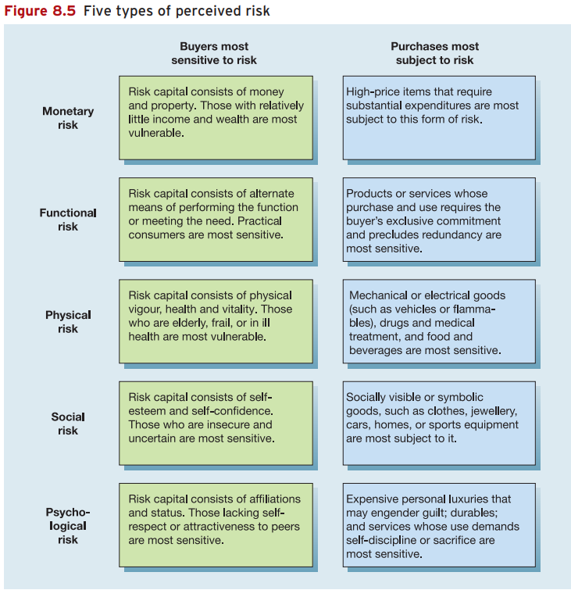
Consumer research decision-making insights
The information search stage & perceived transaction risks
Michael Solomon and others, Consumer Behaviour: A European Perspective (3rd edn, Pearsons 2006)

Slide 30
Consumer research decision-making insights
Goods v Services
The special features of services (i.e. intangibility, perishability, heterogeneity) significantly impact consumers’ decision-making:
certain pre-purchase processes such as information acquisition via packaging or tasting are not available for services
the evaluation of alternatives, which is part of the pre-purchase phase of service consumption, is intimately linked to the way consumers experience that service, making services more ‘difficult to specify or evaluate precisely in advance of the purchase’
when buying services ‘consumers seek and rely to a greater extent on online review sites and talking to friends and family directly or through social media’

Slide 31
Consumer research decision-making insights
Cognitive biases impacting consumers’ decision-making process
Heuristics = a method ‘of streamlining the decision-making process by reducing the amount of integrated information necessary in making the choice or passing judgment’
Factors that influence consumer decisions predominantly in cases of habitual decision-making:
‘buy the same brand I bought last time’
‘higher-priced products are higher-quality products’
brand loyalty (i.e. ‘a conscious decision to buy the same brand’

Slide 32
Consumer research decision-making insights
Cognitive biases impacting consumers’ decision-making process
Heuristics = a method ‘of streamlining the decision-making process by reducing the amount of integrated information necessary in making the choice or passing judgment’
Factors that influence consumer decisions predominantly in cases of habitual decision-making:
‘buy the same brand I bought last time’
‘higher-priced products are higher-quality products’
brand loyalty (i.e. ‘a conscious decision to buy the same brand’

Slide 33
Consumer research decision-making insights
Cognitive biases impacting consumers’ decision-making process
Other biases:
The credibility of information sources = consumers’ beliefs that if a store agrees to test a product and then promote it, then the store is not reporting objectively on the characteristics of the product
‘Anchoring bias’ = ‘people place more significance on the first piece of information they receive’
Purchases of unfamiliar or new products = consumers will not buy the new product until someone they know has bought, used and recommended such product.

Slide 34
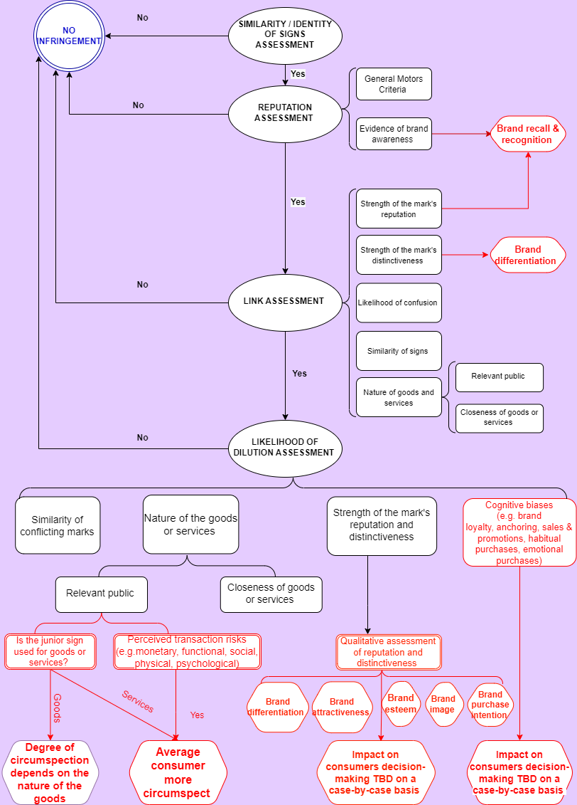
Proposals to reconceptualise the test for infringement

Slide 35
THANK YOU!

