Slide 1
The ethical and legal framework within which the Guardian approaches information concerning natural persons
Gill Phillips, Editorial Legal Director Guardian News and Media Ltd:
Centre for Intellectual Property and Information Law seminar, Cambridge, November 2018

Slide 2
Ethical and legal frameworks …

Slide 3
TOPICS
Regulation
Legal framework
defamation
misuse of private information
data protection
homogenising of claims
miscellaneous
reporting on criminal activity
http://webarchive.nationalarchives.gov.uk/20140122160910/http://www.levesoninquiry.org.uk/wp-content/uploads/2012/08/Joint-submission-from-Associated-GNM-3-Telgraph-media-for-module-2.pdf

Slide 4
1. Regulation

Slide 5
What is journalism
BBC v Sugar [2012] 1 WLR 439 at [39]- [44], Supreme Court endorsed a tripartite view of what constituted ‘journalism’ (in the context of the Freedom of Information Act 2000):
the collecting, writing and verifying of material for publication”;
the editing of the material, including its selection and arrangement, the provision of context for it and the determination of when and how it should be broadcast; and
the maintenance and enhancement of the standards of the output by reviews of its quality, in terms in particular of accuracy, balance and completeness, and the supervision and training of journalists”

Slide 6
Regulation – introduction
19th century Fleet Street rhyme:
“Tickle the public, make 'em grin,
The more you tickle, the more you'll win;
Teach the public, you'll never get rich,
You'll live like a beggar and die in a ditch.”
[sourced: Tickle the Public. One Hundred Years of the Popular Press by Matthew Engel; The Great Outsiders. Northcliffe, Rothermere and the Daily Mail by S. J. Taylor, 1998]
“The evil that men do lives on the front pages of greedy newspapers, but the good is off interred apathetically inside”. : Brooks Atkinson, American essayist, Once around the Sun, 1951

Slide 7
Regulation – introduction cont ..
1973, Pulitzer Prize acceptance speech, the Washington Post’s David Broder urged journalists to drop the pretense of omniscience and instead say:
“over and over, until the point has been made, that the newspaper that drops on your doorstep is a partial, hasty, incomplete, inevitably somewhat flawed and inaccurate rendering of some of the things we have heard about in the past 24 hours, distorted, despite our best efforts to eliminate gross bias, by the very process of compression that makes it possible for you to lift it from the doorstep.”
https://www.washingtonpost.com/local/politicians-journalists-and-readers-remember-longtime-post-reporter-david-broder/2011/04/04/AFEYFglC_story.html?noredirect=on&utm_term=.295e637564c9

Slide 8
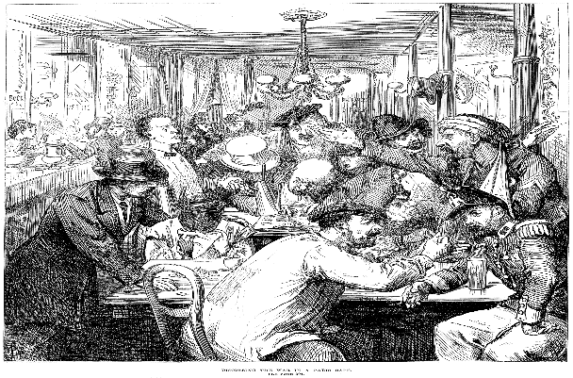
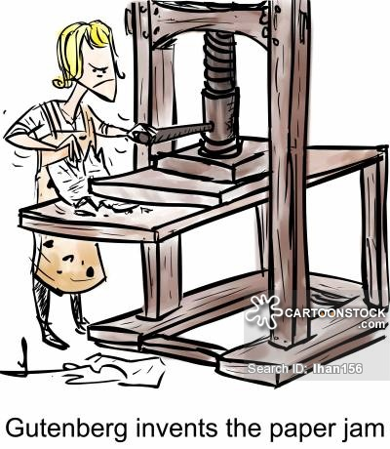
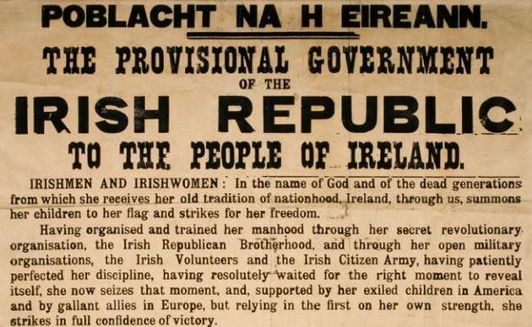
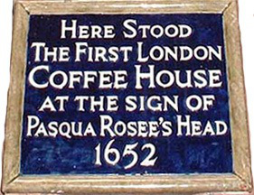
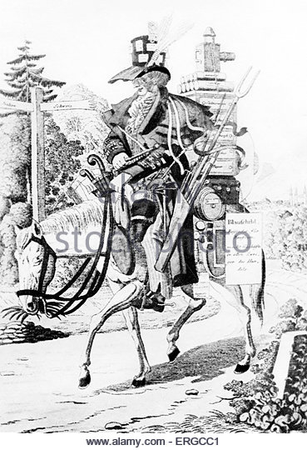
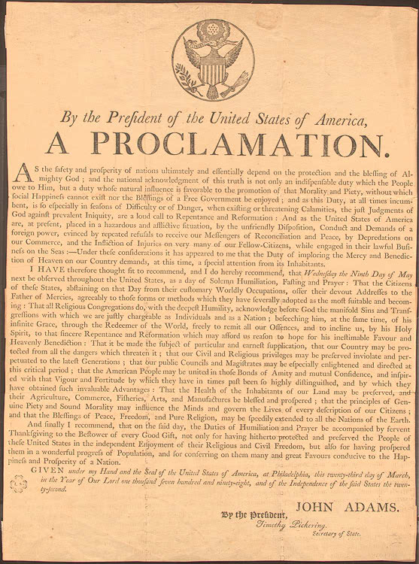
Notes:
gathering and transmitting of news - most people couldn’t read and there wasn’t much available to read so it was word of mouth – travellers / sailors and merchants / pedlars / travelling players / town criers - In thirteenth-century Florence, criers known as banditori arrived in the market regularly, to announce political news, to convoke public meetings, and to call the populace to arms. In 1307 and 1322–1325, laws were established governing their appointment, conduct, and salary.
government proclamations - official government bulletins and edicts were circulated at times in some centralized empires.
Messengers and couriers used to diffuse written documents- eg in Egypt, where Pharaohs used couriers for the diffusion of their decrees in their territory (2400 BC) developed into postal services
public gathering places, such as the Greek forum and the Roman baths / in the Muslim world, people have gathered and exchanged news at mosques and other social places
paper – permanent forms of writing - world's first written news may have originated in eighth century B.C.E. China, where reports gathered by officials were eventually compiled as the Spring and Autumn Annals. attributed to Confucius, were available to a sizeable reading public and dealt with common news themes—though they straddle the line between news and history.[
Advent of the printing press preceded a major advance in the transmission of news. By 1400, businessmen in Italian and German cities were compiling hand written chronicles of important news events, and circulating them to their business connections. The idea of using a printing press for this material first appeared in Germany around 1600. With the spread of printing presses news underwent a shift from factual and precise economic reporting, to a more emotive and freewheeling format.
Private newsletters containing important intelligence remained in use by people who needed to know.
Due to their low cost and ease of production, pamphlets were often used to popularize political or religious ideas.
In the UK By the 1500s, news for public consumption was at first tightly controlled by governments ans printing was within the royal jurisdiction, and was restricted only to English subjects. The Crown imposed strict controls on the distribution of religious or political printed materials. In 1556, the government of Venice first published the monthly Notizie scritte ("Written notices") which cost one gazetta,^{[2]} a Venetian coin of the time, the name of which eventually came to mean "newspaper". - handwritten newsletters used to convey political, military, and economic news quickly and efficiently throughout Europe, more specifically Italy, during the early modern era (1500-1800)
The first newspapers emerged in Germany in the early 1600s.^{[85]} Relation aller Fürnemmen und gedenckwürdigen Historien, from 1605, is recognized as the world's first formalized 'newspaper’;
The 17th century in the UK saw the rise of political pamphleteering fuelled by the politically contentious times^{[5]} of bloody civil war. Each party sought to mobilize its supporters by the widespread distribution of pamphlets, as in the coffeehouses where one copy would be passed around and read aloud.. [picture is Discussing the War in a Paris Café", The Illustrated London News 17 September 1870]

Slide 9
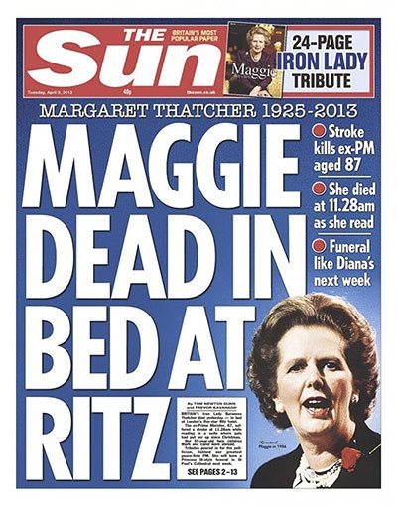
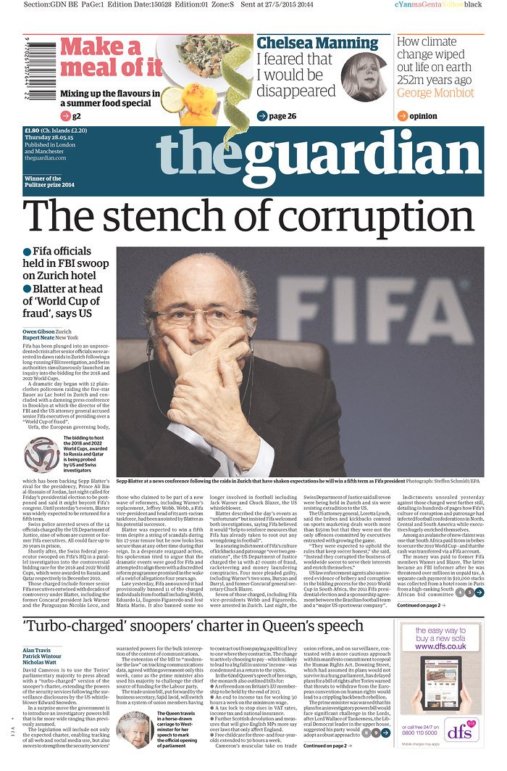
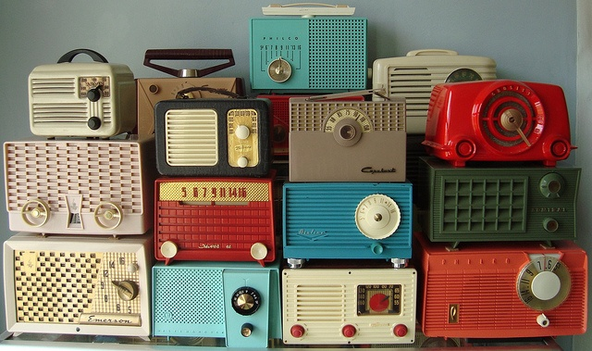
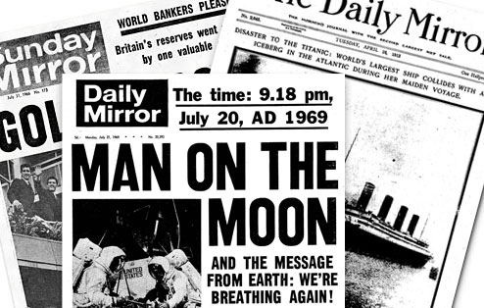
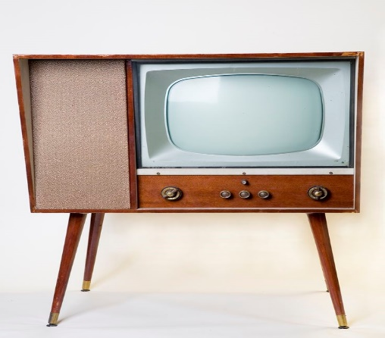
Notes:
the Daily Universal Register published from 1785 and become known as The Times from 1788.
The Manchester Guardian was founded in Manchester in 1821 by a group of non-conformist businessmen. Its most famous editor, Charles Prestwich Scott, made the Guardian into a world-famous newspaper in the 1890s.
The Daily Telegraph was first published on June 29, 1855
newswires / telegraph / telegrams
radio / tv broadcasts
The British Broadcasting Company began transmitting radio news from London in 1922, dependent entirely, by law, on the British news agencies.[The BBC gained importance in the May 1926 general strike, during which newspapers were closed and the radio served as the only source of news for an uncertain public.
Internet

Slide 10
Regulation – recent history
Paul Dacre: former editor of the Daily Mail in the Annual Lecture to the Society of Editors Annual Conference, November 2018 : the Leveson inquiry that followed the News of the World phone hacking "was a calculated attempt by the Establishment to control the one sector of the media it couldn't regulate" and it was "payback time" for a political class badly scalded by the expenses scandal.
Press Recognition Panel (PRP) set up under the Royal Charter on self-regulation of the press to judge whether press regulators meet the criteria recommended by the Leveson Inquiry for recognition under the Charter.
Impress
IPSO
Self-regulation (traditional legacy media Guardian, FT, Independent, Private Eye)
New online digital media Huffington Post, BuzzFeed,
Ofcom - Broadcast media (TV, radio, video on demand), telecommunications, and postal services

Slide 11
Ethics codes in the UK
IPSO - https://www.ipso.co.uk/editors-code-of-practice/
IMPRESS – PRP recognised http://www.pressgazette.co.uk/impress-publishes-draft-10-clause-standards-code/
Guardian– self regulate – https://www.theguardian.com/info/2015/aug/05/the-guardians-editorial-code
BBC - http://www.bbc.co.uk/editorialguidelines/
C4 - http://www.channel4.com/producers-handbook/introduction
Broadcasters generally - OFCOM https://www.ofcom.org.uk/tv-radio-and-on-demand/broadcast-codes/broadcast-code
NUJ - https://www.nuj.org.uk/documents/nuj-code-of-conduct/
Not cover most social media output

Slide 12
Main ethical issues covered by codes
Accuracy / verification [Fake news] – overlap : defamation + DPA
Privacy / health / hospitals / harassment / children – overlap : misuse of private information
Subterfuge
Suicide
Jigsaw identity / reporting the courts more generally
Sources
New problems not specifically covered by Codes
Hate speech / trolling
Anonymity
UGC / comments / Social media
Political advertising [ASA]

Slide 13
Fairness
Guardian Editorial Guidance : Fairness
“The voice of opponents no less than of friends has a right to be heard . . . It is well be to be frank; it is even better to be fair” (CP Scott, 1921). The more serious the criticism or allegations we are reporting the greater the obligation to allow the subject the opportunity to respond.
Guardian Editorial Code : Opportunity to reply
A fair opportunity for reply to inaccuracies must be given when reasonably called for.

Slide 14
The public interest
“…matters relating to the public life of the community and those who take part in it, including within the expression ‘public life’, activities such as the conduct of government and political life, elections… and public administration, but we use the expression more widely than that, to embrace matters such as..the governance of public bodies, institutions and companies which give rise to a public interest in disclosure, but excluding matters which are personal and private, such that there is no public interest in their disclosure…”: BinghamLJ, CA, Reynolds v Times [2001]
IPSO Code asterisked clauses [publication of material that would otherwise offend against these clauses may be justified if in the PI]- Privacy (cl 3), Harassment (cl 4), Children (cl 6), Children in Sex Cases (cl 7), Hospitals (cl 8), Reporting of Crime (cl 9), Clandestine devices and subterfuge (cl 10), Witness payments in criminal cases where proceedings are not active (c115(ii)-(iii)) and Payments to criminals (c11
PI also relevant in defamation [s4]; privacy; confidentiality; data protection

Slide 15
Public interest – reference points
Editorial codes - IPSO / Impress Code
Public Interest Disclosure Act 1998 s 1 / Employment Rights Act 1996 s43B
CPS : Media: Guidance for prosecutors on assessing the public interest in cases affecting the media, 13 December 2012 : https://www.cps.gov.uk/legal-guidance/media-guidance-prosecutors-assessing-public-interest-cases-affecting-media
Some common themes :
Prevention / detection of crime // serious impropriety // miscarriage of justice
Protecting public health or safety
Putting the record straight / protecting the public from being misled
Disclosing a person or organisation’s failure or likely failure to comply with legal / moral obligations
Raising or contributing to a [n important] matter of public debate, including serious cases of impropriety, unethical conduct or incompetence concerning the public.

Slide 16
Public interest (1) IPSO CODE
The public interest includes, but is not confined to:
Detecting or exposing crime, or the threat of crime, or serious impropriety.
Protecting public health or safety.
Protecting the public from being misled by an action or statement of an individual or organisation.
Disclosing a person or organisation’s failure or likely failure to comply with any obligation to which they are subject.
Disclosing a miscarriage of justice.
Raising or contributing to a matter of public debate, including serious cases of impropriety, unethical conduct or incompetence concerning the public.
Disclosing concealment, or likely concealment, of any of the above.
2. There is a public interest in freedom of expression itself.

Slide 17
Public Interest (2) Impress
….. A public interest means that the public has a legitimate stake in a story because of the contribution it makes to a matter of importance to society. Such interests include, but are not limited to, the following:
a. matters such as serious incompetence or unethical behaviour that affects the public;
b. Putting the record straight where an individual or organisation has misled the public on a matter of public importance;
c. Revealing that a person or organisation may be failing to comply with any legal obligation they have;
d. The proper administration of government;
e. Open, fair and effective justice;
f. Public health and safety;
g. National security;
h. The prevention and detection of crime; and
i. The discussion or analysis of artistic or cultural works.
The following provisions apply where a publisher is about to undertake an action that they think would otherwise breach the Code, but for which they believe they have a public interest justification. The action might be a particular method of newsgathering or publication of an item of content. Before undertaking the action, the publisher should, where practicable, make a contemporaneous note, which establishes why they believe that:
i) The action is in the public interest; ii) They could not have achieved the same result using measures that are compliant with the Code;
iii) The action is likely to achieve the desired outcome; and iv) Any likely harm caused by the action does not outweigh the public interest in the action.

Slide 18
Public Interest (3) – PIDA1998
Public Interest Disclosure Act 1998 s 1 / Employment Rights Act 1996 s43B definition of “qualifying disclosure”
a “qualifying disclosure” means any disclosure of information which, in the reasonable belief of the worker making the disclosure, tends to show one or more of the following—
(a)that a criminal offence has been committed, is being committed or is likely to be committed,
(b)that a person has failed, is failing or is likely to fail to comply with any legal obligation to which he is subject,
(c)that a miscarriage of justice has occurred, is occurring or is likely to occur,
(d)that the health or safety of any individual has been, is being or is likely to be endangered,
(e)that the environment has been, is being or is likely to be damaged, or
(f)that information tending to show any matter falling within any one of the preceding paragraphs has been, is being or is likely to be deliberately concealed.

Slide 19
Public Interest (4) CPS : Media Guidance
CPS : Media: Guidance for prosecutors on assessing the public interest in cases affecting the media, 13 December 2012
https://www.cps.gov.uk/legal-guidance/media-guidance-prosecutors-assessing-public-interest-cases-affecting-media
Examples of conduct which is capable of serving the public interest include the following :
(a) Conduct which is capable of disclosing that a criminal offence has been committed, is being committed, or is likely to be committed. (b) Conduct which is capable of disclosing that a person has failed, is failing, or is likely to fail to comply with any legal obligation to which s/he is subject. (c) Conduct which is capable of disclosing that a miscarriage of justice has occurred, is occurring or is likely to occur. (d) Conduct which is capable of raising or contributing to an important matter of public debate. There is no exhaustive definition of an important matter of public debate, but examples include public debate about serious impropriety, significant unethical conduct and significant incompetence, which affects the public. (e) Conduct which is capable of disclosing that anything falling within any one of the above is being, or is likely to be, concealed.
not intended to be exhaustive / Each case must be considered on its facts and merits.

Slide 20
2. Defamation

Slide 21
Defamation - basic constituents
making a false statement
about a person [or organisation]
to others
which lowers them in the eyes of the public // subjects them to ridicule
causes / likely to cause [serious] harm [S1 DA 2013] to their reputation /
[NB 13 / 14 November 2018, Supreme Court heard appeal in Lachaux (Respondent) v Independent Print Limited and another (Appellants) UKSC 2017/0175]

Slide 22
Defamation – bop + meaning
Burden of proof – presumption of falsity
Meaning is the essential starting point in any claim for defamation,
Single meaning rule : The same set of words can legitimately be given quite varied interpretations by different individuals, : a "legal fiction" that a publication can only be understood to bear one ’natural and ordinary’ meaning
The intention of the publisher is irrelevant : ‘Many a true word is spoken in jest. Many a false one too. But chaff and banter are not defamatory, and even serious imputations are not actionable if no-one would take them to be meant seriously. The question, however, is how the words would be understood, not how they were meant….’ Millett LJ [dissenting, CA Berkoff v Burchill, 1996]

Slide 23
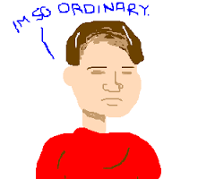
Defamation – meaning
Meaning is the meaning as understood by a hypothetical, ordinary reasonable reader :
Fair minded,
doesn’t read it like a lawyer,
is not looking for the worst meaning,
can read between the lines,
reads the whole article
Jeynes v News Magazines Ltd [2008] EWCA Civ 130; Charleston v News Group Newspapers Limited [1995] 2 AC 65; Skuse v Granada Television [1996] EMLR 27
practice in defamation claims to attribute an accusation of wrongdoing to one of three tiers of gravity : these tiers have become known as Chase level meanings after CA decision in Chase v News Group Newspapers Ltd [2002] EWCA Civ 1

Slide 24
Defamation - meaning
Chase Level 1 - guilt of wrongdoing.
Chase Level 2 - reasonable grounds to suspect that there has been wrongdoing.
Chase Level 3 - grounds for investigating whether there has been wrongdoing.
There are critical rules concerning the admissibility of evidence which result from a determination of the appropriate tier of meaning. The difference between intermediary tiers such as ’strong’ and ’reasonable’ grounds to suspect may be the difference between being sued for libel and not being sued: see eg Armstrong v Times Newspapers Ltd [2004] EWHC 2929 (QB) at [3] per Eady J.
The more serious the allegation, the greater the quality of evidence which will be required for the court to be satisfied of guilt on the balance of probabilities
The “conduct rule’ of justification - arises out of the distinction between a meaning of guilt and a meaning of reasonable grounds to suspect guilt. The reason why a defence of "reasonable suspicion is sustainable is because its sting is that the plaintiff has by his conduct brought suspicion upon himself. It is therefore "an essential requisite of a defence of justification of reasonable suspicion that it should focus on some conduct on the [claimant’s] part giving rise to reasonable suspicion”; need not focus exclusively on allegations of conduct on the part of C & strong circumstantial evidence may also be relied on
Lewis v Daily Telegraph Limited [1964] 2 AC; Cohen v Daily Telegraph Limited [1968] 1 WLR 916; Shah v Standard Chartered Bank [1999] QB 241; Musa King v Telegraph Group Limited [2004] EWCA Civ 613; Curistan v Times Newspapers Ltd [2008] EWCA Civ 432;.

Slide 25
Defamation – defences
s 2 DA 2013 - Truth
statements of fact
substantially true
[NB bop; meaning; evidence]
s3 DA 2013 - Honest opinion
statement of opinion
which contains the basis of the opinion (general or specific)
honest person could hold the opinion on basis of:
(a) any fact which existed at the time of publication ; (b) anything asserted to be a fact in a privileged statement published before the statement complained of.
various reporting privileges [fair and accurate]

Slide 26
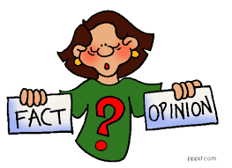
Outrageous opinions are not illegal!
“I think Jones is a liar because … ”
“If you believe the prosecution, Jones must be lying”
(3) “The evidence demonstrates that Jones is a liar”

Slide 27
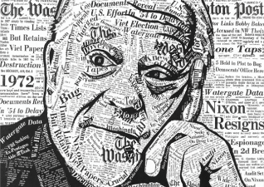
Defamation: defences - public interest journalism
S 4 Defamation Act 2013 : Responsible journalism in the public interest
(1) It is a defence to an action for defamation for the defendant [“D”] to show that—
(a) the statement complained of was, or formed part of, a statement on a matter of PI; and
(b ) D reasonably believed publishing the statement complained of was in PI interest.
(2) Subject to subsections (3) and (4), in determining whether D has shown the matters mentioned in subsection (1), the court must have regard to all the circumstances of the case.
(3) If the statement complained of was, or formed part of, an accurate and impartial account of a dispute to which C was a party, the court must in determining whether it was reasonable for D to believe that publishing the statement was in the public interest disregard any omission of D to take steps to verify the truth of the imputation conveyed by it.
(4) In determining whether it was reasonable for D to believe that publishing the statement complained of was in the public interest, the court must make such allowance for editorial judgement as it considers appropriate.
(5)For the avoidance of doubt, the defence under this section may be relied upon irrespective of whether the statement complained of is a statement of fact or a statement of opinion.
(6)The common law defence known as the Reynolds defence is abolished.

Slide 28
3. Misuse of private information

Slide 29
Misuse of private information

Slide 30
Misuse of private information
Touchstone – reasonable expectation of privacy – if REOP then Art 8 will be engaged –then will be a balancing with Art 10 (see In Re S (a Child), HL, 2004
REOP factors – [not exhaustive]
Location / place [see eg Prince Albert v Strange, 1848; Campbell v MGN, 2004; Murray v Express, 2009; Rocknroll v NGN, 2013]
Nature of activity [Campbell, Murray, Spelman v Express Newspapers, 2012]
Previous attitude to / courting of publicity [Murray, Hutcheson (KGM) v NGN, 2011]
Nature of information [Hutcheson]
Attributes of C [Murray]
Effect on C [Murray, Spelman]
Consent [Rocknroll]

Slide 31
Misuse of private information
Categories of information
Children [Murray, Spelman v Express Newspapers, 2012; Weller v Associated Newspapers, 2015]
Photographs [as opposed to text] [Campbell, Douglas v Hello, 2005; Mosley v NGN, 2008; Rocknroll v NGN, 2013; PJS v NGN, 2016]
Home / family life [Prince Albert, Murray, McKennit v Ash, 2006]
Sex [Stephens v Avery, 1988; Barrymore v NGN, 1997; Mosley; ETK, MJN, TSE and ELP, XJA, and NOM v NGN, 2012; PJS]
Body / health [Campbell, 2004]
Personal relationships [Stephens, Barrymore, McKennit, Gulati v MGN, 2015]

Slide 32
4. Data Protection

Slide 33
GDPR: Key terminology
‘personal data’: information relating to an identified or identifiable living individual: for example:
a post code / email address/ photograph / salary information / IP address / audio recording / video footage/ expression of opinion]
‘special categories of personal data’: data revealing racial or ethnic origin, political opinions, religious or philosophical beliefs, trade union membership, data concerning health / sex life / sexual orientation / criminal activities
‘data subject’: individual to whom personal data relates
‘processing’: any handling of data including obtaining, receiving, publishing, storing etc.

Slide 34
Data Protection
Practical issues :
7 x Data Protection principles:
2. Purpose limitation – collected for specified, explicit and legitimate purpose
3. Data minimization – processing is adequate, relevant and limited to what is necessary in relation to the purposes for which they are processed
4. Accuracy – data is kept up to date
6. Security- data is kept secure and protected against unauthorised access, accidental loss, destruction or damage
[Post publication] – RTBF / Deletion requests Art 17

Slide 35
Data protection - Journalism exemption
Journalism exemption (Para 26 of Sched 2, Part 4) DPA 2018
Personal data which are processed for the ‘special purposes’ (journalism, academic, artistic, literary) - are exempt from key requirements of the GDPR if...
The processing is being carried out with a view to the publication of “journalistic material”;
Data controller reasonably believes that publication of the “journalistic material” would be in the public interest, (i) taking into account the special importance of the public interest in the freedom of expression and information; and (ii) having regard to any of the relevant codes;
Data controller reasonably believes that application of GDPR provision would be incompatible with the special purposes
ICO guidance : https://ico.org.uk/media/for-organisations/documents/1552/data-protection-and-journalism-media-guidance.pdf

Slide 36
Data protection cont
Publication of personal data – photo / information
balancing act - how much personal data is necessary to properly report the story v the level of intrusion into the life of the data subjects
(i) importance of story,
(ii) extent to which the information can be verified,
(iii) level of intrusion,
(iv) potential impact upon data subject and third parties,
sensitive personal data, including an individual’s previous criminal convictions,
spent convictions
NT1 / NT2

Slide 37
Right to be Forgotten

Slide 38
5. Homogenising of claims

Slide 39
Homogenising of claims (1)
The shift from defamation to privacy – Europe
Art. 10 (defamation) cases such as Cumpana v Romania (2004), Chauvy v France (2004), White v Sweden (2006), Petrina v Romania (2008), Karakó v. Hungary (2009), Polanco Torres and Movilla Polanco v. Spain, 2010; Art. 8 case of Pfeifer v. Austria, (2007)
The Court considers that a person’s reputation, even if that person is criticised in the context of a public debate, forms part of his or her personal identity and psychological integrity and therefore also falls within the scope of his or her “private life”. Article 8 therefore applies.”
the right to protection of reputation now established as a Convention right under art. 8 ECHR

Slide 40
Homogenising of claims (2)
Shift from a balance between Art 10 (1) v 10 (2) (where “reputation” was a “legitimate aim”) to a balance between Art 10 and Art 8 – ie between 2 competing Convention rights
Further, ECtHR now using criteria designed to strike a balance between Articles 8 and 10 in reputational privacy cases – eg the criteria set out by the Grand Chamber in Axel Springer v Germany [2012] ECHR 227,[89] to [95], and Von Hannover v. Germany (No. 2) [2012] ECHR 228, [108] to [113] in defamation cases – ie away from the traditional Art 10 (1) v 10 (2) approach
Movement away from focussing on truth
Axel criteria not well-suited to balancing reputation and freedom of expression where the claim is for defamation: for example where issues relate to truth as questions as to how the information was obtained and how well known C is have no obvious relevance.

Slide 41
Homogenising of claims (3)
Re S (A Child) [2005] 1 AC 593 HL at [17]: in a case where Articles 8 and 10 both require to be considered
“First, neither article has as such precedence over the other. Secondly, where the values under the two articles are in conflict, an intense focus on the comparative importance of the specific rights being claimed in the individual case is necessary. Thirdly, the justifications for interfering with or restricting each right must be taken into account. Finally, the proportionality test must be applied to each. For convenience I will call this the ultimate balancing test. This is how I will approach the present case.”
P v Quigley (2008);
Terry v Persons Unknown (2010) identified 4 classes of case where was a possible overlap between privacy & defamation

Slide 42
Homogenising of claims (4)
4 classes of case where was a possible overlap between privacy & defamation :
(no overlap) - information is not defamatory (eg Douglas v Hello!, Murray) - law of confidence, privacy and harassment likely to govern such cases.
(overlap, but where unlikely that protection of reputation is the nub of the claim) - cases which didn’t really fit under defamation but had been placed there historically eg involuntary matters such as disease
(overlap, but no inconsistency) - cases where the information relates to conduct which is voluntary, and alleged to be seriously unlawful, even if it is personal (eg sexual or financial).
(overlap, which is problematic) – cases where C complains about information that is both private & discreditable but says it is false; (if allegedly false defamatory information is published, a D has a complete defence of truth & no need to establish any PI (unless is a s 4 DA 2013 case); but if C sues only as a misuse of private information, D cannot succeed unless he establishes PI
arriving at a place where even in defamation, and even where truth is a defence, if a C sues in privacy, the only issue becomes whether what was published “was for the benefit of the community that the words should be spoken”.

Slide 43
Homogenising of claims (5)
also seeing a shift from C’s using data protection - not defamation - where information is inaccurate”
Unlike defamation:
No threshold for bringing a claim
No limitation period (if anything, old material more vulnerable)
Claims for compensation can be brought for distress alone – no need to show actual damage (Vidal-Hall v Google)
Public interest becomes the decider not truth
Prince Moulay v Elaph Publishing [2017] EWCA Civ 29

Slide 44
Homogenising of claims (6)
Risk of pre-publication injunction
ethically [accuracy/ fairness] / s 4 DA 2013 – will usually put allegations to people before publication – give them a right to reply
Runs a risk where is a privacy / confidentiality issue of a pre-publication injunction [eg Philip Green csse most recently] main defence = public interest
Used to be the case that risk of a pre-publication injunction was slim – if said were going to defend there was “a very high threshold”; “a presumptive priority of Article 10 over Article 8” [see Bonnard v Perryman, 1891; r v ASA ex parte Vernons Organisation Ltd, 1992; Greeene v Associated Newspapers, 2005]
S 11 DA 2013 removed right to trial by jury – meaning determination
This, combined with movement of reputation to being an Art 8 issue,
“the “well established principle” of Bonnard v Perryman is under threat – see Taveta v Investments Ltd v FRC, 2018

Slide 45
6. Miscellaneous

Slide 46
Miscellaneous
Malicious falsehood
Prior notification [Mosley v NGN]
Harassment [Thomas v NGN, 2001; King v Sunday Newspapers [NI], 2010, Trimingham v Associated Newspapers, 2012]
Trespass
Copyright
Criminal reporting restrictions – eg anonymity for juveniles / victims of sexual offences
Reporting Restrictions in the Criminal Courts - https://www.judiciary.uk/wp-content/uploads/2015/07/reporting-restrictions-guide-may-2016-2.pdf
Hate speech – other criminal offences
Global scope – Dow Jones v Gutnick, Aust High Court, Dec 2002; CJEU – Sheville, eDate/ Martinez & Bolagsupplysningen OU

Slide 47
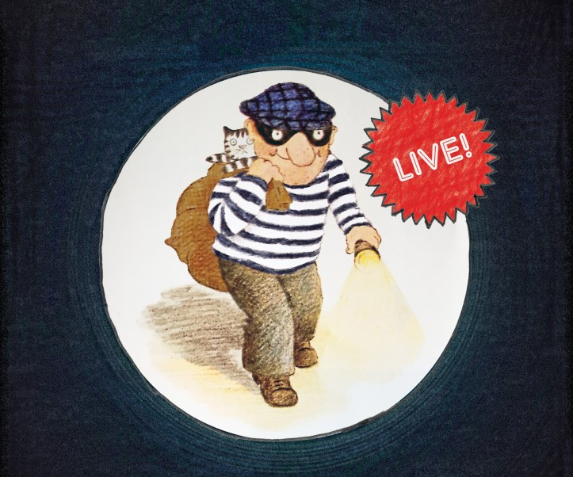
7. Reportingon criminal activity

Slide 48
Reporting on criminal activity
Art 8 – reasonable expectation of privacy [“REOP”] v Art 10 balancing act
Investigations: 2016 ERY v Associated Newspapers Limited; 2017 ZXC v Bloomberg
Witnesses: 2017 - AJS v News Group
Searches: 2018 - Cliff Richard v BBC
Arrest: 2017 – Sun prevented from reporting billionaire’s arrest on suspicion of rape
Convictions in open court: statutory protection for fair & accurate contemporaneous reporting for defamation and contempt; PNM / Khuja v Times Newspapers, 2017
Old Convictions: R (L) v Commissioner for Police for the Metropolis [2009] “as [the conviction] recedes into the past, it becomes a part of the person’s private life”; Re (T) v Chief Constable of Greater Manchester Police [2015] usually when spent under the 1974 Rehabilitation of Offenders Act Act
DPA : arrest, charge, conviction, sentencing - sensitive personal data
Google Spain
RTBF : NT1 / NT2 v Google

Slide 49
THE END

