Slide 1
Accidental Infringement
Patrick Goold
City University

Slide 2
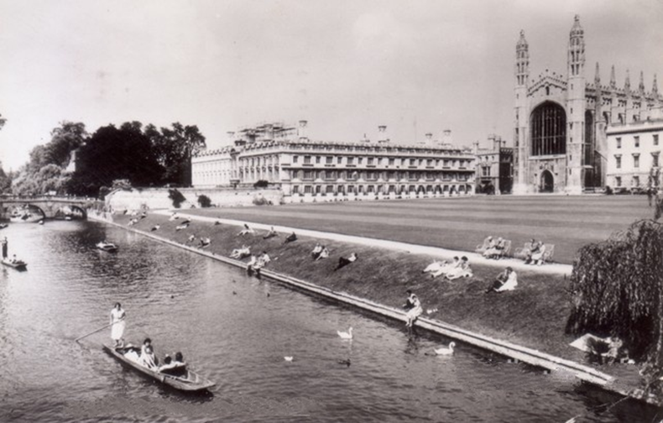
Strict Liability or
Negligence?

Slide 3
The Case for Negligence
Preventing Accidents
1
Incentives for Bilateral Care
Equity
2
Sharing Risk

Slide 4
 | User Incentives | Owner Incentives | Externalities Internalized | Admin. Cost | Error Cost
Strict | Yes | No | No | Low | Moderate
Negligence | Yes | Yes | User only | Moderate | Moderate
Strict + Con. Neg. | Yes | Yes | Owner only | Moderate | High
Negligence + Con. Neg. | Yes | Yes | User only | High | High

Slide 5
Accidental Patent Infringement?

Slide 6
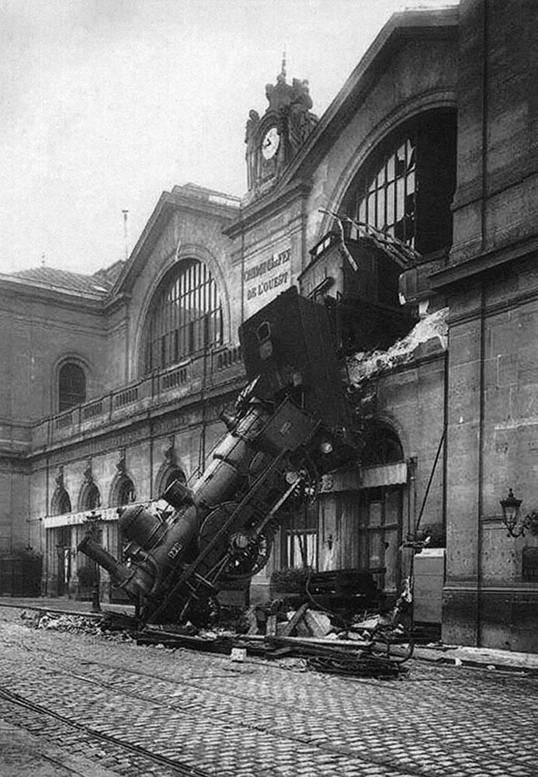

Slide 7
Strict Liability or
Negligence?

Slide 8
Cost of Precaution (B) = Probability of Accident (P) x Loss (L)
B> PL = Take less care
B < PL = Take more care

