Slide 1
Mens rea and trade mark law
In particular: marks having a reputation; due cause

Slide 2
Objective and subjective elements in trade mark conflicts: overview
In general, subjective elements (mens rea) does not play a role in ‘ordinary’ trade mark infringement cases – i.e. cases dealing with likelihood of confusion
That scheme is qualified
when limitations (Art. 14 TMD/EUTM) are invoked
Gerri/Kerry Spring; Anheuser Busch/Budejovicky Budvar
in case of certain uses on the Internet
WIPO Recommendations; UDRP
Posited: Mens rea becomes relevant in those cases because – just as with extended protection of marks having a reputation (and passing off) – the realm of (pure) trade mark law is left for the broader domain of ‘unfair competition’

Slide 3
Protection of marks having a reputation – types of injuries
It is established CJEU case law that Article 9(2)(c) EUTMR (formerly: Article 9(1)(c) CTMR) and Article 10(2)(c) TMD (formerly: Article 5(2) TMD) comprise three types of injury, namely
first, detriment to the distinctive character of the trade mark (‘blurring’),
second, detriment to the repute of that mark (‘tarnishment’) and,
third, unfair advantage taken of the distinctive character or the repute of the mark,
just one of those types of injury sufficing for the rule set out in those provisions to apply.

Slide 4
Commonalities and differences between the individual types of injuries, I
For all three types of injuries alike, a finding of infringement requires the existence of a ‘link’, i.e. that the mark is called to mind by the sign used by the competitor
The following – objective! - factors are considered for that purpose:
the degree of similarity between the conflicting marks;
the nature of the goods or services for which the conflicting marks were registered, including the degree of closeness or dissimilarity between those goods or services, and the relevant section of the public;
the strength of the earlier mark’s reputation;
the degree of the earlier mark’s distinctive character, whether inherent or acquired through use;
the existence of a likelihood of confusion on the part of the public.

Slide 5
Commonalities and differences between the individual types of injuries, II
In case of blurring and tarnishment, it must be shown in addition to the existence of a link,
“that the use of the later mark is or would be detrimental to the distinctive character of the earlier mark requires evidence of a change in the economic behaviour of the average consumer of the goods or services for which the earlier mark was registered consequent on the use of the later mark, or a serious likelihood that such a change will occur in the future” (CJEU, Intel, para 81)
The concept of ‘change in the economic behaviour of the average consumer’ lays down an objective condition (CJEU, Environmental manufacturing (‘Wolf’), para 37).

Slide 6
Commonalities and differences between the individual types of injuries, III
In case of taking advantage, the additional requirement appears to be a subjective one, namely that
“a third party attempts, through the use of a sign similar to a mark with a reputation, to ride on the coat-tails of that mark in order to benefit from its power of attraction, its reputation and its prestige, and to exploit, without paying any financial compensation and without being required to make efforts of his own in that regard, the marketing effort expended by the proprietor of that mark in order to create and maintain the image of that mark, the advantage resulting from such use must be considered to be an advantage that has been unfairly taken of the distinctive character or the repute of that mark” (CJEU, L’Oréal/Bellure, para 49; emphasis added)
Thus, intent is a necessary – and also sufficient? – requirement for finding infringement

Slide 7
…and what about ‘due cause’?
In L’Oréal the CJEU did not bother about examining possible justifications for the alleged infringers’ actions
they obviously considered themselves bound by Article 4 lit. g (then: Article 3a(1)(h)) of the Comparative Advertising Directive
More emphasis was placed on ‘due cause’ in Interflora and, in particular, Leidseplein (Red Bull)

Slide 8
C-65/12 - Leidseplein v. Red Bull, I
Defendant had used the sign ‘The Bulldog’ as a trade name for hotel, restaurant and café services involving the sale of drinks, prior to 1983 when ‘Red Bull’ was registered for the plaintiff in the Netherlands.
Defendant registered ‘The Bulldog Energy drink’ as Benelux mark in 2000, when the defendant already enjoyed a reputation
The question was referred to the CJEU whether prior use of the sign ‘The Bulldog’ constituted ‘due cause’ for use of that sign for goods identical with those that the plaintiff’s mark had a reputation for.
The CJEU noted
that the protection of a mark under (then Article 5(2) TMD) is extensive, but not unconditional, meaning that a balance must be struck between the interests involved (para 42);
that the onus to prove due cause lies on the party invoking it (para 44);
that concept of ‘due cause’ may not only include objectively overriding reasons but may also relate to the subjective interests of the alleged infringer (para 45);
that the deciding court had to
determine how the earlier sign is accepted by, and what its reputation is with, the relevant public (para 54):
examine the intention of the person using that sign, that is, whether the use is made in good faith (para 55).

Slide 9
C-65/12 - Leidseplein v. Red Bull, II
More specifically, the CJEU pointed out that
“(56) For determining whether the use of the sign…was in good faith, it is necessary to take account of the degree of proximity between the goods and services for which that sign has been used and the product for which that mark was registered, as well as to have regard for when that sign was first used for a product identical to that for which that mark was registered, and when that mark acquired its reputation.
(57) First, where a sign has been used prior to the registration of a mark with a reputation in relation to services and goods which may be linked to the product for which that mark has been registered, the use of that sign in relation to that latter product may appear to be a natural extension of the range of services and goods for which that sign already enjoys a certain reputation with the relevant public.” (emphasis added)

Slide 10
Comments and questions
Although Leidseplein is a welcome indication that the CJEU (finally!) recognises the importance of considering ‘due cause’, its impact may be narrower than what appears at first glance.
It is unclear
whether and to what extent a ‘natural expansion of business’ is acceptable if it occurs after the allegedly infringed sign had acquired reputation (see also GC - 528/13…. – Kenzo Estate; confirmed by the CJEU by order (C-87/16 P)
whether this means that if the alleged infringer knew or must have known that the mark had a reputation when use was made of it, any attempt to establish due cause is bound to fail (with an exception only for comparative advertisement and similar cases (adwords)), or whether more (and if so, what?) is required
And: What all this means for parodies….

Slide 11
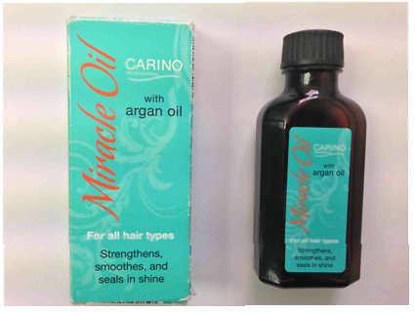
A look at passing off: Moroccanoil Israel Ltd v. ALDI Stores [2014] EWHC (IPEC) (and other decisions)

Slide 12
Intention to deceive v. intention to ‘live dangerously’
In Moroccanoil, Judge Hacon (quoting inter alia Kitchin LJ in Specsavers v. ASDA) distinguishes between ‘an intent to take the benefit of the claimant's goodwill’ and ‘an intent to live dangerously’, considering that the first indicates infringement whereas the latter is neutral.
Regarding the actual dispute the judge concluded
“I do not think there was anything unlawful in Aldi creating a product with get-up which brought the get-up of Moroccanoil to mind. I think Aldi intended to do so and succeeded, to the point that some of the public interested in hair oil thought that the similarities were cheeky and might infringe rights relating to design. That is not passing off. So living dangerously in that regard is not relevant.”

Slide 13
Arguments transferrable to ‘unfair advantage’ and ‘due cause’?
In L’Oréal v. Bellure, the defendants had certainly chosen to ‘live dangerously’, but clearly had no intent to deceive.
As said before, the CJEU nevertheless concluded that the attempt to ride on the coat-tails of the precious marks was sufficient to find for infringement (possibly under the influence of the Comparative Advertising Directive; see above).
Leidseplein did not send a sufficiently clear message to change the situation
And, in contrast to passing off, extended protection does not require misrepresentation, so the distinction may be inapplicable anyhow…
But does that render the provision inherently imbalanced? (maybe, unless ‘due cause’ is interpreted broadly)

Slide 14
Lastly, what about parodies?
There seems to be very little case law in Europe regarding trade mark parodies
EP suggested inserting an express provision making use of marks in the context of parody and satire permissible (if compliant with ‘honest practices’).
The suggestions are reflected to some extent in Recital 21:
“Use of a trade mark by third parties for the purpose of artistic expression should be considered as being fair as long as it is at the same time in accordance with honest practices in industrial and commercial matters. Furthermore, this Regulation should be applied in a way that ensures full respect for fundamental rights and freedoms, and in particular the freedom of expression”
Most likely, parodies are only considered as permissible if intent to profit commercially (selling of postcards, T-shirts etc.) is (non-existent or) offset by the seriousness of the policy goals underlying the message
No place in Europe for simply making fun of famous marks?

Slide 15
German case: Thor Steinar v. Storch Heinar - Parody permitted

Slide 16
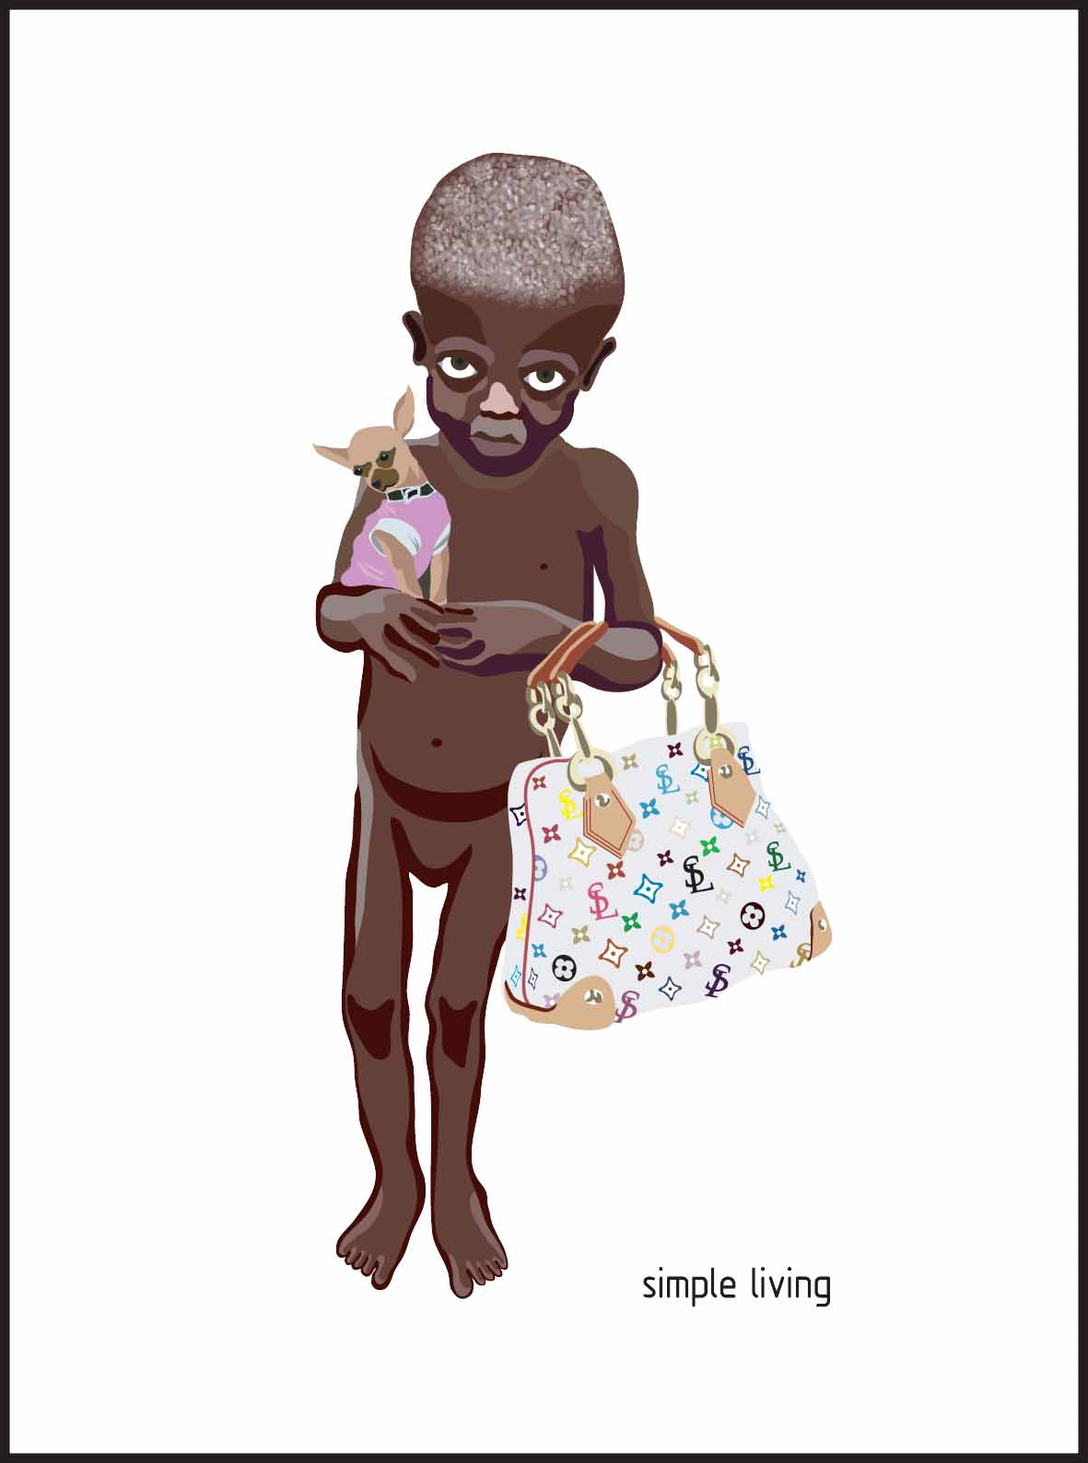
An example from Design Law: Nadja Plesner’s ‘Darfur’ tableau (with detail)

Slide 17
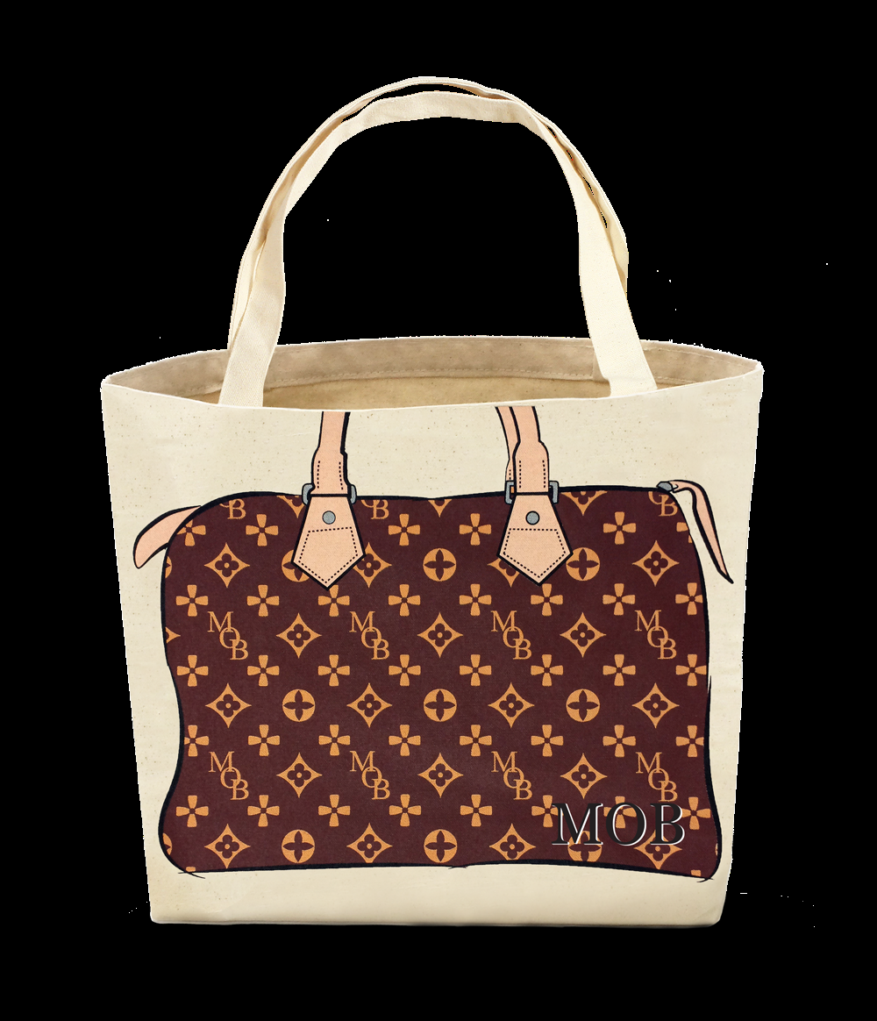
How would judges in Europe look upon this?

Slide 18
Thank you for your attention!
annette.kur@ip.mpg.de

