Slide 1
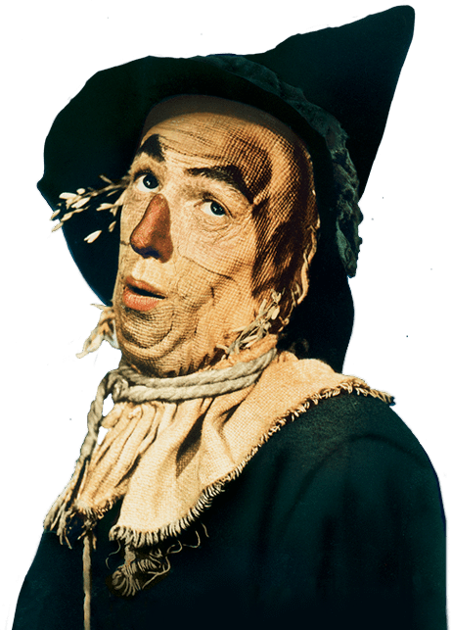
intention and knowledge in copyright: Communication to the public and article 13
CIPIL Spring Conference 2019
Eleonora Rosati
eleonora@e-lawnora.com
@eLAWnora

Slide 2
contents
The mutation evolution of the right of communication to the public
Disappearance of secondary liability?
Policy and legislative developments: The ‘value gap’ proposal
Implications

Slide 3
right of communication to the public
«Member States shall provide authors with the exclusive right to authorise or prohibit any communication to the public of their works, by wire or wireless means, including the making available to the public of their works in such a way that members of the public may access them from a place and at a time individually chosen by them.»
Article 3(1) InfoSoc Directive

Slide 4
PURPOSE-DRIVEN Construction of the right
An ‘act of communication’
Transmission vs accessibility
«Incontournable» intervention
Full knowledge of the consequence of one’s own intervention (since SGAE)
To a ‘public’
Same technical means
New public (undue exhaustion? implied licence?)
(Other interdependent, non-autonomous criteria)
Reha Training (2016 – Grand Chamber): profit-making nature of the communication not conclusive, yet not «irrelevant»

Slide 5
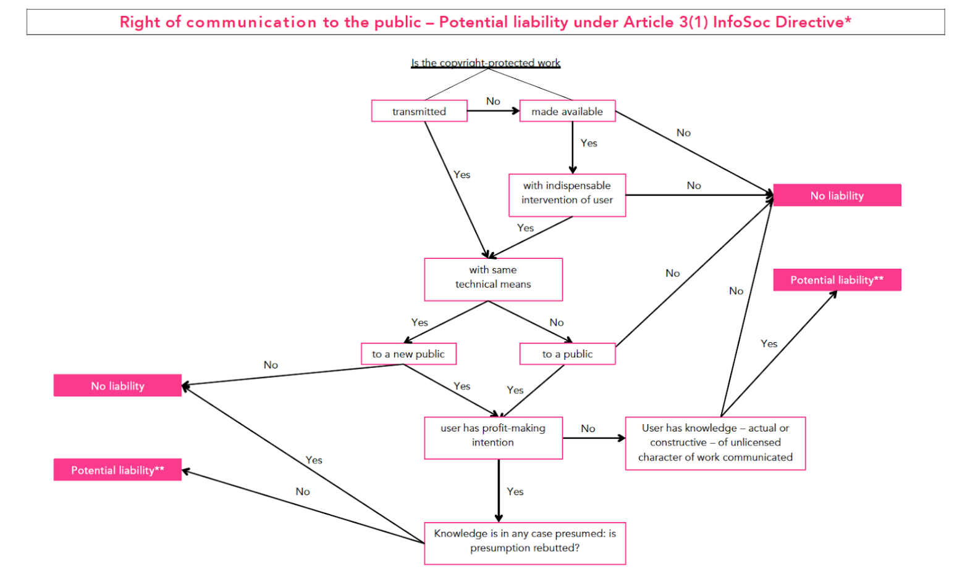

Slide 6
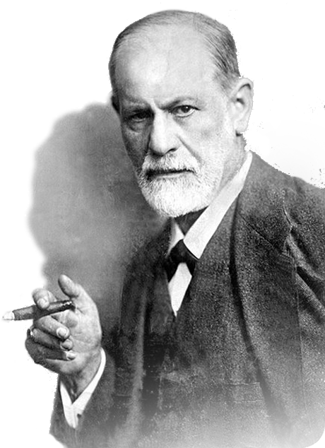
When did psychology Neurosis become DECISIVE?
What the claimant thought: Svensson
What the defendant wanted: GS Media, Ziggo
What the defendant knew or ought to know: GS Media, Ziggo
What the defendant is presumed to know: GS Media, (Ziggo)
What the defendant ‘assumed’: AG Campos in Renckhoff

Slide 7
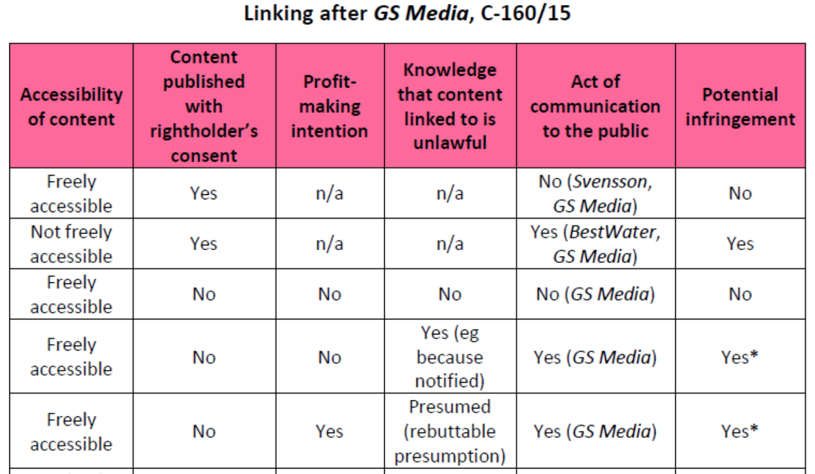
Linking after GS MEdia
Profit-making intention: context or relevant act?
Application of presumption: the BGH ‘rebellion’
Is it even a primary act of communication? AG Wathelet in GS Media

Slide 8
A possible cause?
«The European Commission … contends that liability for sites of this type is a matter of copyright application, which can be resolved not at the level of EU law but under the domestic legal systems of the Member States. Such an approach would, however, mean that liability, and ultimately the scope of the copyright holders’ rights, would depend on the very divergent solutions adopted under the different national legal systems. That would undermine the objective of EU legislation in the relatively abundant field of copyright, which is precisely to harmonise the scope of the rights enjoyed by authors and other rightholders within the single market. That is why the answer to the problems raised in the present case must, in my view, be sought rather in EU law.»
Opinion of AG Szpunar in Ziggo, C-610/15

Slide 9
State of EU copyright harmonization
Objectives of EU copyright harmonization
Need for further ‘push’ … nothing new for CJEU!

Slide 10
The traditional approach: primary and secondary liability
«[T]he state of mind of the defendant is not formally taken into account when deciding whether an act of primary infringement has occurred. In the case of secondary infringement, however, liability is dependent on the defendant knowing, or having reason to believe, that the activities in question are wrongful.»
Bently and Others, Intellectual Property Law (2018:OUP), 5th edn

Slide 11
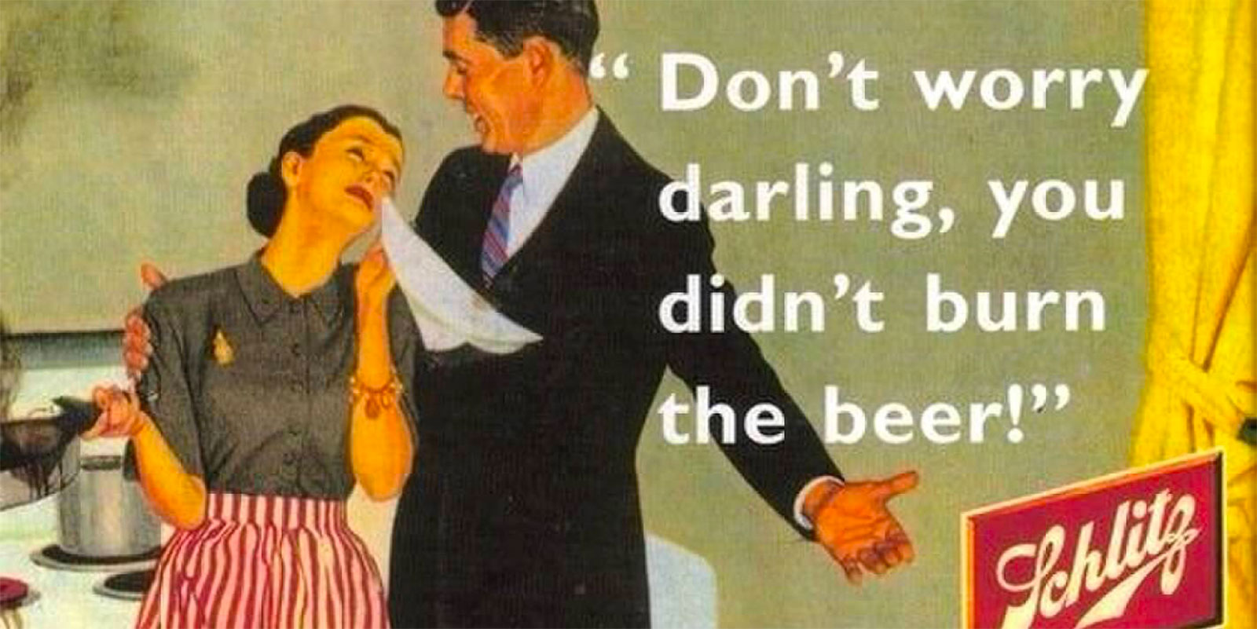
Passé?

Slide 12
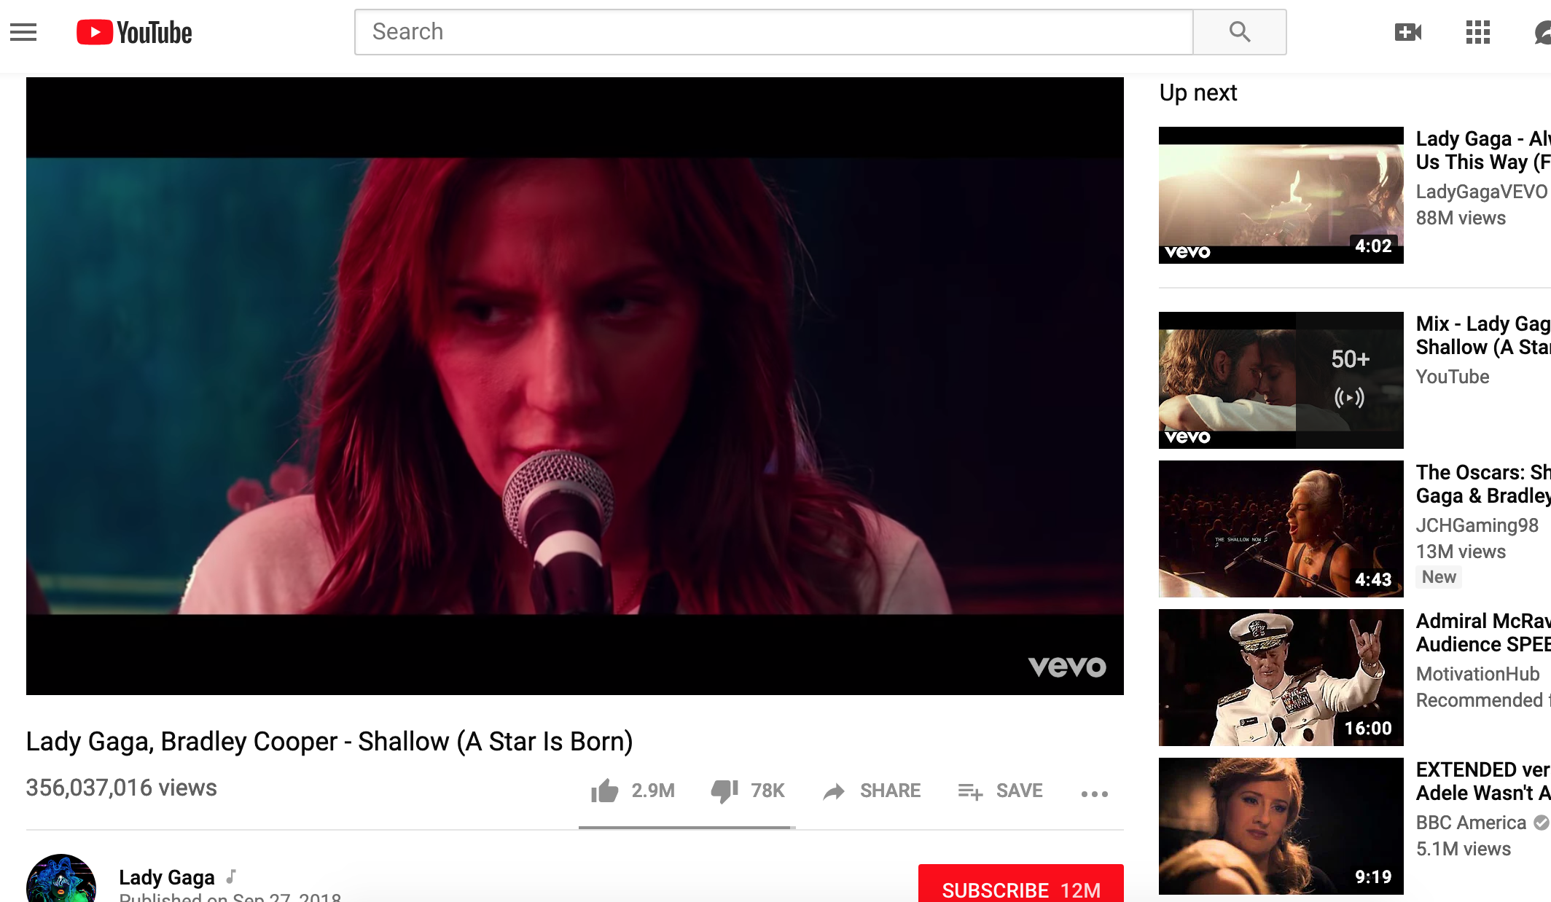
Platform liability after ziggo
Too easy saying: if you call yourself Pirate Bay, don’t be surprised
Safe harbour availability
YouTube, C-682/18: a useless referral?
Individual assessment

Slide 13
Policy and legislative developments: The ‘value gap’ proposal
Article 13(1)-(2)
«an online content sharing service provider performs an act of communication to the public or an act of making available to the public for the purposes of this Directive when it gives the public access to copyright protected works or other protected subject matter uploaded by its users. An online content sharing service provider shall therefore obtain an authorisation from the rightholders … This authorisation shall also cover acts carried out by users of the services falling within Article 3 of Directive 2001/29/EC when they are not acting on a commercial basis or their activity does not generate significant revenues.»
Article 1(5)
«‘online content sharing service provider’ means a provider of an information society service whose main or one of the main purposes is to store and give the public access to a large amount of copyright protected works or other protected subject-matter uploaded by its users which it organises and promotes for profit-making purposes.»

Slide 14
A surprising evolution?
Providing a platform for profit
Content uploaded by users
Organization and promotion of content
Communication to the public
Progressive relaxation of concept of «incontournable» intervention
If secondary liability has disappeared, so have safe harbours?

Slide 15
COMPLICATIONS Implications

Slide 16
A DIAGNOSIS?
State and goals of EU copyright harmonization
Creation of an internal market
‘High level of protection’
Preventive nature of economic rights
Progressive construction of concept of communication to the public
Unhelpfulness of national responses
Yet not a problem-free application of CJEU decisions at national level
Mutation of copyright infringements and liabilities

Slide 17
A treatable condition?
Patchwork harmonization
Instrument chosen to harmonize
Diverging national transpositions
Role of CJEU
De facto further harmonization
Less room for national solutions
Not necessarily less room for uncertainties
A solution?
Better instruments
Greater harmonization

Slide 18
Thanks for your attention!
eleonora@e-lawnora.com
@eLAWnora

