Slide 1
International human rights law
An Overview

Slide 2
The international human rights system
Universal Declaration of Human Rights, 1948
→ GA Resolution | Not binding
  → Truly a founding document?
Art 1: ‘All human beings are born free and equal in dignity and rights’
Art 2: No discrimination
Art 3-21: Civil and political rights
Art 17. Right to own property
Art 22-28: Economic, social and cultural rights
Art 29: Limitations
Notes:
“milestone document in the history of human rights”
Drafted by representatives with different legal and cultural backgrounds
common standard of achievement for all peoples and all nations
Not founding:
Soon forgotten. Messy road to binding treaties
Compromise at its heart – no self determination

Slide 3
The Treaties
‘International Bill of Rights’ – GA recommends inclusion of ESRs into HR Covenant in 1950; recommends split following ECOSOC request in 1952 (GA Res 543)
  Covenant on Economic, Social and Cultural Rights 1966 (ICESCR)
  Covenant on Civil and Political Rights 1966 (ICCPR)
  In force: 1976

Slide 4
ICCPR and ICESCR
ICCPR
Part I (Art 1): Self determination
Part II: Non discrimination and fulfilment provisions
Part III: Enumeration of rights
Part IV: Oversight
Part V: Non-obstante clauses
Part VI: Validity, amendment, etc.
ICESCR
Part I (Art 1): Self determination
Part II: Non discrimination and fulfilment provisions
Part III: Enumeration of rights
Part IV: Oversight
Identical provisions in Arts 24-25
Part V: Validity, amendment, etc.
Notes:
Non-obstante – UN Charter, PSNR/ economic self determination

Slide 5
The Treaties
Convention on the Elimination of All Forms of Racial Discrimination 1965 (CERD)
Women. Convention on the Elimination of All Forms of Discrimination against Women 1979 (CEDAW) OP 1999
Children. Convention on the Rights of the Child 1989 (CRC) OP-AC 2000; OP-SC 2000; OP-IC 2014
Migrant Workers. International Convention on the Protection of the Rights of All Migrant Workers and Members of their Families 1990 (ICRMW)
Persons with Disabilities. Convention on the Rights of Persons with Disabilities 2006 (CRPD) OP 2006
Convention against Torture and Other Cruel, Inhuman or Degrading Treatment or Punishment 1984 (CAT) OP 2002
Convention for the Protection of All Persons from Enforced Disappearance 2006 (CPED)

Slide 6
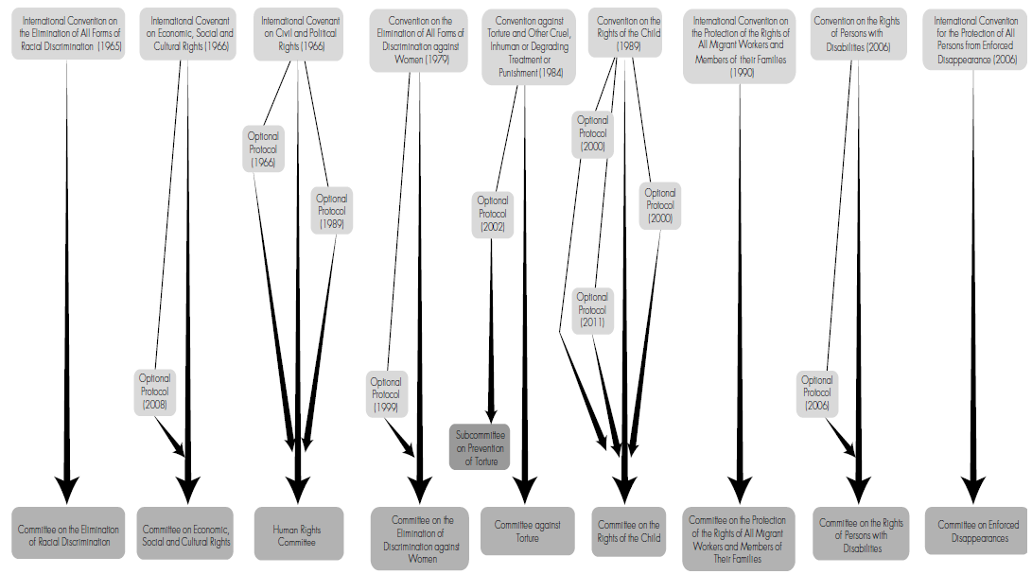
The Treaties

Slide 7
CCPR And CESCR: Some Provisions
Article 1 (2)
All peoples may, for their own ends, freely dispose of their natural wealth and resources without prejudice to any obligations arising out of international economic co-operation, based upon the principle of mutual benefit, and international law. In no case may a people be deprived of its own means of subsistence.
Article 47 / Article 25
Nothing in the present Covenant shall be interpreted as impairing the inherent right of all peoples to enjoy and utilize fully and freely their natural wealth and resources.

Slide 8
CESCR: Some provisions
Article 15
1. The States Parties to the present Covenant recognize the right of everyone:
(b) To enjoy the benefits of scientific progress and its applications;
(c) To benefit from the protection of the moral and material interests resulting from any scientific, literary or artistic production of which he is the author.

Slide 9
CESCR: Some provisions
Article 11
1. The States Parties to the present Covenant recognize the right of everyone to … adequate food, clothing and housing, and to the continuous improvement of living conditions. The States Parties will take appropriate steps to ensure the realization of this right, recognizing to this effect the essential importance of international cooperation based on free consent.
2. The States Parties to the present Covenant, recognizing the fundamental right of everyone to be free from hunger, shall take, individually and through international co-operation, the measures, including specific programmes, which are needed:
  (a) To improve methods of production, conservation and distribution of food by making full use of technical and scientific knowledge, by disseminating knowledge of the principles of nutrition and by developing or reforming agrarian systems in such a way as to achieve the most efficient development and utilization of natural resources;

Slide 10
Non-discrimination and fulfilment
ICCPR
Art 2
1. Each State Party … undertakes to respect and to ensure to all individuals within its territory and subject to its jurisdiction the rights …
2. … each State Party … undertakes to take the necessary steps … to adopt such laws or other measures as may be necessary to give effect to the rights …
Art 3
3. Each State Party … undertakes: (a) To ensure that any person whose rights or freedoms as herein recognized are violated shall have an effective remedy,…
ICESCR
Art 2
1. Each State Party … undertakes to take steps … to the maximum of its available resources, with a view to achieving progressively the full realization of the rights … by all appropriate means, including particularly the adoption of legislative measures.
3. Developing countries, with due regard to human rights and their national economy, may determine to what extent they would guarantee the economic rights … to non-nationals.

Slide 11
Fulfilment – ICESCR
Interpreted as having some obligations of immediate effect:
a) No discrimination
b) Obligation to take steps: must be concrete, deliberate and targeted
And ‘minimum core’ obligations (ESCR Committee)
States must ensure the satisfaction of minimum essential levels of each of the rights
A State party in which any significant number of individuals is deprived of essential foodstuffs, essential primary health care, basic shelter and housing, or most basic forms of education is, prima facie, failing to discharge its obligations

Slide 12
Fulfilment
Respect:
  Do not infringe rights
Protect:
  Create environment in which rights enjoyed; third parties do not violate
  Due diligence obligation
Fulfil:
  Ensure greater enjoyment of rights
  Can include obligations of result and conduct
  Legislative, judicial, administrative, educative etc. measures, remedies

Slide 13
Oversight via Treaty bodies
1) Periodically receive and consider reports by states
    States: measures taken + difficulties encountered
    Committee: may also receive information from others
    Reports considered in public session. Idea of ‘constructive dialogue’
    Issues ‘Concluding Observations’: progress + concern + specific recommendations + practical advice
  2) Inter-state complaints
  Opt-in clause. No complaints received

Slide 14
Treaty bodies
3) Individual communications
Not anonymous. But CESCR provides state duty to ensure complainant protection
Closed meetings. Oral hearings rare. Views determined by consensus (generally). Forwarded to state and individual
4) General Comments
Interpretations of specific rights or treaty provisions
Guidance on information to be submitted in State reports,
Cross-cutting issues, e.g. role of NHRIs, rights of persons with disabilities, violence against women, rights of minorities
How authoritative?

Slide 15
How authoritative are General Comments?
USA on Human Rights Committee:
“[The ICCPR] scheme … does not impose on States Parties an obligation to give effect to the Committee’s interpretations or confer on the Committee the power to render definitive or binding interpretations of the Covenant. The drafters of the Covenant could have given the Committee this role but deliberately chose not to do so … The Committee’s position, while interesting, runs contrary to the Covenant scheme and international law.
ECtHR on Torture Committee:
It has been argued that any rule of international law granting immunity to State officials has been abrogated by the Convention against Torture which, it is claimed, provides in its Article 14 for universal civil jurisdiction. This argument finds support from the Committee Against Torture ... This interpretation has been rejected by courts in both Canada and the UK… The question whether that Convention has given rise to universal civil jurisdiction is therefore far from settled
Notes:
Might be supposed to have specific expertise in the area, but comments not taken as authoritative
Slide 10 – ESCR committee bases this on empirical evidence.

Slide 16
Features of Human Rights Treaties (Some are controversial!)
1. ‘erga omnes’ obligations
2. ‘purpose’ is important: to interpretation of provisions and reservations
3. reservations incompatible with purpose of treaty may be disregarded
4. a State cannot withdraw human rights protections by terminating treaty
5. a State cannot claim a breach by another state as basis for terminating treaty (+ cannot adopt countermeasures that violate human rights obligations)
Notes:
effective, real, and concrete

Slide 17
The UN Human rights syStem
UN General Assembly
Human Rights Council
Special Procedures
Most Treaty Bodies
ECOSOC
ESCR Committee
Secretariat
Office of the High Commissioner for Human Rights

Slide 18
Human Rights council
Succeeded ‘Human Rights Commission’ in 2006
Reports to the UN General Assembly
Intergovernmental body, 47 states
Monitoring function:
    (1) Universal Periodic Review
    (2) Complaints mechanism
    (3) Special procedures

Slide 19
Universal Periodic Review
Docs.
National Report (20pp) achievmts, challenges, priorities, requests for tech. asst.
OHCHR Compilation of UN Info (10pp) obsvns and cmmts by treaty bodies & spl. procedures, etc.
Review
3.5 hr dialogue (UPR working Group, State, and observers). Outcome report: reccos, state response
1 hr discussion in HRC: state can indicate acceptance/objection. NGOs, other states etc. may comment
Final outcome report adopted. Basis for follow-up at next review
Follow-up
Next review
Mid-term reports encouraged by Council
OHCHR, UN agencies, regional orgs and CSOs
OHCHR Summary of Stakeholders Info (10pp): info from NGOs, NHRIs, academics, regional orgs
Notes:
4.5 yr. cycle. Every state reviewed by ref. to relevant standards (UN Charter, UDHR, HR treaties, voluntary commitments & pledges)
Practical success? 2/3 reccos accepted; near universal participation. But quality of reccos? Vague, repetitive, based on what?
Enforcement? Not clear what, beyond encouragement, might be done vis-à-vis recalcitrant state
Objectivity? Friendly states praise

Slide 20
Complaints procedure
Patterns of gross and reliably attested violations
Victims or others with reliable knowledge of violations
Should not overlap with ongoing or decided complaint at another forum
11-15K complaints p.a.: screened by OHCHR. Handful go to Council
Confidential
Notes:
Since complainant and state kept informed of progress, incentive for state to act immediately to avoid public scrutiny
W.r.t. Eritrea 2012, confidentiality removed and a Special Rapporteur appointed

Slide 21
Special Procedures etc.
Working Groups & Special Rapporteurs, with thematic and country mandates
Urgent debates, during regular sessions or special sessions.
  Issues such as economic and food crises,
  Situations in particular states (multiple sessions on Israel, Syria)

Slide 22
Office of the High Commissioner of Human Rights
Part of UN Secretariat. Secretariat for Treaty Bodies and Council
Supports work of High Commissioner for Human Rights
Key roles in promoting and protecting human rights include:
  Recos to UN bodies, rationalizing UN HR machinery; coordinating UN’s public info & education programmes
  Managing advisory, technical and financial assistance to states to fulfil human rights
  Rapid deployment in emergencies
  Growing field presence, for early warning and prevention

Slide 23
Some issues
Fragmented system. Places great reporting burden on States.
→ All bodies emphasize coordination
→ Have sought to harmonize monitoring and reporting requirements
What is monitored: (a) enjoyment of rights or (b) fulfilment of obligations or (c) states own monitoring of (a) or (b)
→ Use of nationally developed indicators; bodies monitor monitoring
→ Efforts to develop international ‘illustrative’ indicators; but context & interpretation
Compliance

Slide 24
“Third generation” rights
Self determination
Right to development
Environmental rights
Right to natural resources
- Collective rights (but, see below: European Commission describing ‘data protection’ as third generation right)

Slide 25
European Protection of Human Rights
European Convention on Human Rights, 1950 (with several protocols)
Ratification condition of membership of CoE
Sets out civil and political rights
Protocol 1 Art 1: Right to peaceful enjoyment of possessions.
Establishes European Court of Human Rights
    Interpretation and application of Convention
    Cases may be brought by States or Individuals, against States
    Effectiveness and Purpose| Proportionality analysis| Margin of appreciation
    Execution of judgments: supervised by the CoE’s Committee of Ministers
Notes:
Interpretation: purpose of treaty, effectiveness of enjoyment of human rights
Rights interpreted broadly, exceptions narrowly; must show necessary and tailored to achieve a specific legitimate aim, incl. rights and freedom of others.
Nevertheless, margin of appreciation permitted to states: allows them, for example, to indicate their preferred concept pf something like ‘public morals’ protection of which permits limitation of many human rights.

Slide 26
European Protection of Human Rights
European Social Charter, 1961 (revised 1996)
Also part of CoE, but membership not conditioned on ratification (most sts are parties)
Economic and social rights
States can choose provisions they do not wish to accede to
Available to citizens, lawful residents only
Compliance monitored by European Committee of Social Rights
- Reporting procedure
- Complaints mechanism (opt in via OP): employers’ orgs, trade unions, NGOs

Slide 27
EU Charter of fundamental rights
Proclaimed in 2000, binding on member states since 2009 (Treaty of Lisbon)
Addressed to: (i) EU institutions and bodies; (ii) states only when implementing EU law
Civil and political; economic, cultural and social rights
- Art 17. Right to Property (incl. intellectual property)
And third generation rights (e.g. data protection)
Content of rights by reference to ECHR
Does not provide additional mechanism for individual petitions; right to access CJEU under TFEU, if applicant affected ‘by reason of attributes peculiar to them’ or ‘by reason of circumstances in which they are differentiated from other persons’
Notes:
Restrictions must be necessary and proportionate to objectives of general interest recognized by EU, or protect rights and freedoms of others
In so far as this Charter contains rights which correspond to rights guaranteed by the Convention for the Protection of Human Rights and Fundamental Freedoms, the meaning and scope of those rights shall be the same as those laid down by the said Convention. This provision shall not prevent Union law providing more extensive protection.
Direct or indirect discrimination

