Slide 1
‘National Trade Mark: Law, Signs and culture in Mandate Palestine’ by Michael Birnhack
Commentary by Lionel Bently

Slide 2
General
Mandate Palestine ‘1917-1948’
Balfour Declaration (1917)
League of Nations Mandate 1922: home for Jewish people/to facilitate self-government
Governed by High Commissioner (initially Herbert Samuel) with an Advisory Council
Population: 750,00 to 1,750,00. Arabic component initially 88%. Jewish population increased from 11 to 31% (550,000).
Arab Revolt 1936-9

Slide 3
Three Parts
Legal History: Adoption of TM Law, interpretation, amendment
Trademark Data: Who Applied? For what?
Cultural Meaning: treatment in TM office, and more general observations

Slide 4
Legal History
Trademarks Ordinance 1921 and 1938, based on Trade Marks Act 1905 (GB)
Merchandise Marks Ordinance 1929, based on Nigerian MMO, and on MMA 1887
Existing Ottoman Law did not comply with Paris (1911 revision) (‘the excuse’)
The need for a TM registration system was ‘taken for granted’
‘a colonial legal transplant’, but with variations
Examines case-law, esp Supreme Court, which followed ‘English precedents’
Judicial emphasis on ‘consumers’

Slide 5
Legal History
‘the British acted first and foremost so to promote the interests of the colonizer ie of foreign, mainly British traders who exported their products to Palestine’
Is there any evidence of pressure from British businesses on BT/CO, and thus pressure on HC of MP?
Does a TM system ‘promote interests’? How? Cf India (no TM registration system until 1940)
Other explanations: international ‘zeitgeist’ (Dimou); ‘nation building’ for MP

Slide 6
The Mandate, art 19
‘The Mandatory shall adhere on behalf of the Administration of Palestine to any general international conventions already existing, or which may be concluded hereafter with the approval of the League of Nations, respecting … literary, artistic or industrial property.’

Slide 7
Empirical Analysis
MB reconstructed TM register from official gazette
‘trademark registries provide us with rather accurate data about the use of the law in the field.’ Do they? Would we be comfortable with such an observation today?
Mirrors population growth, especially middle class of third wave (1930s), and geopolitical events (uprising, war)

Slide 8
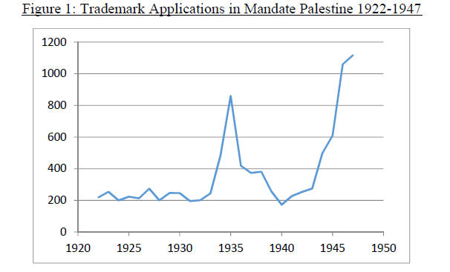
Trademark Applications

Slide 9
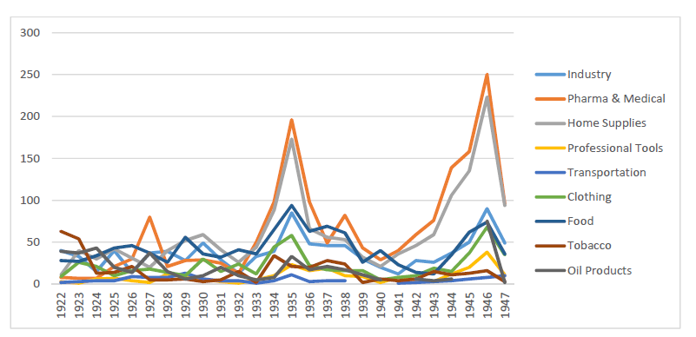
By Class

Slide 10
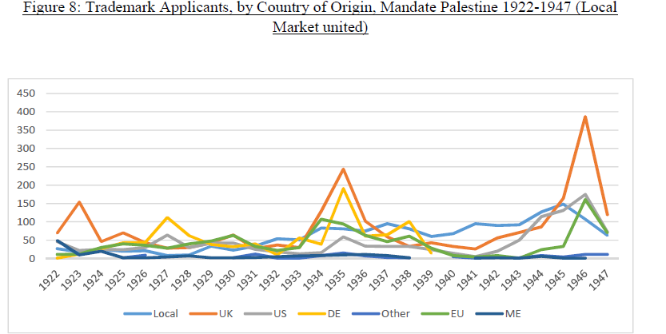
By Applicant

Slide 11
‘Critical Cultural History’
Examines the trademarks registered
Aim to locate ‘the big picture, the cultural trademark mosaic’
‘self aware uses’ signal ‘emergence of brands’: LB dubious.
Finds ‘the cultural content was fuelled with issues of nationality’
Arab-owned marks contained images (87%), compared to Jewish owner (55%)
Categorises content (religious symbols, animals etc)

Slide 12
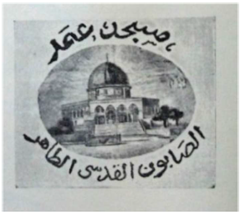
Arab Chamber of Commerce/Sup Moslem Council v Hannoch (1938)
Applicant: Moshe Hannoch from Tel Aviv
For soap
‘Omar Mosque’ ‘Pure Jerusalem Soap’
Was it ‘injurious to public order or morality?’
Registrar did not think so, but application was withdrawn

