Slide 1
REVISITING PERSONHOOD THEORIES AND EFFECTIVE AI LEGAL FRAMEWORK: CONTEMPORARY AND MUSLIM’S DISCOURSE
IDA MADIEHA BT ABDUL GHANI AZMI
PROFESSOR
IIUM

Slide 2
Key Points
Where we come from – the liability gap
Debates on AI personhood
Liability gap within Muslim scholar’s discourse
Analogy with corporate bodies as artificial entities
conclusion

Slide 3
European Parliament Resolution on Civil Law Rules on Robotics (2017)
Creating a specific legal status for robots in the long run, so that at least the most sophisticated autonomous robots could be established as having the status of electronic persons responsible for making good any damage that may cause, and possibly applying electronic personality to cases where robots make autonomous decisions or otherwise interact with third parties independently”.

Slide 4
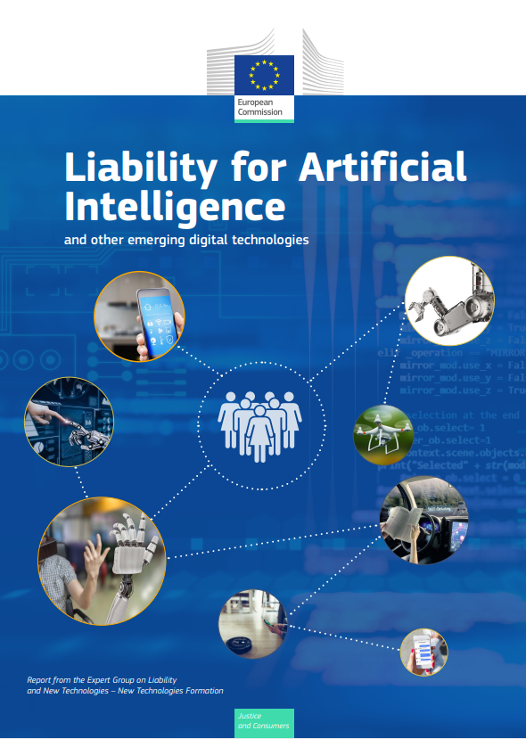
Expert Group on Liability and New Technologies (2019)
There is currently no need to give a legal personality to emerging digital technologies. Harm caused by even fully autonomous technologies is generally reducible to risks attributable to natural persons or existing categories of legal persons, and where this is not the case, new laws directed at individuals are a better response that creating a new category of legal person.
Any additional personality .. Amount to putting a cap on liability and – as experience with corporations has shown- subsequent attempts to circumvent such restrictions by pursuing claims against natural or legal persons to whom electronic persons can be attributed, effectively ‘piercing the electronic veil’.

Slide 5
Resolution 2020/2014 on a Civil liability regime for artificial intelligence
Notes that all physical or virtual activities, devices or processes that are driven by AI-systems may technically be the direct or indirect cause of harm or damage, yet are nearly always the result of someone building, deploying or interfering with the systems;
notes in this respect that it is not necessary to give legal personality to AI-systems; is of the opinion that the opacity, connectivity and autonomy of AI-systems could make it in practice very difficult or even impossible to trace back specific harmful actions of AI-systems to specific human input or to decisions in the design;
recalls that, in accordance with widely accepted liability concepts, one is nevertheless able to circumvent this obstacle by making the different persons in the whole value chain who create, maintain or control the risk associated with the AI-system liable;

Slide 6
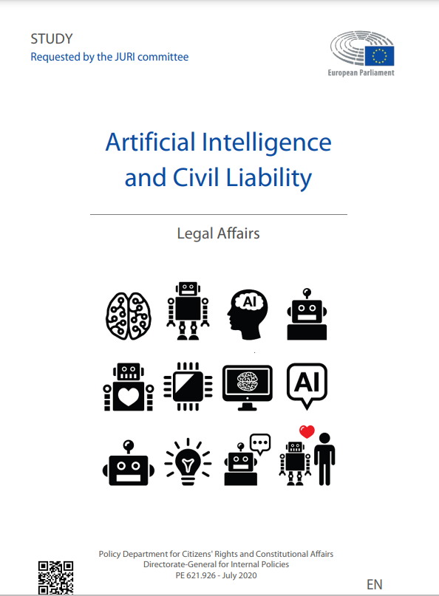
European Parliament – Study requested by the JURI committee
As of today, the only possible fundamental and universal consideration about AI-systems, is that there is no philosophical, technological nor legal ground to consider them anything but artefacts generated by human intellect, and thence products.

Slide 7
The liability gap
All advanced technologies are not subjects, but merely objects, and there are no reasons to grant them rights, nor hold them legally responsible. Even in light of existing liability rules, it is always theoretically possible to identify a human being who might be deemed responsible for damages arising from the use of the device. In this sense, the liability framework may be suboptimal- e.g. because it gives rise to high-cost and complex litigation- but excludes the existence of a responsibility gap.

Slide 8
Functional perspective
… we may identify some conditions … appropriate to attribute a fictitious form of legal personality to a specific class of applications, as it is today done with corporations to
(i) achieve coordination between different parties (replacing contracts)
(ii) separate assets and limit liability
(iii) differentiate tax treatment from that reserved to natural persons
Attributing legal personality is not the only way of achieving this effects. For most of, if not all, existing applications, resorting to other legal tools is indeed preferable.

Slide 9
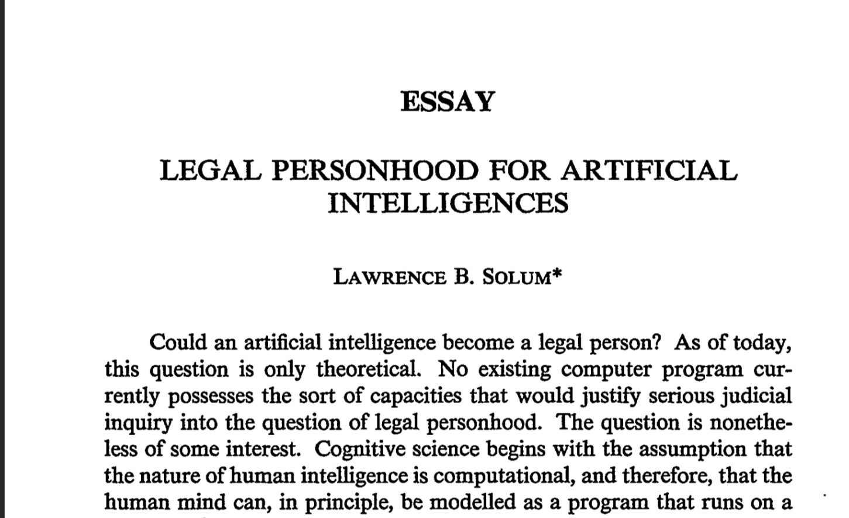
THE MAIN INQUIRY
Could an artificial intelligence become a legal person? As of today, this question is only theoretical. No existing computer program currently possesses the sort of capacities that would justify serious judicial inquiry into the question of legal personhood.

Slide 10
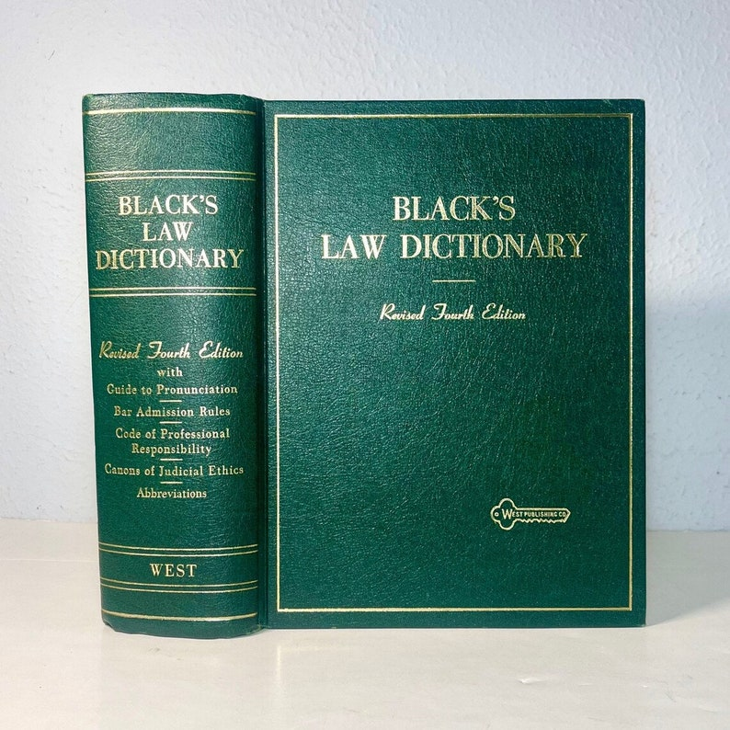
WHO IS A LEGAL PERSON?
Black’s Law Dictionary
…a person is any being whom the law regards as capable of rights and duties…

Slide 11
Natural vs legal person
Philosophical moral question -Capabilities and capacities – both cognitive and emotional – that an entity must posses in order to be accorded the status of moral personality.
Natural or human like behaviour
Free will
consciousness
intelligence
Conscience

Slide 12
Discourse on Personhood
Discourse is nothing new
Passive legal persons- fetuses or comatose individuals – cannot bear full responsibilities and duties
Other non human entities – plants, animals eg People ex rel Nonhuman Rights Projects v Lavery – personhood in its full sense must embody both rights and duties
Inanimate objects such as the Whanganui River in New Zealand and several rivers in India
3

Slide 13
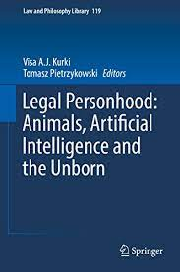
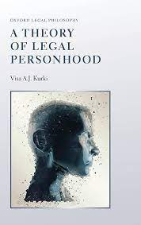
AI PERSONHOOD
All of this raises the question: what does it mean to be a legal person, or to be ‘recognized or treated’ as such? The cases above are not merely instance of employing similar terms and phrases – such as ‘person’, ‘legal person’, and ‘legal personhood’- in saliently dissimilar circumstances. Rather, all of them actually make reference to a conceptual scheme extant in Western legal systems: the person/thing distinction, or as I will call it, person/nonperson distinction.

Slide 14
Kurki
Bundle theory of legal personhood
1. the legal personhood of X is a cluster property and consists of incidents which are separate but interconnected.
2. These incidents involve primarily the endowment of X with particular types of claim-rights, responsibilities, and/ or competences.
Main tenets are two fold:
3

Slide 15
Issues for discussion
AI as tools
Ai as agents
Ai as independent actor
Rights and accountability goes back to the user using the AI
Human as the principal will bear rights and responsibilities
Concept of wakalah
Can it liable like a human actor?
Implications? AI to be developed following certain ethical precepts

Slide 16
Ontological status of ‘human’
حيوان ناطق
Organized being infused with a vital spirit
The living being that speaks
Nafs – articulate soul
Aql – act of grasping, withholding, binding – the reasoning power of mind
Ruh – the spirit of man that carries the Amanah
Al qalb – the heart (spiritual perception)
ISLAM: THE COVENANTS FULFILLED
SYED MUHAMMAD NAQUIB AL ATTAS (2023)

Slide 17
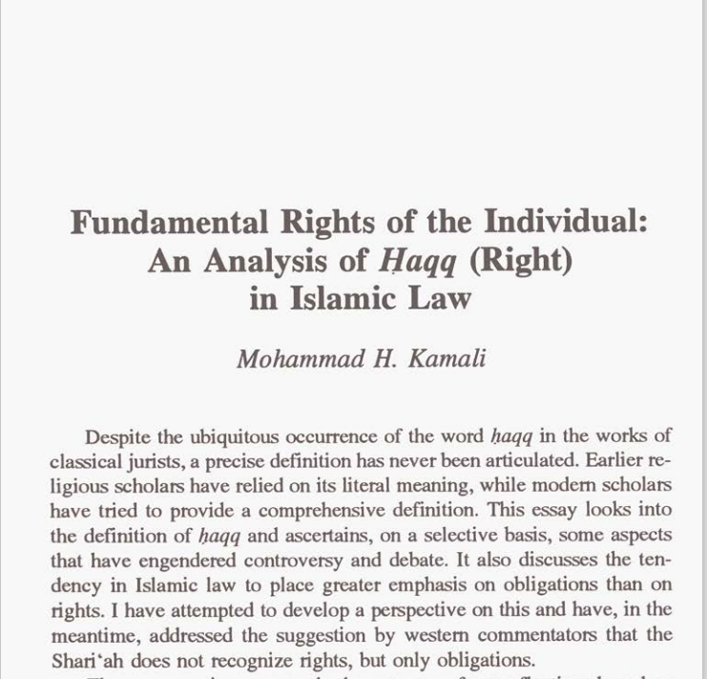
Personhood and legal rights
Legitimate rights must derive from the Quran and Sunnah
Al Zarqa, stresses that the term legal right or ‘haqq’ refers only to express power or obligation recognised by the Shariah
Al Qarafi, reiterates the importance of explicit textual authority from the Creator lawgiver (alkhatib) either in the form of mandate or proscription.
Recipients of such legal rights?
Abdul Salam Daud Al Ibadi stresses that both the right holder (sahib al-haqq) and the party to whom the haqq is addressed or the ‘mukallaf’ must be natural humans
Can rights and duties be detached from each other?
Prof Hashim Kamali disagreed vehemently. His view is that a legal right cannot be detached from corresponding duty; it is like two sides of a coin
rights supersedes duty and is emphasized more in legal obligations. always seen as subservient to duty
textual evidence means that in the ‘original absence of liability’ (bara’ah al-dhimmah al-asliyyah) no legal rights can accrue
8

Slide 18
Artificial entity – al shakhsiyah al’itibariyah an analogy to corporations
Non person entity
Notion of Al AHLIYYAH
Theory of aldhimmah
I’tibariyyah – presumably in existence, not in pact proven in reality.
Al-Khawli – need in human society for collectives of individuals to form certain groups of individuals, or certain groups of wealth
Introduced as a legal device in achieving uniformity and continuity in legal activity that caters the interest of numerous individuals
rights but not full individuals
Divided into two:
(i) states, organizations and public institutions
(ii) partnerships, associations, universities, companies, waqf entities and private institutions or organizations
Al-ahliyyah al wujub – the capacity for acquisition of rights
Ability to exercise both rights and obligations
Basis is ‘aql’ (intellect) and rush (discretion)
Ah-ahliyyah al-ada’ – the capacity for execution or performance of duties
Ability to exercise such rights and perform duties
Ubaidillah Ibn Mas’ud – ‘a legal attribute bestowed on a natural person to have rights and obligations
Ibnu al-Abidin and alQarafi – legal meaning conferred for a mukallaf capable of bearing rights and duties
Al-Bujairami and Al-I’z ibn al salam – an attribute attached to a human to be able to possess rights and duties
Al-Buhuti – a legal mandate possessed by a human as having capacity to bear rights and obligations

Slide 19
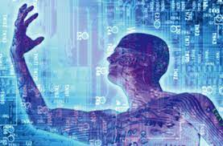
Al-Khayyat quoting Ali al Khafifi
“the concept of al-dhimmah and the rules pertaining to it are merely a matter of reorganizing rules and it is not something that requires ijtihad that is legally subject to changes in line with the demands of muamalat and its development, particularly when the maslahah requires it so. In fact there is nothing in the Quran and the Sunnah that denies this assignment of dhimmah to a non-human and should the assignment of it be interpreted widely to ratify corporations, institutions and public treasuries provided that such assignment should not be extended to something that is only confined to human beings only which are Ibadat and the religious obligations

Slide 20
Corporations as artificial entity
Mustafa Ahmad al-Zarqa
“If these institutions which exist now recognized fictitious personality existed in the early era of development in fiqh, it would be obvious that is would be recognized by the fuqaha at that time through legal justifications which are similar to legal justifications of the institution of daulah, bayt al-mal, al-waqf.’
Nyazee Imran Ahsan Khan, Islamic Law of Business Organization (KL: The Other Press, 2002)
“There has been a prolonged debate about the existence of the concept of a fictitious person (shaksiyah i’itibariyah) in Islamic law. Most modern scholars insist that this concept was known to Islamic law, while some are doubtful whether Islamic law was aware of the concept, but they rejected it for the system they were dealing with. This does not mean that the concept cannot be accepted in Islamic law’’

Slide 21
Nyazee (2006)
Ruler may assign limited dhimmah to a non human with conditions:
No religious duties will be expected of a fictitious person
Some form of ‘aqal’ must be associated with the fictitious person eg board of directors
Dual title of ownership – board of directors as carrying the accountability of the company

Slide 22
Example of al shaksiyyah al ‘I’tibariyyah
Waqf
Waqf – prop purchased belong to waqf entity
Baitul Mal
may borrow and lend to other department
If funds used – would be recorded as debts owed by the Baitul mal
Zakat on Khultah
joint stock company or partnerships between its business partners
Mosque
an entity to own property of their own
Any donation or waqf bequeathed to it will belong to the masjid itself and is not considered as a waqf property
Al-dawlah al-Islamiyyah
Disposition of the head of state reflect the legal personality of a-dawlah.
Inheritance under debt
Any outstanding debts owed by the deceased must be settled prior to its distribution to the legal heirs

Slide 23
Concluding thoughts
Incomplete person and animals
Notion of personhood
Ai personhood
Ahliyyah al ada
E.g. fetuses – given rights but not full individuals
Potential human being
Animals – given souls but no intellect
Defining a person relationship as Allah’s servant
Must live life in compliance with his laws
Not for financial responsibility akin to corporate responsibility
Or determine culpability in criminal trails or abortion cases
Full personhood like individuals? In the sense of attributed sins? Ahliyyah al wujub
Or for financial responsibility
Or agents/ wakil/ qadi
There must be specific guidelines on the development of AI
Sadd al Dharai
Ends must justify the means

Slide 24
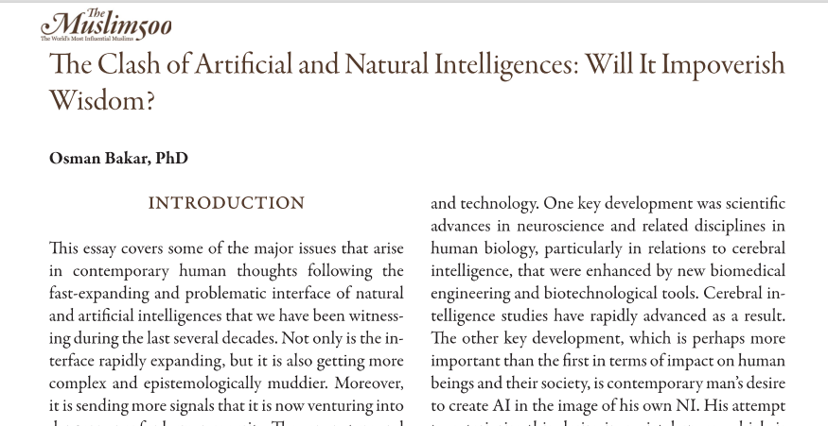
Concluding thoughts
Artificial Intelligence Goes Nowhere Near Natural Intelligence Of A Human Being.
Natural Intelligence Here Refers To That Part Of The Human Comprising All His Cognitive Organs, Physical And Non-physical, Together With Their Respective Functions And Activities In Information Gathering And Organisation For The Purpose Of Knowledge Processing Acquisition And Understanding The Mysteries Of Human Language.
There Are Two Fundamental Differences Between Human Intelligence And Natural Intelligence That Is Self Consciousness And Self Discovery As Important Psychological Features That Are Integral To Human Nature.
From Theological Point Of View, Ai Will Always Be Inferior To Human Ni, Simply Because It Is Man’s Creature.

Slide 25
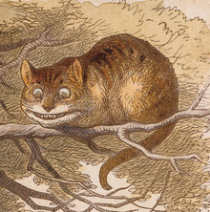
CONCLUDING REMARKS
Notional ‘person’
Endowed with specific set of legal rights and duties
Bearers of legal rights and obligations
No moral or ethical dimension
Only abstract capacity to function in law
Need to address the liability gap
9
Cheshire Cat – non existing entity
There one needs and vanishes when superfluous

Slide 26
Terima kasih
Ida Madieha Abdul Ghani Azmi
imadieha@iium.edu.my

