Slide 1
The ICO’s Role in Realising a Free and Accountable Press Post-Leveson
Professor Paul Wragg
University of Leeds

Slide 2
Overview
Why Regulate?
Recent Events
The Code
Law or Ethics?
Prospects
Independence
The State of Press Regulation
Leveson’s Recommendations
“General Special Public Interest”
Relationship to Editors’ Code
Courage
Deference

Slide 3
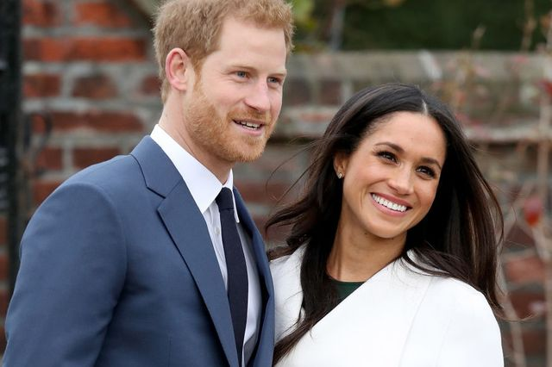
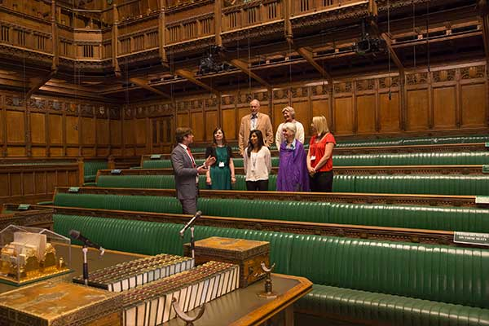
Why Regulate? (Recent Events)
Credit: Town & Country Magazine
https://www.townandcountrymag.com/society/tradition/a20751869/duke-of-sussex-anti-slavery-abolitionist-royal-wedding/
Credit: Barnes Coaches
https://www.barnescoaches.co.uk/itineraries/990-houses-of-parliament-multimedia-tour?tourid=168781&t3p=

Slide 4
Why Regulate?
The state of press regulation
Membership is voluntary (Guardian, Independent, and FT sit outside regime)
Mainstream press aligns with IPSO
New journalism/citizen journalism with Impress
Leveson Inquiry was seventh public inquiry in press malpractice since 1947
Royal Charter created PRP, implemented Leveson’s Recommendations

Slide 5
Why Regulate? (Recent Events)
Credit: Town & Country Magazine
https://www.townandcountrymag.com/society/tradition/a20751869/duke-of-sussex-anti-slavery-abolitionist-royal-wedding/
Credit: Barnes Coaches
https://www.barnescoaches.co.uk/itineraries/990-houses-of-parliament-multimedia-tour?tourid=168781&t3p=

Slide 6
The Code: Law or Ethics?
s125 (1) The Com. must prepare a code of practice which contains—
(a) practical guidance… in accordance with the requirements of the data protection legislation, and
(b) such other guidance as the Com. considers appropriate to promote good practice...
(5) “good practice…” means such … as appears to the Com. to be desirable having regard to—
(a) the interests of data subjects… and
(b) the special importance of the public interest in the freedom of expression and information

Slide 7
Should or Must?
Misleading (albeit strictly true)
Factors illuminating the Misuse of Private Information tort described in terms of ‘should’.
Judicial finding that MPI/DPA overlap: Campbell v MGN Ltd [2004] 2 AC 457 [32]; Murray v Express Newspapers Ltd [2007] EWHC 1908 (Ch), [22]; Richard v BBC [2018] EWHC 1837, [226], ZXC v Bloomberg LP [2019] EWHC 970 (QB), [3]

Slide 8
Journalistic Exemption

Slide 9
Editors’ Code of Practice
The editors’ code does not ‘balance’ privacy v free speech
Public interest speech allows for exemptions from obligations under code
The Code and guidance are silent on this point.

Slide 10
Prospects
Independence
Courage?
Deference?

